Slide 1
Strong Start to Y4

Slide 2
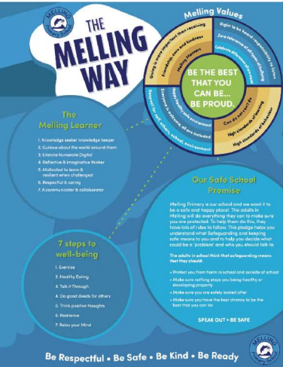
Welcome to Lower Key Stage 2.
Here is all the information you need to know to ensure your child’s start to the new school year is successful.
We are looking forward to welcoming our new class back to a brand-new school year.
Staff:
Mrs Toborne (Monday, Tuesday and Wednesday)
Mrs Grainger (Thursday and Friday)
Miss Riley (every morning)
Start 8:55
Break 10:40
Lunch 12:30
Finish 3:15

Slide 3
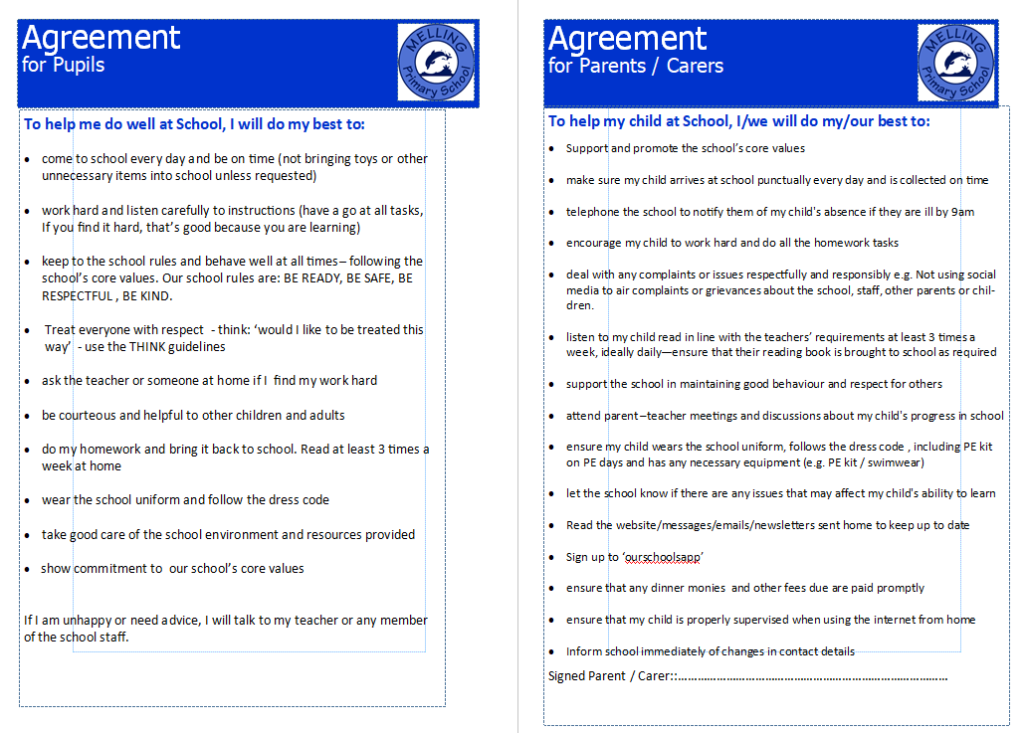
Reminder: Home-School Agreement

Slide 4
Please see the class page for the following documents detailing information on the curriculum:
Y4 CURRICULUM MAP
YEAR 4 KEYWORDS SPELLING LIST
YEAR 4 WRITING STANDARDS
MATHS STANDARDS: End of Year Expectations
RECOMMENDED READS FOR Y4
CALCULATION METHODS FOR Y4
SPELLING LISTS FOR EACH HALF TERM

Slide 5
Trips & residentials in Y4
Autumn Term:
CHET residential
Spring Term:
Liverpool Museum/ Kingsley Bookshop
Summer Term:
To be confirmed

Slide 6

In Key Stage 2, children are expected to read and understand texts at a much higher level than previously; the skill of comprehension is needed across the curriculum to be able to access a wide range of subjects.
All children will have the opportunity to read a variety of texts during lessons.
Individual readers will also be heard and children will have the opportunity to read books of their own choice in class.
If they wish to bring in a book from home to read in class, this is welcomed.
There is an expectation that your child should read at least 3 times a week at home - this will be monitored and rewarded (a prize for every 50 reads and a raffle ticket for a draw at the end of the year).
Please hear your child read, discussing the text and new vocabulary with them; fill in and sign the purple reading record to note their progress and any difficulties they may have.
We recommend a ‘3-read approach’ – 1. decoding 2. fluency 3. understanding
Please ensure reading records are sent into school daily to help us with monitoring.
Children are encouraged to return and change a book on any day. day.
If children fall behind with reading at home, there will be a discussion with parents/carers to help get them back on track.

Slide 7
Spelling Spelling test day - Monday
Each week, children will be taught a spelling pattern and 4 of the Y4 statutory key words.
For homework and in class, they will be given a sheet for written practice of 10 words containing the spelling pattern and 4 key words.
It would be useful if you could help your child with learning spellings at home using whichever method they find most helpful to learn. For example, the ‘Look Say Cover Write Check’ method is just one way to learn to spell.
New spellings will be given out on a Monday for a test on the following Monday.
Please ensure your child is learning and practising their spellings regularly.
Spelling homework sheets should be returned to school on a Monday.
Spelling results will be sent home to keep you informed of your child’s attainment.

Slide 8
Homework
In addition to reading and spelling practice, children are expected to access online tasks to support learning.
Login details are stuck on the front of the reading records. If these are lost, please request a new one.
The following platforms should all be accessed each week:
Mirodo– an English and a Maths task will be set
Times Tables Rock Stars
If homework/home reading is not completed, parents will be notified. Children will be given an opportunity
to complete it in school. If a child does not have a device at home for online homework, they will be given
an opportunity to complete it during school hours.

Slide 9
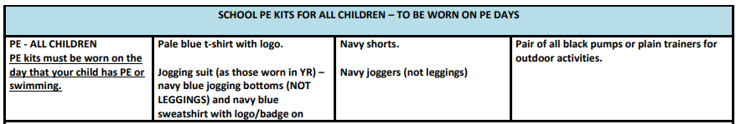
P.E. days - Wednesdayand Thursday
Children should come to school dressed in their P.E. kit on P.E days.
If your child is attending an after school sports club, they are permitted to wear their P.E. kit on that day also.
Alternatively, they can bring a kit to get changed into after school.

Slide 10
Behaviour System
‘BE THE BEST THAT YOU CAN BE…BE PROUD.’
Whole school rewards:
Name in Lights for Melling values: BE READY BE RESPECTFUL BE SAFE BE KIND
Cups – awarded in the weekly Friday assembly at 2:30. You will be invited in if your child wins.
House points – winners announced weekly and a chance to win a prize each half term.
Gold stars – these are collected to earn a badge for your child’s school cap.
Golden text – a very special award from Mrs Ainsworth.
Roar the resilient lion – awarded to the child who shows resilience through the week.
Special rewards in Y4:
Pupil – each week, the children will nominate a pupil as pupil of the week. They will receive a prize, special message and gold star.
Special Message – for achieving something special!

Slide 11
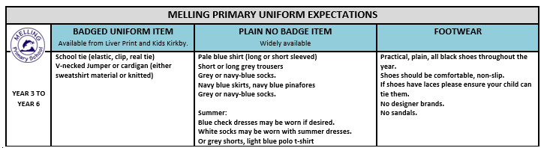
Reminder: Uniform

Slide 12
Reminder: Health and Safety
Children are encouraged to bring a bottle of still water to school to keep them hydrated throughout the day. Children must take their bottles home each day so that they can be washed, refilled and remain clean and fresh.
Snacks for playtime should be healthy choices. Sweets and chewing gum are not permitted.
Children are encouraged to continue to practise good toilet and hand hygiene. Please reinforce the importance of this with your child.
Bags must be the school satchel as other bags are a tripping hazard;
cloakrooms and corridors lead to fire exits; there is no space to accommodate
large items in these spaces.

Slide 13
Reminder: Health and Safety
Children are not permitted to:
wear jewellery other than small stud earrings
wear nail varnish, false nails, tattoos or make up
wear smartwatches, or watches with games on
bring toys or other personal belongings, including pencil cases – everything the children need will be provided
Hair – shoulder length (boys and girls) must be tied back
Please make sure that your child’s clothing, lunch box and water bottle are clearly labelled with their name.
This facilitates returning lost items.

Slide 14
Phones – Social Media – Internet
We ask parents/carers to think very carefully before allowing your child to have a mobile phone. Social media (eg WhatsApp; Snapchat; Instagram; TikTok) can cause numerous issues between children and can affect friendships in school. Platforms such as these can have unsuitable content on and can lead to children accessing inappropriate posts.
We would advise all parents/carers to familiarise themselves with the guidance on use of Parental Controls. (https://primarysite-prod-sorted.s3.amazonaws.com/melling-primary-school/UploadedDocument/f279259b-9483-480d-8353-10c25cf44e9a/parental-controls-booklet-2025.pdf )

Slide 15
Reminder: Communication
Absence must be reported to the office on or before the day of absence. Please leave a message on the answering machine. This will be received and noted.
Urgent information, questions or complaints should be communicated to the office.
Share information or news with us at y4.melling@schools.sefton.gov.uk Please remember that this may not be picked up straight away. Replies will only be sent between the hours of 8am and 6pm. You will be contacted by telephone should there be a concern regarding your child.
Check the class webpage, website and app regularly as these are our main sources of communication with you.

Slide 16





Be The Best That You Can Be…Be Proud

