Slide 1
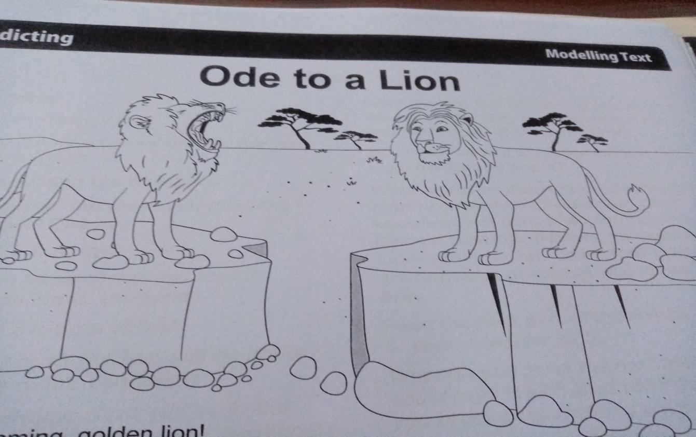
1) Look at the illustrations. Discuss and predict.
2)Look at the title . Discuss and predict.

Slide 2
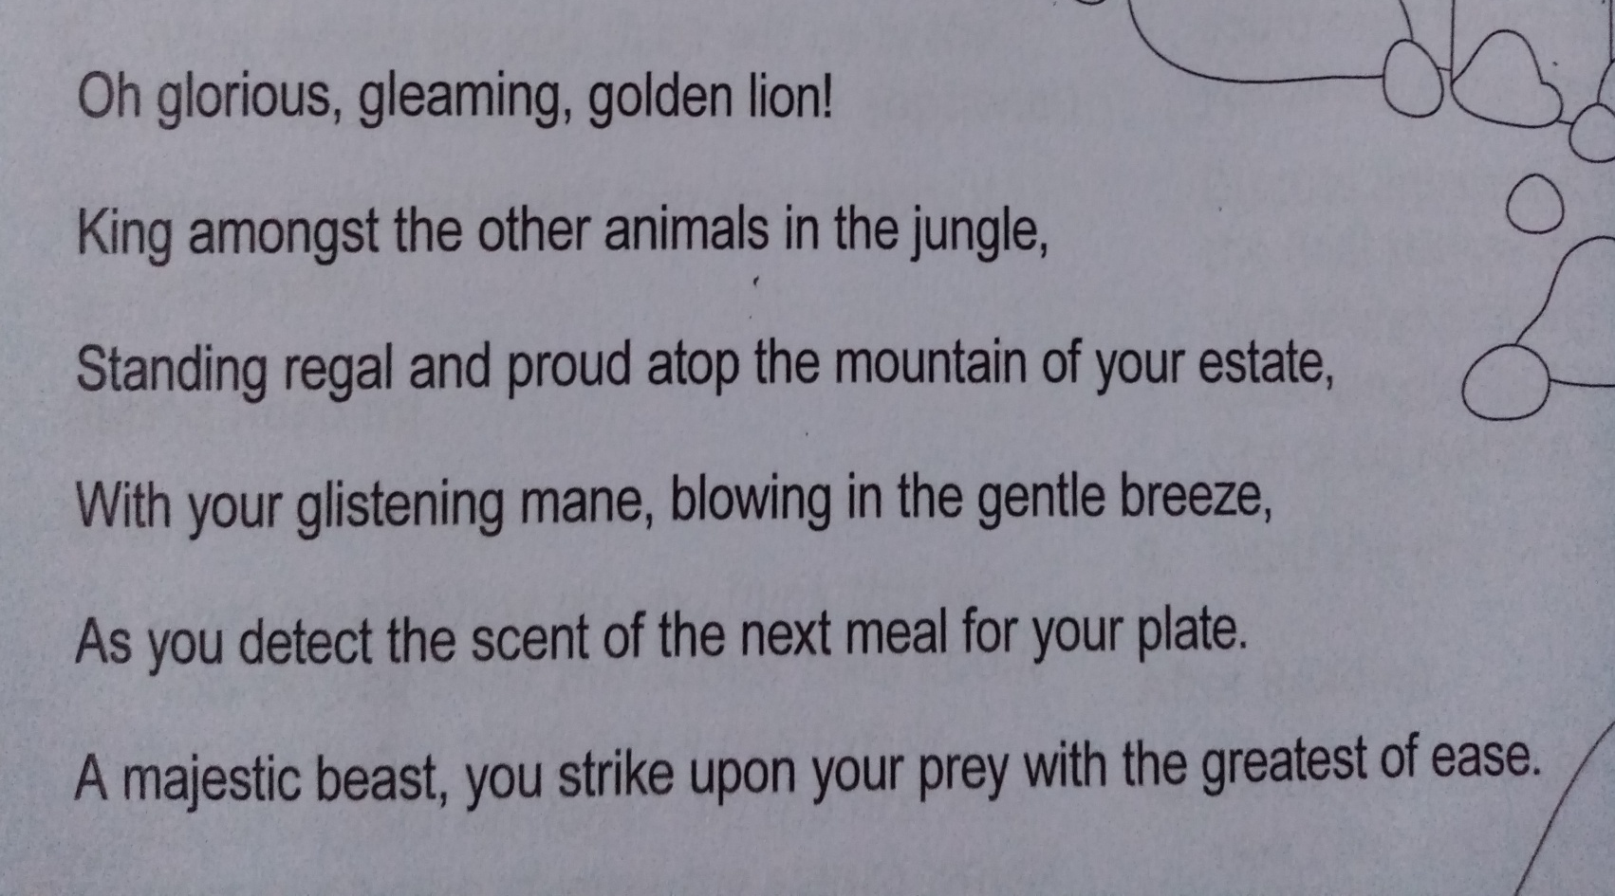
3)Read the first stanza. Discuss text type, audience and purpose.
Rainbow words and phrases.
What do they tell you about lions?
4)Does the first stanza portray a positive or negative impression of lions? Support your answer with evidence from the text.

Slide 3
Ode to a Lion
Mighty Write: Write a to a lion praising its appearance.
Lion – you are the King! What a gleaming coat and glistening mane you have. How easy it is for you to strike upon your unsuspecting prey! Standing regal and proud atop the mountain is a sight to behold. You ARE King of your estate.

Slide 4
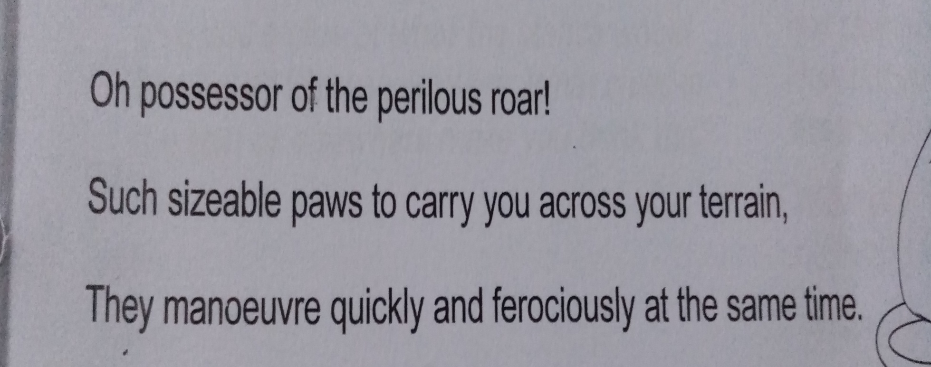
5)Read the first 3 lines of the second stanza. What will the rest be about? What clues tell you this?

Slide 5
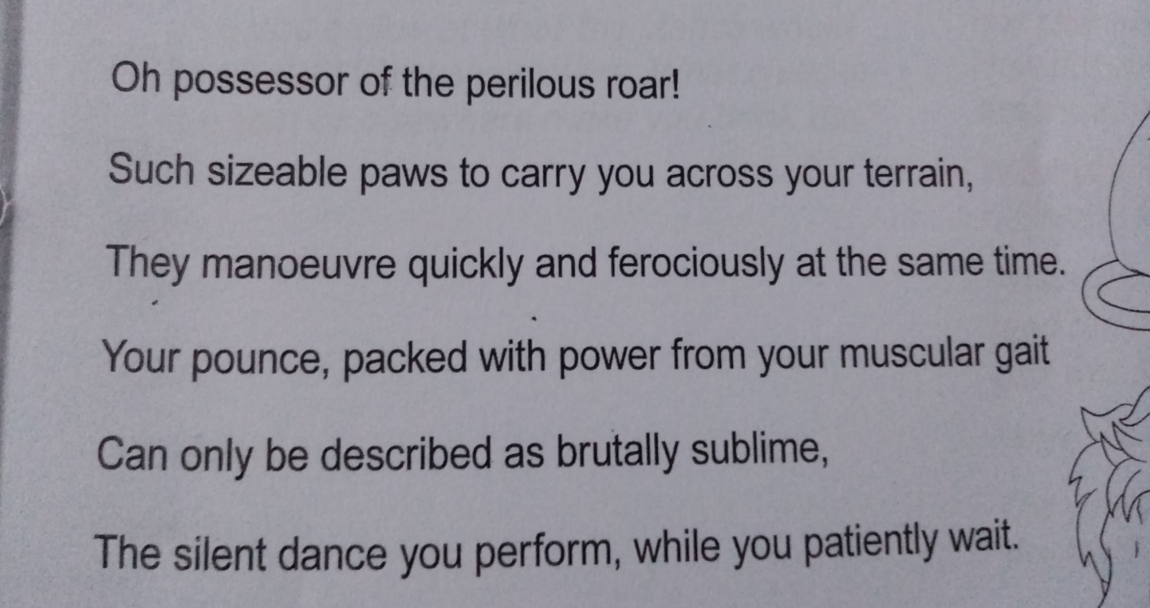
6)Read the rest of the second stanza. What will the rest be about? What clues tell you this
Rainbow words and phrases.
What do they tell you about lions?
7)Does the second stanza portray a positive or negative impression of lions? Support your answer with evidence from the text.

Slide 6
Ode to a Lion
Mighty Write: Write a to a lion praising its actions.
Lion – you are the possessor of the perilous roar! What sizeable paws you have to carry you across your terrain. How quickly yet ferociously you pounce. Your powerful muscles are sublime. Whilst patiently waiting, you perform your silent dance.

Slide 7
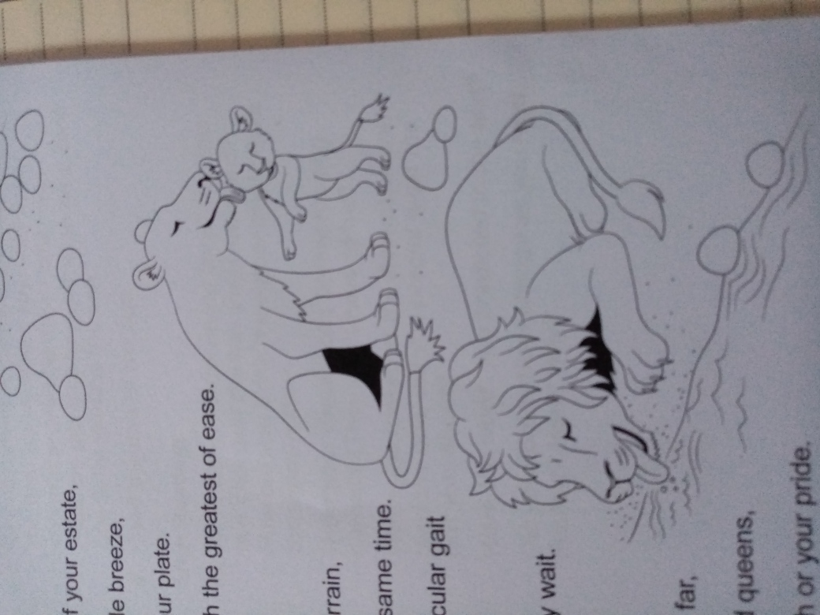
8) Predict what the last stanza will be about from the illustration.

Slide 8
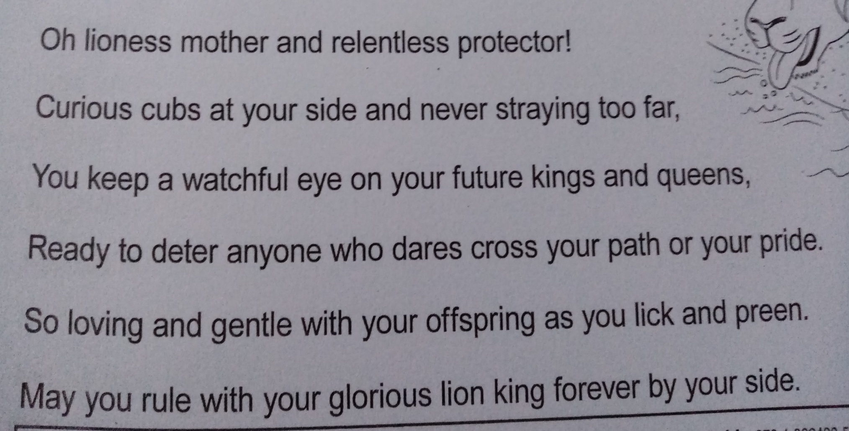
9) What is the main idea of the last stanza?
10) Does it portray a positive or negative impression of the lioness? Support your answer with evidence from the text.
11) Put words and phrases into the word class chart. What more do they tell you?

Slide 9
Ode to a Lion
Mighty Write: Pretend you are a lion . Write a personal statement about yourself – show off!
Sentence starters:
I am .....
Standing on top .....
My .........
Unsuspecting prey have.......
I am......

Slide 10
Ode to a Lion
Sat style questions: Worksheet

