Slide 1

English Read to Write Journey
Y3

Slide 2


Slide 3
English Text: A Bear Called Paddington
Lesson 1: WOW: Show a prop from the story, e.g. Paddington’s suitcase filled with jars of marmalade. Discuss and make connections. Read pages 7 – 11. Watch film clip film clip https://www.youtube.com/watch?v=sCgnuhb45ik (Youtube: PADDINGTON – Paddington Meets the Brown Family – Film Clip). Collect examples of similarities and differences. Begin role on the wall character analysis of Paddington and Mr and Mrs Brown. Display on working wall. Begin story map. Display on working wall. Grammar: Identify nouns in the text. Create complex sentences using the conjunction – when both within and at the start of the sentence/ comma to separate clauses Oracy: Discuss characters of Paddington, Mr and Mrs Brown. Chn to base their points on evidence from the text. Mighty Write: Model write sentences using the conjunction when in the middle of the sentence. EG: Mr s Brown clutched at her husband when she saw the bear. Chn write their own. Repeat task using when at the start of the sentence using a comma to separate main and subordinate clause. EG: When she saw the bear, Mrs Brown clutched at her husband. Vocabulary: railway platform unusual crowded loudspeaker blaring porter amazement adjusted distinctly laden triumphantly clutched brim revealing stowaway anxiously emigrated glimpse Begin display of said words: insisted announced replied exclaimed inquiringly asked | Lesson 2: Intro: Read pages 12– 20. Watch film clip https://www.youtube.com/watch?v=VBku6tXLDo4 (Youtube: PADDINGTON – Tearoom – Film Clip)Collect examples of similarities and differences. Model use of tentative language, e.g. Perhaps …; At first I thought…; Maybe …; particularly when exploring early parts of the story, where much is yet to be revealed. Chn to use this language to make inferences – continue role on the wall and the story map. Grammar: Identify nouns in the text – introduce terms common proper. Revise when. Introduce the conjunction before. Oracy: Using tentative language to support opinions. Mighty Write: Model write sentences using the conjunction before in the middle of the sentence. EG: You need to know our names before you come home . Chn write their own. Repeat task using before at the start of the sentence using a comma to separate main and subordinate clause. EG: Before you come home, you need to know our names. Vocabulary: highly irregular hastily doubtfully expression inspiration wail distinguished hesitated lamely aware promptly | Lesson 3: Intro: Read .21 – 24 - hot seat activity. Read pages 25 – 43. Watch film clip https://www.youtube.com/watch?v=xTye8Mj5hpU (Youtube: Paddington Movie Clip (2014) -Sally Hawkins, Hugh Bonneville Movie HD).(bathroom scene) Collect examples of similarities and differences. Continue role on the wall- begin Mrs Bird . Continue story map. Grammar: Identify the noun phrase in a sentence. Revise when, before. Introduce after. Model write sentences using the conjunction after in the middle of the sentence. EG:. Chn write their own. Repeat task using after at the start of the sentence using a comma to separate main and subordinate clause. EG:. Oracy: Hot seat: How does Paddington feel after the events in chapter 1? Mighty Write: Model/ share write a letter from the children to Aunt Lucy. Include the use of conjunctions when, before, after. Vocabulary: expect pleasantly greeted replying mysteriously whispered retreating grocer flight tread remarked fumbled retired indignantly cried pleaded impression blissfully fate baling ominous crestfallen
Lesson 4: Intro: Introduce a competitive dynamic by providing a single page of text and asking them to scan for information . After reading Chapter 3, Paddington Goes Underground, return to these pages to scan and find information: Who brought Paddington his breakfast? (p45) What did the notice say in the underground station? (p52) How much was the fine for not using the escalators properly? (p55). Start with names, dates, numbers, italicised or emboldened text – facts that are easy to find and ‘jump out’ from the piece, before moving on to information that perhaps is harder to locate. E.g. What excuses does Mrs Brown give the ticket inspector for Paddington’s behaviour? (p59).Continue role on wall and story map. Grammar: Identify the noun phrase in a sentence – identify tense. Revise when, before, after. Introduce while. Use the comma to separate clauses. Oracy: Chn to step through the ‘magic mirror’ at key moments and interview them in role. literal retrieval moving on to inference. E.g. Who are you? What’s just happened? (literal-recounting of information. How are you feeling about this? What made you do this? What would you like to happen next? (inference – character thoughts, feelings and motivation). Mighty Write: Model/ share write a letter from the Paddington to Aunt Lucy describing the day he has had. Include the use of conjunctions when, before, after, while. Vocabulary: advantage cautiously privileged perched muffled thoughtful innocent trailing bounding sternly vaguely flustered gratefully depths descended shifted uneasily ignorance ominously reassuringly abide | Lesson 5: Intro: Read chapter 4. draw up a toolkit of what is included within a Paddington adventure story. E.g. Paddington encounters a problem or tries something new; he tries to solve the problem or try something out, but in doing so, the problem/situation invariably gets worse before it is resolved; members of the Brown family are involved – though sometimes Paddington has been left on his own; there is always humour; the reader is likely to feel sorry for Paddington with his misdemeanours etc. Continue role on the wall. Grammar: Identify the verb in a sentence – identify tense. Revise when, before, after, while. Introduce until. Use the comma to separate clauses. Oracy: Discuss timeline of events with their group. Mighty Write: Working in a small group , chunk events from chapter 4 and put into a timeline. Model/ share write a letter from the Paddington to Aunt Lucy describing the day he has had. Include the use of conjunctions when, before, after, while. Vocabulary: department distastefully shuddered averting offending rummage wretched persistent constant possessed unpredictable assistant mournful sheepishly observant rickety | Lesson 6: Intro: Rewatch film clip https://www.youtube.com/watch?v=xTye8Mj5hpU (Youtube: Paddington Movie Clip (2014) -Sally Hawkins, Hugh Bonneville Movie HD).(bathroom scene) Give chn sentence strips of the events in the chapter. Chn order them into chronological order. Grammar: Identify the verb in a sentence – identify tense. Revise all conjunctions from the week. NNG: To use a wide range of conjunctions Activity 1b.10: Patterning sentences. Address any misunderstandings. Create an intervention group for those who are still struggling or continue as a class. Oracy: Order strips and use to describe their day to Aunt Lucy (their partner) in the role of Paddington. Ask 2 chn to present to the class ( using dressing up props) Extended Write: Using ordered sentence strips Independently write a letter to Aunt Lucy describe your day in the role of Paddington. After marking identify class weaknesses and address in following sessions. Plan intervention groups accordingly. Vocabulary: Revise all

Slide 4
English Text: A Bear Called Paddington
Lesson 7: Intro : Watch a classic Paddington Bear clip. Compare with the movie. Discuss similarities/ differences. Discuss preferences. Grammar: Inverted commas to punctuate direct speech (speech marks). Give chn a page from the text. Chn highlight the direct speech and rest of sentence in different colours. Circle punctuation. Chn punctuate given sentences from the text with direct speech (punctuation omitted) Oracy: Choose chn to rehearse and present a page from the story. Act out in the character roles and also as the narrator. Mighty Write: Model/ share write dialogue between 2 characters (freeze frame an image from the movie as a guide) Vocabulary: Synonyms for said | Lesson 8: Intro: Give chn the titles of the other chapters. Have a vote which one they would like to hear. Predict what will happen. Work in groups to make a timeline of their predicted events. Read the chapter. Chn compare with their predictions. Grammar: Inverted commas to punctuate direct speech (speech marks). Give chn a page from the text. Chn highlight the direct speech and rest of sentence in different colours. Circle punctuation. Chn punctuate given sentences from the text with direct speech. Oracy: Discuss, suggest ideas and predictions in group. Mighty Write: Model/ share write dialogue between 3 characters from the chapter. Vocabulary: Synonyms for said | Lesson 9: Intro: Explore with the children a number of choices from which they can select ideas for their own story. Where might their scene of chaos take place? What task could Paddington start out doing? Which unfamiliar objects might Paddington find in the chosen setting and might he misuse? How might things go wrong? Which character is going to uncover the scene of chaos? Vote for and note down final decision. Grammar: Warm up – Quiz of grammar taught throughout unit: nouns, verbs, conjunctions, direct speech. Oracy: Discuss/ share ideas for a class adventure. Justify their vote. Extended Write: Model write a plan. Share write the beginning of their story. Include / refer to grammar terms that have been taught throughout unit. Chn write their own beginning. Vocabulary: Adjectives to describe nouns in their plan
Lesson 10: Intro: Read high quality writing from previous day. Use to reinforce grammar terms. Chn offer some sentences containing pink highlighter and demonstrate how to improve them. Grammar: Work on any class issues which were evident after marking. Oracy: Justify their opinions when discussing pieces of writing. Extended Write: Share write the build up of their story. Include / refer to grammar terms that have been taught throughout unit. Chn write their own build up. Vocabulary: Select ambitious words chn have used in their writing | Lesson 11: Intro: Read high quality writing from previous day. Use to reinforce grammar terms. Chn offer some sentences containing pink highlighter and demonstrate how to improve them. Grammar: Work on any class issues which were evident after marking. Oracy: Justify their opinions when discussing pieces of writing. Extended Write: Share write the problem of their story. Include / refer to grammar terms that have been taught throughout unit. Chn write their own build up. Vocabulary: Revise all | Lesson 12: Intro: Read high quality writing from previous day. Use to reinforce grammar terms. Chn offer some sentences containing pink highlighter and demonstrate how to improve them. Grammar: Work on any class issues which were evident after marking. Oracy: Justify their opinions when discussing pieces of writing. Extended Write: Share write the resolution and ending of their story. Include / refer to grammar terms that have been taught throughout unit. Chn write their own build up. Vocabulary: Revise all Assessment Piece: Chn independently plan and write their own adventure story for Paddington. Assessment Toolkit:

Slide 5
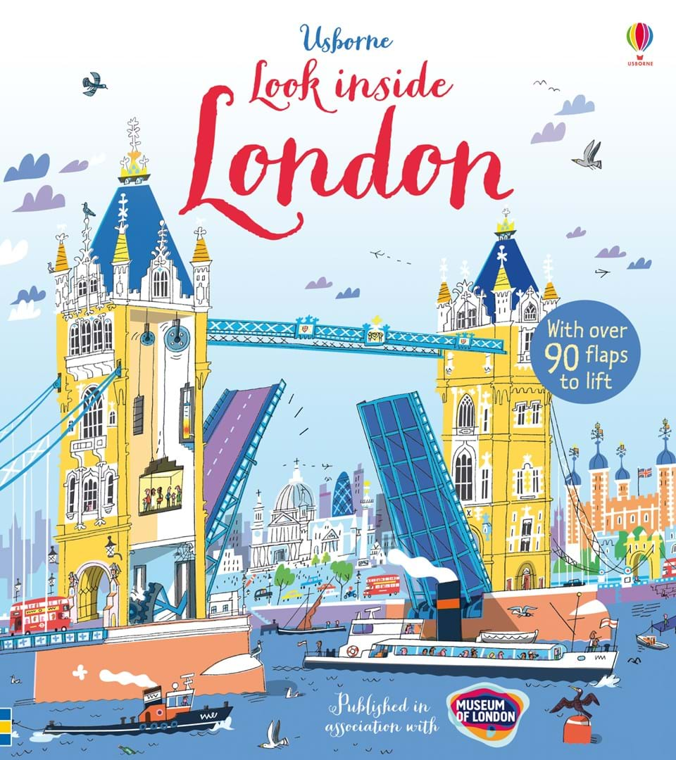
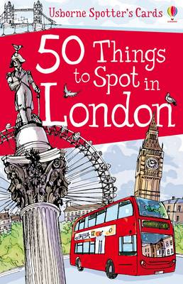

Slide 6
English Text: The Big Picture Book Of London
Lesson 1: WOW: Explore the meaning of the word ‘landmark.’ Show a collection of pictures/slides of London (or local) landmarks. View Transport, travel and landmarks of London – William Whiskerson https://www.youtube.com/watch?v=MuDAUa0XSHI Can children identify each landmark? Which do they recognise? Have they visited any? What do they know about each? Begin to jot key facts on sticky notes or fact cards. Invite children to bring in own photographs, postcards or holiday memorabilia linked to these landmarks. locate the landmarks on a class map displayed on the working wall. Which of these landmarks have been visited by Paddington? Add pictures of Paddington and children’s own postcards and photographs to the display. Grammar: Revise using sentences with different forms: statement, question, exclamation - Provide a mixture about London landmarks. (e.g. When was the Shard built? Who lives at Buckingham Palace? St Paul’s Cathedral was re-built after the Great Fire of London. Big Ben was completed in 1859. What an amazing dome sits at the top of St Paul’s Cathedral!)) Sort into each category, Provide examples without punctuation for chn to punctuate correctly. Oracy: Discuss own experiences of London. Discuss own knowledge of London and what they would like to find out. Mighty Write: Share write then chn write sentences with different forms: statement, question, exclamation about London. Vocabulary: landmark famous palace museum cathedral parliament underground stadium bridge theatre explore sightseeing prison | Lesson 2: Intro: Enlarge one of the cards from Usborne 50 Things to Spot in London. Discuss how the information is presented on the card. Read together. Discuss new vocabulary. Turn the card over to hide the information. Ask the children to turn and tell their partner something new they have just found out about the focus landmark. Look back at the card to check. Share some of the facts discussed. Grammar: explore and identify main and subordinate clauses in complex sentences. In doing so, use the opportunity to make links with the earlier grammar focus during the fiction unit on conjunctions to show time. Provide a mixture of main and subordinate clauses about a chosen landmark. (e.g. When it was built (subordinate) / St Paul’s Cathedral was the tallest building in London (main). After being destroyed by the Great Fire of London (subordinate) / St Paul’s Cathedral was redesigned by Sir Christopher Wren (main). Until the Star of Nanchang was built in China (subordinate) / the London Eye was the tallest giant wheel in the world (main). While the wheel is still turning (subordinate) / passengers can embark and disembark the London Eye (main). Can children sort the clauses into main or subordinate? Can they combine some of the main and subordinate clauses provided to make complex sentences? Can they use the construct a setting description orally. Oracy: Share facts about London with their partner Mighty Write: Chn write sentences with a time conjunction at the beginning. Vocabulary: Adjectives for size: tallest highest biggest huge towering deepest lowest largest | Lesson 3: Intro: Provide a collection of cards in the middle of the table. On a shared signal, ask each pair to take a card. Provide a designated time to share and read the information card. When a timer or buzzer sounds, turn cards over and encourage children to each tell their partner a new fact they have learnt from the card. Chn write their new fact on a sticky note. Replace the cards into the collection in the middle of the table and repeat. Extend by playing ‘find a friend’ encouraging children to move around the room and share/swap new found facts with each other. Have any children found and recorded the same facts? Are any facts particularly surprising or fascinating? Grammar: Using the sentences from the previous day investigate whether the time conjunction can be moved to the middle of the sentence. Does it still make sense? Which one is better/ Why? Divide a section of the working wall into sections with different landmark headings. Add sticky notes to the wall. Oracy: Share facts about London with other class members. Mighty Write: Working with a partner look at their own sentences from the previous day. Move the time conjunction to the middle and decide if it makes sense. Write up the sentences that do. Vocabulary: fascinating exciting spectacular amazing fantastic luxurious priceless gigantic beautiful
Lesson 4: Intro: Model how to use a non-fiction book, using the contents and/or index pages to try and find relevant information. Use film clips such as Big Ben for Kids: Famous World Landmarks for Children – Free School https://www.youtube.com/watch?v=fKmpld1PoPQ to watch and gather further information about specific landmarks. Encourage ‘focused listening’, whereby children are presented with a key question(s) for which they have to listen out for the answer. In groups, children could then complete focus boxes on the landmark addressing key information. Grammar: NNG: Understand how to punctuate complex sentences Activity 1b.9: Fill in the punctuation. Oracy: Suggest / orally rehearse sentences with their group members. Mighty Write: Model write then chn write in groups a paragraph about their landmark using their focus box as a plan. Vocabulary: Nouns: contents index chapter paragraph title subtitle fiction non fiction keyword glossary diagram | Lesson 5: Intro: Give a riddle, e.g. I am a London landmark. I am very tall. I can be seen from 40 miles away. I was designed by an Italian architect. I was completed in 2012. I have 11,000 glass panels. (The Shard). Chn guess the landmark. Grammar: To use the determiner a or an according to whether the next word begins with a consonant or vowel. Ensure to make explicit how the determiners a and an are used in their riddles. Oracy: In groups make up their own riddle using the information from the previous day. Present to the class who try to guess the landmark. Mighty Write: To write up their riddle in pairs. Vocabulary: Verbs: visitors tourists guards politicians musicians business prisoners knights royal family guests performers | Lesson 6: Intro: Chn to select a statement and using an appropriate book/leaflet/fact card, navigate the information to find out whether in fact the statement is true or false. Model scanning text, starting with information that is easily located, e.g. numbers, dates, capitalised names etc. True and false statements collated in true/false boxes. Share with the class. Grammar: Revise all sentence types Oracy: Play ‘Tour Guide’, taking ‘tourists’ around the classroom as if about to tour around London or their local area, or look specifically at a chosen landmark. Guides must provide the tourists with a general introduction to the landmark, before moving around, pointing out key facts or details of interest. Mighty Write: Give chn a photocopy of a page from with the information taken out. Chn to annotate the picture with factual information in a variety of sentence types. Vocabulary: Present tense verbs: serves displays performs train sail visit built arrive houses celebrates attend

Slide 7
English Text: The Big Picture Book Of London
Lesson 7: Intro: Share the text on the Paddington trail https://www.visitlondon.com/things-to-do/family- activities/paddington- bear-itinerary (Visit London: Paddington Bear Day Out for Families) Look carefully at how the guide introduces each new section of the tour starting sentences usually with verbs (e.g. Follow …; Take a stroll along …; Enjoy …; Visit …; Walk towards …; Take a stop by …; Hop on the tube to …’ ), before then providing information about each landmark. Collect examples and record on the working wall. Grammar: Adverbials showing preposition EG; along he Thames, walk towards, cross over , stop in front of etc.. Command sentences Starting with an imperative verb. Oracy: Read their command sentences to a partner who finds the relevant place on a map. Mighty Write: Model write then chn write their own command sentences starting with an imperative verb. Vocabulary: Past tense verbs: designed held completed built locked powered tortured | Lesson 8: Intro: Outline the task - to write a newcomer’s guide or leaflet on London. Using the ‘boxed up’ template chn ‘plot’ their paragraphs on the page/leaflet and determine what they need to find out. E.g. If their page is to focus on just one landmark, boxes/paragraphs could be split into; when the landmark was built and what it is famous for; where it can be found; interesting facts etc. Alternatively, if their page is to focus on local/London landmarks in general, each box/paragraph could be assigned to a different landmark. Chn navigate a range of non-fiction sources to find key pieces of necessary information and organise under different boxed-up headings and sequenced appropriately. Grammar: Revise all grammar objectives from this unit during the shared writing process. Oracy: Model orally (and in writing) how to rehearse expanding notes into full sentences and sequencing the sentences coherently, e.g. to avoid repetition of the noun. Chn repeat rehearsed teacher sentence. Extended Write: Using shared writing techniques model write a section at a time. During shared writing, also draw on previously taught skills and continue to model orally rehearsing each sentence prior to writing. Model explicitly how to move from the notes collected in a ‘box’ on the planning frame to clear sentences in a paragraph. Model rereading the paragraph aloud from the beginning each time a new sentence is added, in order to proof-read and check for cohesion. Children follow the modelling each day from the whole class focus and use their own ‘boxed-up’ plan to inform writing. Use AfL, marking and feedback to adjust shared writing focus daily. Build in regular editing opportunities, following modelling, allowing children to focus on key skills one at a time, e.g. punctuation, spelling, vocabulary etc. Following this modelling, allow children the opportunity to evaluate their writing with adults and with peers. Guided writing would be the ideal time for this to take place. Vocabulary: Revise all | Lesson 9: Intro: Share their writing about London with the class/ partners. Celebrate achievements. Model how to use their original plan about London to plan and write a tour guide for Melling Primary. Grammar: From marking, identify and address any issues/ misunderstandings. Oracy: Present their writing to others/ Discuss strengths and justify their opinions. Extended Write: Assessment Piece: Apply this text-type across the curriculum later in the year. E.g. a guide or leaflet about your own school for new parents and pupils. Chn to plan and write independently. Assessment Toolkit: Vocabulary: Revise all

Slide 8
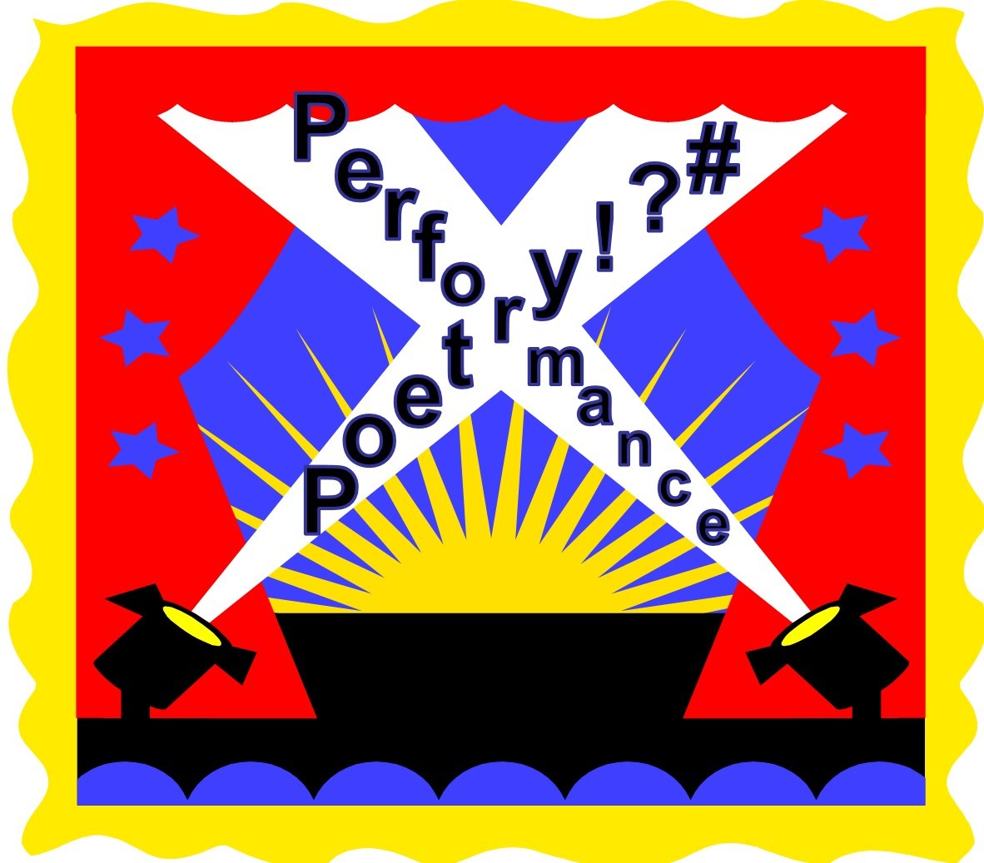

Slide 9
English Text: School Poems
Lesson 1: WOW: Read and discuss At the End of School Assemblyby Simon Pitt (see resources) and read it with expression and intonation to the class. Emphasise the poem structure: 4 lines in each stanza with each line beginning with a teacher’s name. Re-read parts, this time with no expression or intonation and ask children to comment on your performance. Explain that to give the best performance you need to really think about the meaning of the words and express this in your voice. Display on working wall. Grammar: Use PowerPoint: Verbs (Slides 1-6) to revise verbs, simple past and present forms and to introduce the idea that some verbs are more powerful than others. Discuss the pattern of the poem and challenge children to spot the noun and corresponding verb pairs in the poem Oracy: Children learn by heart as many stanzas of the poem as they can. Perform with actions, expression etc ... Mighty Write: Children generate a list of powerful verbs. They then select one for each class and use it in the simple past tense to compose a new poetry line. Vocabulary: galloped herded buzzed beetled thundered whirled made tracks sailed off skates on wheeled trickled | Lesson 2: Intro: Model thinking of a matching powerful verb: Miss Butterfly’s class fluttered out, Mr Thunder’s class rumbled above. Brainstorm example teacher ‘nouns’ and list on flip chart. Grammar: Revise powerful verbs and changing verbs from present to past tense using PowerPoint: Verbs(slides 1-6) and then discuss slide 7. Oracy: Children perform their poem to a partner. What powerful verbs have children used? Have children written some funny lines? Ask children to share their funniest line with the class. Mighty Write: Children concentrate on precisely chosen verbs (fluttered not flew) to put together four-line stanzas Vocabulary: Revise words from previous day. Add new ideas to working wall. | Lesson 3: Intro: Read and discuss Ghoul School Rulesby Sue Cowling(see resources). Write Rule 6 from Ghoul School Ruleson a flip chart and ask children to find the verb phrase: ‘line up’. Can children pick out the adverb that says HOW the verb happened?Ask children how else they think this rule could be followed. Brainstorm/rewrite the rule with other adverbs instead of ‘quietly’: Line up LOUDLY for the ghost train; Line up SILENTLY…; Line up QUICKLY... Each time, ask for volunteers to show you HOW, using the adverb to tell them how to perform the verb. What about adverbs for time and place? What could we replace ‘quietly’ with? (first, next, there, here, outside, etc.) Grammar: Use PowerPoint: Adverbs(see resources) slides 1 -5 to discuss adverbs and how they modify verbs. Oracy: Repeat performance from yesterday: Oracy assessment opportunity Mighty Write: In pairs, children underline all of the verbs in the rules and then choose adverbs to modify them, or replace adverbs which are already there.Children rewrite the rules neatly for display. Vocabulary: glide flit clanking skeleton permission corridor
Lesson 4: Intro: Remind children about Ghoul School Rules and ask what they think rules would be like in other schools, e.g. A pirate school, a clown school etc. Look at slide 6 and discuss some ideas. What other schools can children think of? List alternative schools on a flip chart and choose one to model writing some rules for. Use adverbs to modify the verbs or whole clause for each rule. Grammar: Revise adverbs using PowerPoint: Adverbs (slides 1-5). Oracy: Chn read out their set of rules; ask the rest of the class to identify the verbs and adverbs. Compile a book or create a display of Alternative School Rules for your classroom. Mighty Write: Chn work in pairs to choose a type of school and write their own set of rules for it. Rules to include an adverb. Vocabulary: Add own adverb ideas to working wall | Lesson 5: Intro: Display and enjoy Where Teachers Keep Their Pets by Paul Cookson(see resources). Can children spot the pattern? Each stanza describes a teacher and their pet. The name of the teacher, the pet type and the place it is kept all rhyme. Grammar: Use PowerPoint: Prepositions to explore prepositions and how they can be used to express time, place and cause. Can children spot the prepositions in this poem? Highlight one or two. Oracy: Share some examples of new lines. Can children identify the preposition? What is it expressing? Time, place or cause? Mighty Write: In pairs, children write on the poem changing the preposition and other words such as nouns adjectives, e.g. Mr Spare’s got grizzly bears hiding underneath his spacious flares. Discuss the change in meaning. Vocabulary: nesting locks beneath various stains stoat spacious | Lesson 6: Intro: Read together the first two stanzas of A Sea Creature Ate our Teacher. Discuss ideas around layout and language using prompt sheet (see resources). Display and discuss the ‘Storyboard’ (see resources). Explain that the boxes can be used to record what happens in each stanza, a bit like the action in a story. Fill in the first box together, include examples of powerful description and action. Grammar: Revise irregular verbs- spoke, forgot (from poem) Teach other types. Oracy: In small groups, with copies of the poem, children discuss and record the plot of the poem on a blank ‘Storyboard’ (see resources). Mighty Write: Plan and write their own stanza in their group Vocabulary: inquisitive tide bulging spoke identify stench rotten mass forgotten hideous snaking vaccumed digest lunge revolting staggering smirked

Slide 10
English Text: School Poems
Lesson 7: WOW: Display and reread A Sea Creature Ate our Teacher by Brian Moses(see resources).Ask children to think, pair, share ideas for another school trip they could go on where the teacher is eaten! It could be a shopping mall, a theme park, a museum etc. As a class, agree on one location for your poem, e.g. supermarket. Ask them to shut their eyes and imagine what the monster looks like. Children then describe their monster to a partner. Collect some words and phrases on a flip chart. Include how it looks, smells, feels, sounds and moves. Use ideas to complete a class version of the ‘Notes on your Monster ’activity sheet (see resources). Grammar: Identify adjectives, verbs, adverbs and prepositions in the poem Oracy: Discuss ideas in their group Mighty Write: Distribute blank copies of ‘Notes on your Monster’(see resources). Children think of and record ideas for powerful verbs, adverbs and adjectives to describe the monster. They make use of a range of prepositions. As a group, children explore the shared description of the monster created during the teaching. They discuss rich language they can use to describe their own monster while the teacher helps to decide which column it goes into. e.g. scuttles quickly rapidly or oozes pink goo green slime Vocabulary: Revise previous day | Lesson 8: Intro: Display A Supermarket Creature Ate our Teacher (see resources). This is an example of the poem adapted for the super market. Read and notice what words have been kept from the original poem and what has been tweaked to change it. Model write a class plan to write the first stanza of a class poem, taking suggestions from the class and trying to follow the poem structure. Point out that we can keep the original rhyming words in our new poem to help us. Grammar: Identify adjectives, verbs, adverbs and prepositions in the poem Oracy: Rehearse and perform their poem in their group Mighty Write: Children use the shared plan to draft new stanzas for their poem. Explain that they need to make sure that each stanza acts like a paragraph, organising the information for each section of the planning sheet. Encourage children to use parts of the original poem by Brian Moses, but to look for opportunities to use their own ideas for powerful verbs and adverbs in order to show how, when and why the monster moved. They should also incorporate their own ideas for adjectives and prepositions. Vocabulary: inquiring aisles jingling that’ll | Lesson 9: Intro: Share good examples of children’s writing with the class. Display a copy of one, under a visualiser or scanned,and explain that the writer has kindly given you permission to use it as an example of how to improve our writing. Read together as a class and ask chn to give reasons why this is a good poem.Then agree that all writing can be improved (including teachers’). Discuss and compile an editing list, e.g. check sense, check rhythm still flows, check rhyme scheme still applies, check for and replace boring vocabulary etc.Model using this list to improve one stanza of the example poem, encouraging chn to help you but encouraging respect for the writer’s feelings!Remind children that they are aiming for humorous poetry, so exaggeration using description will help here. Add check for exaggeration to the editing list. Grammar: Chn identify and discuss effectiveness of adjectives, verbs, adverbs and prepositions in the selected poems Oracy: Justify opinions in editing session. Extended Write: Chn choose their own location and monster. Chn independently plan and write their own poem : A ________ ate my teacher Vocabulary: Choose effective language from chn’s writing

Slide 11
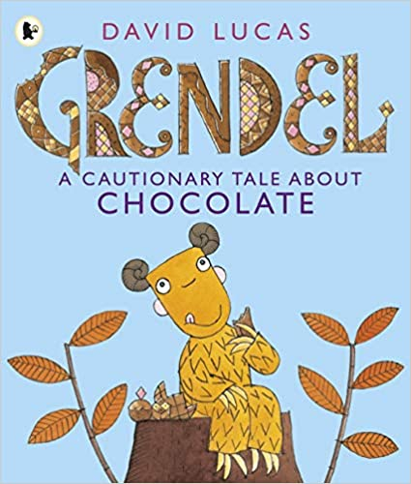

Slide 12
English Text: Grendel A Cautionary Tale About Chocolate
Lesson 1: WOW: Look at the illustration of Grendel sitting on the log on the title page – without revealing the cover or title of the book. Who is this? What are they like? What do you think they are doing? Focus on the gaze of Grendel, what is he looking at? What does that suggest about him? Grammar: Oracy: Mighty Write: Vocabulary: | Lesson 2: Intro: Read story to page 6.Begin story map. Describe characters of Grendel and mum. Grammar: Inverted commas NNG Activity 1c.8 Who said? Oracy: Freeze Frame – give reasons for personality traits of Grendel and mum. Act out page 3. Mighty Write: Rewrite page 3- chn putting inverted commas in correct places and changing said to a better verb. Vocabulary: cautionary tale snatched I’ll delicious note magic | Lesson 3: Intro: Read to page 18. Predict what happens next. Continue story map. Grammar: Inverted commas in different sentence types. NNG Activity 1c.9: Sorting Sentence Types Oracy: Act out story so far. Mighty Write: Rewrite pages 15-18 putting in inverted commas. Vocabulary: sensible slurp until roared
Lesson 4: Intro: Read pages 19,20. Discuss use of elipses. Predict how he will solve the problem. Read rest of story and finish story map. Grammar: Continue Inverted commas in different sentence types. NNG Activity 1c.9: Sorting Sentence Types Oracy: Act out whole story Mighty Write: Rewrite page 22 putting in inverted commas. Vocabulary: claws moral yesterday familiar moral | Lesson 5: Intro: Look at CDLP resources- Watch video clips of author David Lucas. Grammar: Expanded noun phrases. NNG Activity 2.17 :Nonsense phrases Oracy: Hot seating - discussing character of Grendel. Mighty Write: Model write then chn write description of Grendel including expanded noun phrases. Vocabulary: Adjectives Assessment Toolkit: Autumn Term - Description | Lesson 6: Intro: Read Grendel’s diary extract ( teacher’s own writing as a wagoll) Find key features. Grammar: Adverbials NNG Activity 3:12 Adverbial slots. Use wagoll to revise adverbials Oracy: Freeze frame each page. Choosing different chn to act out Grendel and what he would say in a diary. Extended Write: Model write then chn write diary extract of their day by pretending to be Grendel. Vocabulary: Revise all so far. Assessment Toolkit: Autumn Term – Fictional Recount in the Form of a Diary
Lesson 7: Intro: Using NNL text structure sheet choose a different object other than chocolate and create a new adventure. Plan out new story as a story map. Grammar: Adverbials NNG Activity 3:16 Transform it! Oracy: Give ideas for new adventure/ shared plan and write Mighty Write: Class Shared Write of the story Vocabulary: Revise all so far | Lesson 8: Intro: Read class story from day before. Take some sentences and change it into a diary extract form. Grammar: Adverbials NNG Activity 3:16 Transform it! Oracy: Give ideas for changing sentences. Mighty Write: Write new story in the form of a dairy extract by writing from the perspective of the main character. Assessment Toolkit: Autumn Term – Fictional Recount in the Form of a Diary | Lesson 9: Narrative – use NNG text structure. Chn plan and write their own story. Can write up as a diary extract but as a narrative including inverted commas or invent new story – A Cautionary Tale About .......

Slide 13
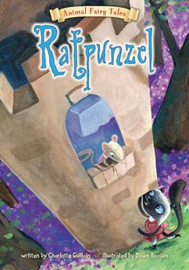

Slide 14
English Text: Ratpunzel
Lesson 1: WOW: Watch cartoon of Rapunzel or clip from Tangled. Read story of Rapunzel – discuss similarities/differences with fairytale.. Make story map. Grammar: Adverbial Phrases- Find adverbial phrases in the story. Sort them into 3 headings- When. How, Where. Teach comma usage if adverbial phrase is at the front of the sentence. Oracy: Use Sentence Starters from NNL to discuss story. Mighty Write: Chn write their own sentences using WHEN adverbials. Vocabulary: fetch forest begged mercy cruel | Lesson 2: Intro: Reread story- chn join in. Grammar: Adverbial phrases – Generate HOW adverbial phrases. Oracy: Chn join in with story Mighty Write: Chn write their own sentences using HOW adverbials. Vocabulary: scurried agreed appeared passed deep | Lesson 3: Intro: Drama Circle- Use cards from NNL and in pairs act out in the circle. Continue in pairs until all cards are completed. Grammar: Adverbial phrases – Generate WHERE adverbial phrases. Oracy: Drama Circle Mighty Write: Chn write their own sentences using WHERE adverbials. Vocabulary: handsome thread weave escape furious
Lesson 4: Intro: Act out page 9. Discuss how they could expand action/ text. Act out page 18. Grammar: Direct Speech Oracy: Acting out scenes Extended Write: Write a direct speech conversation with action / statement sentences Vocabulary: puffed heavier snarled thorn wandered blinded | Lesson 5: Intro: Act out conversations from previous day. Grammar: Conjunctions- use conjunction cards to generate sentences eg: Terrified, the husband agreed ... Identify main and subordinate clauses. Move these around the sentence and discuss effect. Oracy: Act out conversations/ discuss impact of changing clauses. Mighty Write: Write own sentences using different conjunctions. Vocabulary: familiar clearing wept magically | Lesson 6: Intro: Make a list of other traditional tales. Choose one and plan a different version. Grammar: Paragraphs – Plan story in paragraphs. Oracy: Give ideas for the new story Extended Write: Model write beginning. Chn write their own. Vocabulary: Revise all
Lesson 7: Intro: Read successful piece from yesterday. Discuss strengths. Grammar: Address any issues from Address any issues from previous day. Revise adverbials/ inverted commas Oracy: Discuss strengths. Mighty Write: Model write middle. Chn write their own. Vocabulary: Revise all | Lesson 8: Intro: Read successful piece from yesterday. Discuss strengths. Grammar: Address any issues from previous day. Revise adverbials/ inverted commas Oracy: Discuss strengths. Mighty Write: Model write end. Chn write their own. Vocabulary: Revise all. | Lesson 9: Intro: Read successful story. Grammar: Address any issues from story writing. Oracy: Discuss strengths. Extended Write: Chn choose a traditional tale that they know well. Plan and write their own version changing some part of it. Assessment Toolkit : Spring Term - Narrative

Slide 15
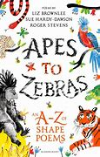

Slide 16
English Text: Shape Poems
Lesson 1: WOW: Display example Calligrams( see resources). What do you notice about these words? Define a calligram as a word or piece of text in which the form of the letters, the font, the size or the shape, represents an aspect of the writing itself. Write growing on the flip chart to demonstrate. Watch Bembo’s Zoohttps://www.youtube.com/watch?v=pmEph902N8wto see animations of different animal calligrams. Discuss how the words are used to create the shape of the animals. Grammar: Revise nouns Oracy: Give valid reasons for their suggestions Mighty Write: Children study the three Bembo’s Zoo examples – these are the octopus, the hippopotamus and the antelope.Tell children which ones they are but do not write these words. For each animal, children write out the word onto the Letter by Letter table. Draw a careful copy of this calligram and discuss their reasons for thinking it is the best. Chn will design their own calligram, by hand or using a programme such as Textease. Vocabulary: | Lesson 2: Intro: Read and discuss two or three poems chosen from Apes to Zebras: an A-Z of shape poems. Define shape poetry as poems in which shape poems. They are a type of calligram. do they make us feel? What language patterns can you notice? Are they helping us to see something in a new way? Are they using a few words to describe something? Look at some more animal shape poems from Apes to Zebras: an A-Z of shape poems or from your own collection. the layout of the words reflects an aspect of the subject (what the poem is about). Explain that they are sometimes called concrete In each case, discuss the way in which the shape of the poem reflects the meaning and also look at the type of descriptive language used and how important this is to the overall poem. Grammar: Identify nouns, adjectives, verbs, conjunctions and similes in Penguin and Seal Oracy: Participate actively in collaborative conversations Mighty Write: They discuss each poem using Talking Point Questions. Write a record of their answers. Write own similes to describe a chosen animal from the book. Vocabulary: waterproof recycle escape trumpet comical shaggy rusty ancient graceful sleek among unfold slumber | Lesson 3: Intro: Share poems from Apes to Zebras: an A-Z of shape poems. Explain task - produce their own simple animal shape poem. strategies to generate good ideas for descriptive language. Choose an animal and model writing the words for poem using these strategies. Then show children how the poem can be moulded into either the shape of the animal or another related or associated shape, using poems from Apes to Zebras: an A-Z of shape poems for examples. Grammar: Identify nouns, adjectives, verbs, conjunctions, onomatopoeia and similes in an animal from the book. Oracy: Compose and rehearse sentences orally Mighty Write: They brainstorm in pairs to think about their animal, creating imaginative descriptions or noting fascinating facts. They record these ideas as they go, whether they are just good descriptive words or whole phrases they could use straight away in their poems. Children then compose their poem and decide how they will lay it out. Vocabulary: choose vocabulary from chosen poems
Lesson 4: Intro: Display and share Rolling Down A Hill by Colin West (see resources).Discuss the form of the poem and identify its features (e.g. repetition, rhyming, rhythm). Grammar: Briefly recap slides 1 to 9 of the Tenses PowerPoint(see resources), then explore slides 10 to 16.Discuss the progressive form of the present and past tense. Children then work with a partner to change the sentences on slide 16 from present to present progressive and past progressive. Oracy: Discuss /record ideas. Compose and rehearse sentences orally Mighty Write: Model write then Children design and produce a shape ‘action’ poem using either past or present progressive form verbs Vocabulary: From PPT: sympathise absolutely adore squawked relieved whining quarrelling achieved punctured swum | Lesson 5: Intro: Display and share I Have Had an Awful Day (see resources). Ask children to identify the perfect form verbs in the first verse and then to find the ‘hidden’ perfect form in the second verse. (It is Now we have come home… ‘we have’ is shortened to we’ve’). Grammar: Briefly recap present and past progressive verb forms. Then share slides 17 to 19 of the Tenses PowerPoint. Discuss perfect form then challenge children to work in pairs to change the sentences on slides 20 to 22 of the PowerPoint. Oracy: Maintain attention and participate actively in collaborative conversations, staying on topic and initiating and responding to comments Mighty Write: In pairs, children take turns to pick a Past and Perfect form sentence. They decide if it is currently written in the past tense or the perfect form. The picker then orally composes a corresponding past or perfect form version. Once each pair has agreed the tense is correct, the picker then fills in their chart by sticking the sentence down in the correct column and filling in the missing column. ( see resources 2) Vocabulary: awful soul sympathy we’ve | Lesson 6: Intro: Explain that children will write a similar poem, involving a different pet of another person who rescues them from their horrible day! Grammar: Look back at the last three slides of the Tenses PowerPoint and revise perfect form. Revisit I Have Had an Awful Day(see resources) and ask children to remind you of the perfect form verbs in this poem. Oracy: Compose and rehearse sentences orally Extended Write: Model write then in pairs children discuss and record four or five possible openers written in the perfect form: I have had an awful day; I have had a dreadful day; I have had a horrendous day etc. They choose their starter and pet,and then plan out their poem. Children compose their poem and write it in neat using a shape element Vocabulary: Revise all

Slide 17


Slide 18
English Text: Gregory Cool
Lesson 1: WOW: Watch Franz Job Tobago video on youtube Grammar: Revise expanded noun phrases. Determiners a/ an. NNG Activity 2.15 a/an Oracy: Discuss question- What is more important – to have lots of things to play with or to have a friend to play with? Mighty Write: Write sentences about Tobago using expanded noun phrases. Vocabulary: Adjectives to describe Tobago | Lesson 2: Intro: Read pages 1-6. Begin a comparison chart between his home and the Carribean. Discuss dialogue of Granny and Grandpa and lack of verbs- we so pleased ( we are so pleased) Grammar: Find different sentence types and discuss impact on reader. NNg Activity 1c.9 Sorting sentence Types Oracy: Act out story so far. Mighty Write: Give picture on page 3. Model write then chn write a few sentences from the viewpoint of Gregory including a ? and ! Vocabulary: stifling disturbed poured expected spluttered | Lesson 3: Intro: Read pages 7- 14. Discuss why the author has chosen Cool for his name. Continue comparison chart. Grammar: Give chn the text without pictures-find all the language that describes the setting. Begin class display. Categorise the words into classes. Oracy: Hot seating- views of Gregory so far. Mighty Write: Look at picture on page 7,8. Model write then chn write a few sentences from the viewpoint of Lennox which include description and a ? and ! Vocabulary: shimmering offered leaping wicked politely crammed sauntered chuckling
Lesson 4: Intro: Read pages 15 – 20. Finish comparison chart. Chn join in and choose actions to accompany the story. Predict ending. Grammar: Look at past perfect tense on pages 17, 18. Find examples of past tense verbs and change them to past perfect form. NNG Activity 4: 14:Changing tenses. Oracy: Role play reading a postcard from Gregory to his mum including simple past and past perfect form Eg: I have really tried but I don’t like it here. The sun has been blazing hot and insects bite me all night. Mighty Write: Model write then chn write the postcard. Vocabulary: stomped blazed An presented machete massive sting -ray | Lesson 5: Intro: Finish story. Discuss how it links back to start and the Title. Discuss use of short sentences and impact on reader. Grammar: Find examples of past tense verbs and change them to past perfect form. NNG Activity 4: 14: Changing tenses. Oracy: Role play reading a postcard from Gregory to his mum including simple past and past perfect form showing his change of heart. Mighty Write: Model write then chn write the postcard. Vocabulary: dusk whirred brayed | Lesson 6: Intro: Plot feelings of Gregory through the story. Grammar: Key Features of a letter Oracy: Conscience Alley- Should Gregory ask his mum to let him come home. Extended Write: Chn pretend to be Granny. Write a letter to mum explaining how Gregory has settled in. Vocabulary: Revise all Assessment Toolkit Summer Term : Letter
Lesson 7: Intro: Discuss generic pattern of story (NNLsheet) Grammar: Key Features of a narrative. Oracy: Discuss ideas for a story which describes Lennox coming to stay in London. Extended Write: Model write beginning. Chn write their own. Vocabulary: Revise all | Lesson 8: Intro: Read successful piece from yesterday. Discuss strengths. Grammar: Address any issues from Address any issues from previous day. Oracy: Discuss strengths. Extended Write: Model write middle. Chn write their own. Vocabulary: Revise all | Lesson 9: Intro: Read successful piece from yesterday. Discuss strengths. Grammar: Address any issues from previous day. Oracy: Discuss strengths. Mighty Write: Model write end. Chn write their own. Vocabulary: Revise all. Assessment Toolkit Summer Term : Narrative

Slide 19
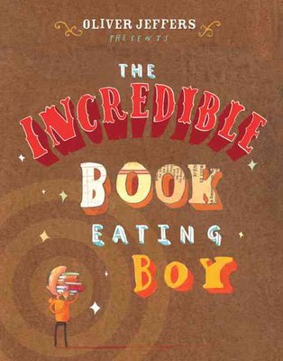

Slide 20
English Text: The Incredible Book Eating Boy
Lesson 1: WOW: Eat the an edible book in front of the chn! ChoconChoc Miniature Chocolate Books – Etsy. Read book to the line “ But then things started going not quite as well” page 17. Chn predict what will happen next. Grammar: NNG: Assess understanding of sentence structure Activity 1b.7: What’s in a sentence? From this assessment plan intervention /future lessons Oracy: Debate: Ask children if they think Henry was wrong or right to eat books? Is it a bad thing to do? Should he have been prevented from doing this? Mighty Write: Model/ share write then chn write their predictions Vocabulary: incredible quite attention single definitely fierce rate smarter smartest fussy | Lesson 2: Intro: Read some predictions. Read book to page 24 – was anyone correct? Predict what Henry will do next. Ask the children to imagine they are able to eat books like Henry, which book would they select to eat and why? Show different examples of books and encourage children to share their ideas for what benefit could be gained from eating it e.g. a book about flowers would help you to grow a beautiful garden. Children select a book from the library they would eat and tell talk partner why. Grammar: NNG: Understand the terms conjunction, clause and subordinate clause Activity 1b.8: Joining clauses Oracy: Make predictions on how the story will end. Discuss their choice of book. Mighty Write: Model writing a sentence, using the conjunctions ‘because’ or ‘so’ to give a reason for each book choice e.g. If I were like Henry, I would choose to eat a book about animals so I would know how to look after and care for them and I could become a vet. Chn write their own. Vocabulary: ejecting contents digest properly embarrassing besides | Lesson 3: Intro: Read some predictions. Read book to the end – was anyone correct? Finish story map. Display three sentences about the book on the board e.g. Henry eats books (!), Henry ate a single word first (.), What do books taste like (?). Read through them together and decide what type of punctuation each one needs. Grammar: Continue NNG: Understand the terms conjunction, clause and subordinate clause Activity 1b.8: Joining clauses. Choose sentences from the text showing different uses of conjunctions. Oracy: Give ideas for the story map. Mighty Write: Using Resource 3d model/ share write then hildren use the clues to write a statement, deciding which type of punctuation it would need. Vocabulary: after a while almost by accident discovered enough although
Lesson 4: Intro: Re-read the book, discussing Henry’s actions, choices and feelings at different stages, for example, the first time he ate a book, when he was cleverer than his teacher, when the information was jumbling up in his head, when he could no longer eat books, when he discovered he could get information by reading the books instead. What questions would we like to ask Henry? What would we like to know? Take suggestions of questions using different question words chosen from Resource 4a. Grammar: Punctuation in an interview Oracy: Children take it in turns to hot seat as Henry and answer questions asked by the other children in the group. Mighty Write: Model write then children imagine they are interviewing Henry and write the questions that they would like to ask him on Resource 4b. They should then imagine themselves as Henry and write their imagined answers. Vocabulary: smart smarter smartest clever cleverer cleverest green greener greenest | Lesson 5: Intro: Watch youtube version of reading the book- Best Children’s stories version. Take sentences from the book and identify the verb s including modal verbs eg; could and being verbs eg: was .Introduce the word adverb, and explain that like an adjective describes a noun, e.g. an ancient castle, an interesting book, an adverb describes a verb e.g. singing beautifully, writing neatly. Grammar: NNG: Identify if a verb is written in past or present tense Activity 4.13: Perfectly formed sentences . Oracy: Can we think of any adverbs that Oliver Jeffers could have added into his book? Take suggestions from the children. Mighty Write: Children make a verb dictionary on Resource 5c, thinking of alternative words for commonly used verbs e.g. eat (munch, chew) or say (shout, whisper, mutter). Model write then chn write sentences containing these verbs. Discuss if an adverb is needed or is the verb precise enough. Vocabulary: Verbs from the text | Lesson 6: Intro: Display a large copy of Resource 6a and Resource 6b. Read and discuss purpose/ features of the letters as a class together. Explain that these are two different types of letter, formal and informal, and explain the meaning of these words. Introduce Resource 6c and 6d. Read through and ask the children to indicate, either using a whiteboard or a thumbs up thumbs down action, which of the two letters displayed they believe is the formal and the informal. Grammar: Features of a letter/ Punctuation within the letters Oracy: Discuss features and make justifications for their choices Mighty Write: Children glue labels from a cut up and mixed up Resource 6g to Resources 6e and 6f as appropriate Vocabulary: inform successful application sincerely forward
Lesson 7: Intro: Write the number 4821 on the board before the lesson. Ask the children what they think it might be? After some suggestions, explain that it is the number of books the Library have found are missing. Discuss how they would feel. Grammar: Oracy: In small groups , chn imagine they are the Librarians. Ask them to roleplay, what the Librarians might say to Henry. Feedback to the class. Teacher scribes words and phrases mentioned by the chn that could be used in the letter. Mighty Write: Share Resource 7d, with other suggestions of sentence starters that the chn could use in their letter writing. Guide the children into creating a list of ideas and make class plan.Using Resource 7c, children think of 4 ideas and sentence starters, making notes for writing their formal letter in the next lesson. Vocabulary: Formal language | Lesson 8: Intro: Read formal letter example in a formal voice. Revise features of formal letter. Grammar: Features of a formal letter Oracy: Discuss features/ formal language Extended Write: Look at the class plan.Shared write of the formal letter from the Library to Henry, modelling referring back to the plan and using the sentence starters and ideas collected in the previous lesson to write the letter today on an enlarged copy of Resource 8. Encourage the use of conjunctions such as ‘because’ to add more detail to their sentences e.g. You simply must stop eating books you have borrowed from the Library because we are running out of books for other people to read and enjoy. When the shared write is complete, including appropriate sign off, read the letter as a class and look for any opportunities to improve it e.g. changing vocabulary used, correcting punctuation, using an extra conjunction. Chn write and edit their letter over a few sessions. Vocabulary: Formal language | Lesson 9 Intro: Ask chn to imagine if Henry ate their favourite book. How would they feel? Share ideas and make a list of their emotions e.g. sad, devastated, angry annoyed, cross, shocked. How could we make sure this doesn’t happen? How could we make sure he knows this is our favourite book and that he shouldn’t eat it? We need to persuade him to make sure he doesn’t eat these books. How? Share ideas about how we could do this. Explain that the children should write an informal letter telling Henry why their book is so good that he shouldn’t eat it. Grammar: Revise features of an informal letter Oracy: Discussion as above. Extended Write: Model using some of their suggestions and sentence starters linked to the book e.g. ‘You simply can’t eat this book because it is the funniest book I have ever read and everyone should be able to read it.’ Chn make plan. Children write and edit their letter to Henry (over next few sessions) on Resource 10a to ask him not to eat their favourite book, using ‘because’ to give a reason and linking to the plot or characters of the book to give extra detail. Vocabulary: Informal language

