Slide 1

English Read to Write Journey
Y5

Slide 2


Slide 3
English Text: The Tear Thief
Lesson 1: WOW: Take children outside and describe the street. Brainstorm how it would look different at night. Return to class and read / look at illustration on pages 1,2,3,4 Grammar: Revision of all types of adverbials/noun phrases NNG:Activity 2.22: Revising noun phrases Oracy: Describe the street Mighty Write: Write a description of their street at night Vocabulary: reflection handkerchief neat flushed enticing drifting deepening dusk sharp | Lesson 2: Intro: Read pages 1-8 Order events. Grammar: Language features of the description of the tear thief – alliteration, simile, language choices Oracy: Alternatives for word choices Mighty Write: Rewrite the character description of the tear thief using different word choices but the same features Vocabulary: pressed sneaked sly perched wailed plump pearl gleaming | Lesson 3: Intro: Reread pages 1-9. Quick Fire spag identification – verb, adjective, hyphen etc ... Grammar: Identify different sentence structures (simple, compound, complex) and discuss use of punctuation – brackets, dashes, commas Oracy: Discuss other reasons why a child might cry in the bath. Role play pages 8, 9 choosing an alternative. Mighty Write: Rewrite pages 8 and 9 using alternative reason. Vocabulary: flown shimmied
Lesson 4: Intro: Read pages 1-13. Show picture on page 16. Chn predict what will happen next. Look at mood PPT. Read pages 14, 15, 16 and describe the mood and when/how it changes Grammar: Identify figurative Language techniques Oracy: Predictions/Alternatives for figurative language Mighty Write: Rewrite page 15 with their own similes, metaphors, alliteration, personification Vocabulary: slithered scattering bawled eventually flute envy filched purloined brimming | Lesson 5: Intro: Read up to page 23 Grammar: Modal verbs NNG: Activity 4.17: Could you, should you? Identify modal verbs in the text. Oracy: Role play conversation between the girl and the tear thief using pages 20 – 24. Mighty Write: Chn pretend they are the tear thief and write a paragraph using page 24 as a scaffold. Vocabulary: spilt milk crocodile tears pluck sorrow precious pure gathered | Lesson 6: Intro: Read to the end of the story. Grammar: Modal Verbs NNG:Activity 4.18: Are you sure? Oracy: Freeze Frame the ending Extended Write: Rewrite their own ending including modal verbs for shades of meaning. Vocabulary: glimpse luminous beyond moon-bathed dazzled lovesick snuffled
Lesson 7: Intro: Discuss features of a good story. Model a plan as a class using the story mountain model. Grammar: Use sentences from the text to identify Year 5 grammar and punctuation features. Oracy: Ideas for an alternative Tear Thief story Extended Write: Write their own story of The Tear Thief Vocabulary: Revise all vocabulary

Slide 4
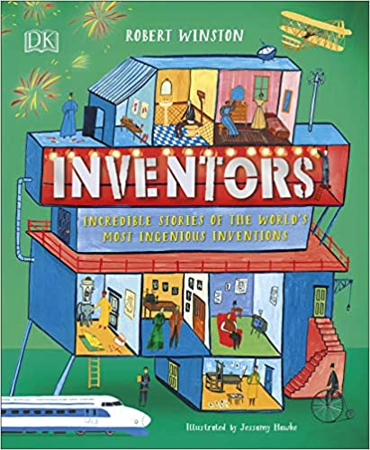
Instructions
Explanations

Slide 5
English Text: Instructions
Lesson 1: WOW: Watch https://www.youtube.com/watch?v=NnPaEU3-H0katch World's Best Card Stacker Builds Insane Outdoor Card Tower - COOLEST THING I'VE EVER MADE-EP13 Chn have a go at building a simple structure with 10 cards . Discuss any games children know and how they learnt the rules. Discuss origin of cards (see planning) Discuss features and annotate an instructional text. Grammar: Identify features: Clear and concise sentences Present tense, imperative verbs Third person Useful details Precise language Time adverbs Oracy: Justify choices when finding features Mighty Write: Distribute ‘Card Games’ sheets (see resources). Children to try one or two games and evaluate how easy the instructions are/are not to follow and which features help make them clearer. Children make notes on the sheets, either to note features or add improvements. Vocabulary: Features - display on working wall | Lesson 2: Intro: Display and read instructions on Resource PPT Slide 1. How do writers make the order of instructions clear, and make links between the steps? Order of steps, numbers, bullets, arrows and time adverbs. Grammar: Recap adverbs for time using Resource PPT Slides 2 to 6 (see resources) and extend to other adverbs for cohesion. Oracy: Talk in pairs to improve Boarding a Bus’ (see resources), adding adverbs, imperative verbs, numbers or bullet points. Mighty Write: Children use activity sheets (see resources) to prompt writing clear, cohesive instructions. HARD: ‘How to Use the Telephone’; MEDIUM: ‘How to use an Escalator’; EASY: ‘How to use an Escalator Safely’. Vocabulary: Examples of adverbs for time/order, lists/adding, causes, contrasts, manner | Lesson 3: Intro: What do children think good instructions are like? Children discuss ideas, thinking about their card games on Day 1. Can they identify features that helped? Briefly recap features of instructions – checking children are secure in understanding terms: imperative verbs, person and concepts of audience and purpose. Grammar: Add adverbs for time and listing to features list. Oracy: Articulate and justify answers Mighty Write: HARD: ‘A guide to using twitter’; ‘Getting Started with your iPhone’ & ‘Thinking about Instruction Texts 1’. MEDIUM: ‘LeapPad Instructions’; ‘Aeroplane Instructions’ & ‘Thinking about Instruction Texts 2’. EASY: ‘Art Attack Instructions’; ‘Aeroplane Instructions’ & ‘Thinking about Instruction Texts 3’. Vocabulary: purchases required recommended activated connecting comprehensive managing prompted create install application earn account balance straightforward
Lesson 4: Intro: Read and discuss How Escalators Work’ (see planning) Grammar: Look at adverbs for cause and contrast, using Resources PPT (see resources). Find adverbs for cohesion in text. Read ”How Alexa Works” Children edit or rewrite the pairs of sentences, adding appropriate adverbs. Oracy: Children should say the new sentences to listen to the impact of adverb choice and placement. Mighty Write:. Allocate ‘Research Questions’ and display website (see resources). Explain that today's task requires children to answer a question by reading an explanation text, making notes, and presenting information to a peer. Research questions are numbered in order of reading difficulty (EASY:1 →HARD:12). Vocabulary: Adverbs for cohesion – display on working wall | Lesson 5: Intro: Display the opening of ‘A Guide to Using Twitter’ (see resources). Reread and note the text in brackets. Explain that brackets are used to mark off extra information in a text in a noticeable way (this extra information is called parenthesis). Grammar: Use Resources PPT Slides 2 to 6 (see resources) to explore parenthesis and challenge children to decide where brackets should go. Ask children whether any other punctuation could be used to mark off the extra information: commas or dashes. Explain that commas are a subtler form of parenthesising and dashes are used in informal writing. Oracy: Articulate and justify opinions of where punctuation should be. Mighty Write: Each child needs a separate game sheet to pass around. As in the parlour game Consequences, children take turns to add to the story, with extra information in brackets (there is an example sheet in resources). At the end of each turn, children fold over the sheet to hide what they have written. Children unfold the sheet when it has been completed. Children can write out one of the scenarios in their books, correctly punctuated. Children read scenarios to a partner and peer mark punctuation. Vocabulary: parenthesis brackets commas dashes phrase clause formal informal technical influential engineer filed patents enforce transparent distractions | Lesson 6: Intro: Explain that new technology often requires instructions for use and explanations of how it works. Display Baby Cage pictures (see resources), and discuss, explaining what a patent is. Challenge half of class to write quick drafts of instructions for use and the other to write draft explanations of how the Baby Cage works (a harder task). Can we tell the genre from the structure and language? Create a side-by-side list of the features of instructions and explanations picking out similarities and differences. Explain that today children will be planning and performing explanations of genuine patented products (in the style of Dragons’ Den pitches). Grammar: Include adverbs for opinion (cleverly, easily, clearly, amazingly, etc.) in addition to cause and contrast. Oracy: Discuss ways to take turns and allocate roles within their groups, importance of voice variation. Mighty Write: Distribute patent designs to groups and challenge children to plan a three-minute presentation (pitch), explaining how the inventions work. Remind children of explanation features (referring to display) and remind children that notes to prompt are better than reading from a written text. Vocabulary: Adverbs for opinion (cleverly, easily, clearly, amazingly, etc.)

Slide 6
English Text: Explanations
Lesson 7: Intro: Revisit explanation text features - emphasise that the sequential, cause-and-effect nature makes them distinct from reports. Children will write formal explanation texts based on last session's pitches. Present an everyday item (a mug, pen, glove) as a fabulous new gadget (bad joke blocker, playtime-extender, etc.). Model an explanation of how this item works, emphasising language features: present tense, 3rd person, causal language, impersonal tone, tech/formal vocab. Model adding additional information using commas for subtle parenthesis and brackets for information which should stand out. Grammar: Revision of parenthesis Oracy: Editing- Partner work Extended Write: Using notes from Day 6, children( in pairs) draft formal explanation texts which aim to explain and persuade. Discuss need for formal, persuasive tone and display features of explanation texts for reference. Remind children how they should use brackets to add extra information which they want to stand out. Edit with partner. Vocabulary: Revise language features of a persuasive explanation | Lesson 8: Intro: Display ‘Transport of the Future’ (see resources) and discuss. What if they became available tomorrow? How might different people feel about them? What issues might arise? Collect a list of potential audiences on a f/c to support planning later. Explain that children will be writing a guide to a futuristic form of transport, which will include both instructions for use and explanations as to how they work. Children should include all the genre conventions explored so far and apply the grammar focuses of the block. Grammar: Revise grammar taught in this unit Oracy: Use spoken language to develop understanding through speculating, hypothesising, imagining and exploring ideas Mighty Write: Children plan a guide for users of their invented transport. Allow for discussion time before children begin to record their plans.They should choose an audience for their guide, considering their needs (children, teens, parents, technophobes, older people etc.). Encourage children to think about the structure of each part of the text & associated language features. Children may find it helpful to plan their guide layout first, with boxes for introduction, explanation, instruction and a summing up sentence. Vocabulary: Summing up language | Lesson 9: Intro: Distribute ‘Cycling Helmets A& B’ (see resources) to children in small groups. Ask children to compare texts and discuss which is easiest to read and why (text is identical). Discuss importance of organisational features in supporting reader. Create a list on a f/c of organisational features which children might choose to use in their writing today. Assign a score for each which children can collect when using correctly and ask children to refer to list during today's writing. Explain that this text combines explanation and instruction features and that children's writing should do too. Grammar: Share your own WAGOLL for Transport of the future and identify language and organisational features including examples of parenthesis. Oracy: Articulate and justify answers Extended Write: Children write first drafts of guides. Encourage use of displays to ensure use of organisational and presentational devices. Remind children of grammar learning to apply: adverbs for cohesion and brackets for parenthesis. Ask children to keep score for organisational devices. Vocabulary: Choose language you would like children to include from your own WAGOLL
Lesson 10: Intro: Address areas of improvement from marking writing so far. Put children into improvement partners. Children read their work to themselves and then to partners. Discuss giving positive feedback and display areas of focus on f/c: clear layout, use of headings, bullet points, linking adverbs etc. Remind children how to use dictionaries and thesauruses efficiently.Children compile a plan for today's writing (which may include finishing), thinking about improvement focuses. Grammar: Address any areas from marking. Oracy: Editing- Partner work Extended Write: Children complete and edit guides based on guidance given in whole-class teaching. Return to improvement partners during or at the end of this process to discuss and share writing changes. Encourage children to use dictionaries for spelling and a thesaurus to improve vocabulary choices. Vocabulary: Choose ambitious choices of language the children have used. | Lesson 11: Future lesson for assessment Intro: Research a current class topic. Chn use research skills to gather information. Plan writing using the design sheet as previous lessons. Grammar: Revise parenthesis Oracy: Share information with a partner. Extended Write: Plan, write and edit an explanation from their research. Vocabulary: Choose vocabulary linked to their topic.

Slide 7


Slide 8
English Text: Street Child
Lesson 1: Literacy shed Lesson 1 WOW: Play a clip from Oliver Twist. Discuss what a workhouse was. Show ‘The History of Barnardo’s’ pages from the back of the novel. Explain that the novel Street Child is inspired by a true story and that the main character is based upon a real boy. Model turning the bullet point into notes. Ask children to read the other bullet points to a partner and then listen to their partner reading it back. Chn to work with their partners to make notes from the bullet point paragraphs. Grammar: Revision of capital letters- give chn a photocopy of In The Workhouse- highlight capital letters and discuss use eg; proper nouns/ start of sentence/ start of bullet point Oracy: Show images of a workhouse. Discuss their thoughts and feelings after viewing them and after reading the bullet points. Mighty Write:Provide books and online sources to make notes about life in Victorian times for children. Chn choose 3 -4 areas of interest (school, toys, family life, children at work etc) to research and make notes on. Resource 1c Vocabulary: century thriving squalor union harsher grim intimidating detterent degrading inmates severe conducted mundane provision | Lesson 2: Literacy shed Lesson 2 Chapters 1 and 2 Intro: Watch a Horrible History clip about the Vile Victorians. Give the chn : Read pages 13-26. The Sneaglegator’ report from the Literacy Shed Plus. Equip each child with a piece of tracing paper, ask them to choose a page from a non-chronological report and then ask them to trace all the features mentioned in Resource 2a. When they take their page away, they should have a good visual presentation of the layout of a non-chronological report. Begin a story map/ role on the wall character of Jim – continue this throughout unit and display on working wall. Grammar: Find examples from chapter 1 of 2 and 3 clause sentences. Underline main and subordinate clauses in different colours. Look at dialect and use of contractions eg: ain’t d’you that’s Oracy: Listen to a London accent. Read page 17 in groups of 3 attempting the accent Extended Write: Chn work in partners to write their non-chronological reports. Use the template provided (Resource 2b) or base their own approximately on this template, to help structure the layout. When marking note any weaknesses to be addressed in future sessions. Give chn time to edit their work after marking. Vocabulary: mister hammock carriages shovered prised shilling triumph brimming shovelling ragged hearth trundled taut Rapping cane hauled indicating strained | Lesson 3:Literacy shed Lesson Chapters 3 and 4 Intro: Look at a diary extract. Recap features of a diary – informal, chatty, chronological order, thoughts and feelings, personal pronouns, structured into paragraphs, time connectives to order events and put on working wall. Grammar: Key Features of a diary Oracy: Task 1: ‘Statue building’: Teacher describes a moment from chp. 1 or 2 and names a character (e.g. Mr Spink as he inspects Jim’s mother). Partner A ‘sculpts’ Partner B into this character by gently moving their arms, tilting their face etc. (for children who do not wish to be touched, one partner instructs the other by demonstrating body positions and expressions for them to copy). Now swap roles. Task 2: ‘Sound Clues’: Children chose or are given (in small groups) a key plot point which would have a sound attributed to it (e.g. eating pie; Mr Skink arriving etc.) they work together to rehearse this sound or collection of sounds and then perform to the other groups who guess the plot point being performed. Mighty Write: Model to chn how to write a diary entry as if they were JJ, recounting the events of Chapters One and Two. Chn write a quick 5-point plan of their diary (e.g. 1. buying pie; 2. sharing pie but mum not eating; 3. lying awake; 4. Mr Spink evicting them; 5. gathering things to leave) Use this plan to write a diary entry. Read to a partner and edit if necessary. When marking note any weaknesses to be addressed in future sessions. Give chn time to edit their work after marking. Read to chapter 14 before next writing session. Vocabulary: anxious stately bulged jangled afterthought squatted infirmary sluice ladle stifling tilted shambling scrawny despatch pauper asylum hunched wailings lunged trough reckless sallow recite shabby readiness bleak bewildered laboured hobbled attic spluttered steely droned cholera cuffing
Lesson 4: Literacy shed Lesson 5 Intro: Carry out a ‘visualisation’ task. Read the chn extracts describing Grimy Nick from pages 107 – 109, 118 and ask the chn to draw a picture of him. Can they label it with words and phrases from these chapters? For example: growled, lumbered, belched loudly, face black with coal-dust, grey thatch hair. Now look at a partner’s work. How are your pictures similar? How are they different? Grammar: Find examples of expanded noun phrases in description of Grimy Nick. Highlight determiner, adjective and noun. Look at sentence openers sheet. In groups find examples form the text. Choose sentences form the text and change the sentence structure by changing the sentence opener. Oracy: Resource 5b. Debate all the pros and cons of working for Grimy Nick .Present their description to their small group. Mighty Write: Model to chn how to write a character description of Grimy Nick, using expanded noun phrases, paragraphs, sentences about hi size/appearance/movement/speech, range of sentence openers. Chn write a description of Grimy Nick using expanded noun phrases and varied sentence structure. Vocabulary: hoisted gleam glided rumbled baffled reckoned cackle tweaked hearth coaxed churned prancing reproach furtive narrowed moored haunches contempt roused Read to chapter 20 before lesson 6. | Lesson 5: Literacy shed Lesson 6 Chapters 20 - 21 Intro: Look at some images from this article: http://www.vam.ac.uk/content/articles/v/victoriancircus/) Read Chapters 20 and 21. Focus on pages 161 and 162. Grammar: Teach relative clauses beginning with who, which, where, when, whose, that, or an omitted relative pronoun – Find examples in chapters 20, 21. Model write how to take a sentence and rewrite to include a relative clause. Oracy: Discuss how they feel after watching circus clip. Discuss atmosphere in tent on pages 161,162 Mighty Write: Model to chn how to write a first-person recount of the night in the circus, focusing on expanded noun phrases, interesting sentence openers, JJ’s feelings when watching the animals, capturing the atmosphere of inside the tent and then ending on a cliffhanger when JJ sees Grimy Nick. Chn write a descriptive passage, using all elements of DADWAVERS? (Resource 6a) including a semi-colon to join clauses. Vocabulary: clearing lashing instinctively conscious fittings shrugged harnesses paraded procession scudding billowing prancing briefly peering spectre bulged | Lesson 6: Literacy shed Lesson Intro: Carry out a class debate and discussion – should wild animals perform in circuses? Are circuses cruel? You could watch http://www.bbc.co.uk/newsround/34648475 to support the children’s understanding of this issue. Read the WAGOLL of Should Zoos Still Exist? and highlight key features. Make a class plan for their discussion piece of writing. Grammar: Revise relative clauses. Use of rhetorical questions in a discussion text Oracy: Class debate Mighty Write: Model write how to use the sentence structures in the WAGOLL to rewrite with their points of discussion about circuses. Finish the book before the next session. Vocabulary: blare charming cockerel cramming desperate flagged lolloping ploughed piercing hazier wharves curiosity wretched hunkered rasping clamoured bitterly moistened swarmed lofty feverish coax drenched dingy lilting flinch

Slide 9
English Text: Street Child
Lesson 7: Literacy shed Lesson 7 Intro: Show front cover. Show pictures of a meat pie, circus, boat, orphanage, workhouse, old-fashioned Victorian house, shrimps, a green caravan. Discuss how these link to Jim’s life? Place them in chronological order? Resource 7a – in groups chn complete a storyboard, showing the main events in the book? Allow the chn Reduce the six main events to four. Which would they choose now? What about three? Now try the opposite. What might you add to the original 6 events? Grammar: Passive verb- Change active verb sentences from the text to passive verb sentences. Oracy: Discuss how the events in Jim’s life impacted upon his personality. Discuss the highs/lows of his life in the story. Chn write down 6 words to summarise JJ’s character. Give chn order them into a list of importance, discussing ideas and justifying their word choice. Compare their list with a partner. Mighty Write: Chn to complete (Resource 7c), a timeline showing the main events in JJ’s life Vocabulary: Revise all | Lesson 8: Literacy shed Lesson 8 Intro: Gather question ideas from the drama activity and then work together to add to these (try to cover his family, the workhouse, Rosie, Grimy Nick, The Lily, the circus, orphanage). Display these as prompts. Discuss what JJ might be like in an interview. Chn plan and note down some questions and answers.. Grammar: Key features of an interview: open ended questions, answers which capture how the interviewee speaks Passive verb- Change active verb sentences from the text to passive verb sentences. Oracy: Rehearse a drama performance (this could be slow motion with narration or tableau with narration etc.) of this and to also rehearse a short speech to be spoken at the end which starts with the phrase ‘This part of the story is a defining moment for Jim because......’ Each group must now perform their drama and speech to a partner group. Ask each group to reflect on what they would wish to ask JJ about the plot point they chose and how it impacted his life. Mighty Write: Model/ share write a shared question and the answer JJ might give. Chn write their own questions and answers. Chn dress up rehearse interview and perform to another pair. Film or audio record the interviews. Vocabulary: Revise all | Lesson 9: Literacy shed Lesson 9 Intro: (Resource 9a). Chn work in groups to sort into chronological order. carry out a ‘trace it’ activity. Chn place tracing paper over their biography and trace around the structure and language features of the text, including any sub-titles or ‘Did you know…?’ fact boxes. Discuss layout and features – how do they grab the reader’s attention? Together, draw up a class success menu for biographies, which may include some of the following elements: question or engaging statement to hook reader in; written in past tense; include key events in person’s life in chronological order; uses the passive voice; third person pronouns (he, his); may include a quote or anecdote from a close friend/family member (a good way to include speech); a conclusion discussing their achievements/influences. Grammar: Key features of a biography. Passive verb- Change active verb sentences from the text to passive verb sentences. Oracy: Watch/listen to and review the interviews from the previous day. Display Resource 8a (sentence stems) to guide children with their feedback. Green = positive feedback orange = areas for improvement. Mighty Write: Model how to make notes and plan using bullet points. Give chn large pieces of sugar paper, post-it notes, felt tip pens etc to encourage them to plan in their own style. What information will they include in each section? How will they grab their reader’s attention? Vocabulary: Revise all
Lesson 10: Literacy shed Lesson 10 Intro: Recap JJ’s life in the form of a quiz. Recap the features of a biography and review success criteria . Show the children ‘The Story of Lego’ again. Discuss how to use the language and structure of this piece to help them with their writing. Ensure the children understand that they are trying to capture JJ’s life and personality and that careful vocabulary choice and controlled, interesting sentence structures will help guide the reader and keep them hooked. Maintain an ‘expert’ voice to the biography and impress upon the children the importance of using the passive voice e.g ‘Jim Jarvis was known throughout London as the boy who survived… The carpet beaters were used by Jim as an escape from the terrible workhouse.’ Grammar: Key features of a biography. Passive verb- Change active verb sentences from the text to passive verb sentences. Oracy: Ideas for changing verb tense sentences. Extended Write: Complete a shared write of the introduction. You’ve probably never heard of Jim Jarvis before although you may well have come across his legacy....’ Vocabulary: Investigating the use of the Greek prefix ‘bio’ which means life. Chn use this knowledge to collect a range of words beginning with the ‘bio’ prefix and work out their meaning For example: biology, autobiography, biodiversity, biomechanics, biodegrading, biological, biographical etc. | Lesson 11: Literacy shed Lesson 10 Intro: Look at a successful piece of writing. Chn identify strengths and annotate the writing together. Grammar: Key Features of a biography Oracy: Read their biography to a partner. Justify their opinions. Mighty Write: Ask chn to work with a partner to peer-assess their writing against the class success menu for writing a biography. Which elements have they included? Which elements do they need to include to further improve their work? As a further lesson, you may wish to set up a range of ‘Editing Stations’ where chn can edit and improve their spelling, punctuation, use of formal language, improve their subheadings to include alliteration etc. Vocabulary: Swipe effective language used by the chn. Assessment Toolkit:

Slide 10


Slide 11
English Text: Viking Voyagers
Lesson 1: WOW: Watch A Viking Village – Literacy Shed. Brainstorm ideas of vocabulary to describe the village on the film clip. Use the vocabulary to model an oral commentary of a fly through of the village. Grammar: Look at WAGOLL of a commentary fly through. Revise rainbow word classes. Underline examples of word classes using rainbow colours. Oracy: Describe the village from the film clip using the senses. Read aloud their own commentary fly through. Mighty Write: Model write using the WAGOLL to change the sentences. Chn work with a partner to write their own commentary fly through . Vocabulary: | Lesson 2: Intro: Show book cover and discuss title. Predict what the book will include. Read pages 24, 25.( without flap) Identify text type, audience and purpose . Identify key features / layout of this text type. Begin working wall. Demonstrate how to make notes by summarising a sentence and generating a list of bullet points . Grammar: Identify the subordinate and main clause in the text. Rearranging the clauses and discuss effect. Change the conjunction/connective to an alternative and discuss effect. Oracy: Describe and explain the effect of changing the position of clauses/ choice of connective. Mighty Write: Using sentence starters and bullet points, children write factual sentences in a formal style. Vocabulary: scandinavians simple farmsteads thatched expeditions oversee bustling trading timber scarce | Lesson 3: Intro: Reread pages 24, 25 (with flap) Discuss the purpose of including a flap. Revise text type, audience, purpose and features. Continue the list of bullet points from the previous day. Grammar: Identify fronted adverbials and what type of adverbial it is. Rearrange the sentences so that it begins with a main clause/ subordinate clause and discuss effect. Oracy: Using bullet points, children take the position of a Viking and describe their lifestyle to a partner. Mighty Write: Using sentence starters and bullet points, children write factual sentences in a formal style. Vocabulary: heart hearth gathered plummeted shelter status pelts limited doubling
Lesson 4: Intro: Explain the task to the children- to plan and write a formal factual double spread page which will be part of a booklet about the Vikings. Using bullet points, model how to organise the information into a planning sheet in the format of a spider web diagram. Share ideas for title and sub headings. Grammar: Revise key features, audience and purpose of a report. Revise assessment toolkit features and what should be included in their writing. Model how to use a bullet point to construct a sentence. Model how to use the assessment toolkit to guide their sentence writing. Oracy: Rehearse sentences with their partner using Think, Say, Write, Read, Check method. Extended Write: Children work with a partner to write their report about Viking life. Vocabulary: Revise all | Lesson 5: Intro: After marking, identify and address any class issues from their writing. Give children time to edit and improve their writing. Grammar: Address class issues/ individual targets Oracy: Share their writing with another partnership. Articulate their responses after listening to a report by another partnership. Extended Write: Plan the layout for their writing. Children rewrite their writing as a double spread page either handwritten or using computer. Include illustrations and a flap. Vocabulary: | Lesson 6: WOW: Watch horrible histories season 2 Vicious Vikings. Read page 48. Demonstrate how to make notes by summarising a sentence and generating a list of bullet points . Make a list of fronted adverbials. Revise type of fronted adverbials using chart. Recreate sentences orally. Grammar: Dashes/ Brackets to add extra information/ add an explanation. Look at examples in the text to teach . Oracy: Think and say a sentence to their partner using the bullet points and fronted adverbials. Mighty Write: Give children a sentence, they add a dash or brackets to add an explanation. In pairs create their own sentences to include an explanation and choice of dash or bracket. Vocabulary: ferocious raiding expeditions expand honourable occupation glorious merchants blacksmiths sturdy status brutal frenzy

Slide 12
English Text: Viking Voyagers
Lesson 7: Intro: Share sentences from the previous day. Read page 49. Discuss the purpose of opening with a question. Quickly revise the 3 sentence types and identify in text. Children make notes by summarising a sentence and generating a list of bullet points . Grammar: Look at how the connectives especially and however are used in the text. Oracy: Think and say sentences using especially and however by changing the vocabulary in a clause. Extended Write: Children work with a partner to organise the information into a planning sheet in the format of a spider web diagram. Share ideas for title and sub headings. Children write their report independently. Vocabulary: territory limited opportunities milder factor tempting fortune | Lesson 8: Intro: After marking, identify and address any class issues from their writing. Give children time to edit and improve their writing. Grammar: Address class issues/ individual targets Oracy: Share their writing with another partnership. Articulate their responses after listening to a report by another partnership. Extended Write: Plan the layout for their writing. Children rewrite their writing as a double spread page either handwritten or using computer. Include illustrations and a flap. Vocabulary: Hyphenated words – hand-to-hand chain-mail pre-battle | Lesson 9: Intro: Give children the titles of the pages from the book. Independently children choose a page from the book to explore. Children make notes by summarising a sentence and generating a list of bullet points . Grammar: Revise key features, audience and purpose of a report. Revise assessment toolkit features and what should be included in their writing. Model how to use a bullet point to construct a sentence. Model how to use the assessment toolkit to guide their sentence writing. Oracy: Share their booklets with another class/ parents Assessment task: Independently plan the layout for their writing. Children write their report on their chosen topic.. After marking and editing, children rewrite their writing as a double spread page either handwritten or using computer. Include illustrations and a flap. This will be added to their previous pages . Form into a booklet with a front cover, back cover with a blurb and a contents page. Vocabulary: Revise fronted adverbials for children to include in their writing

Slide 13
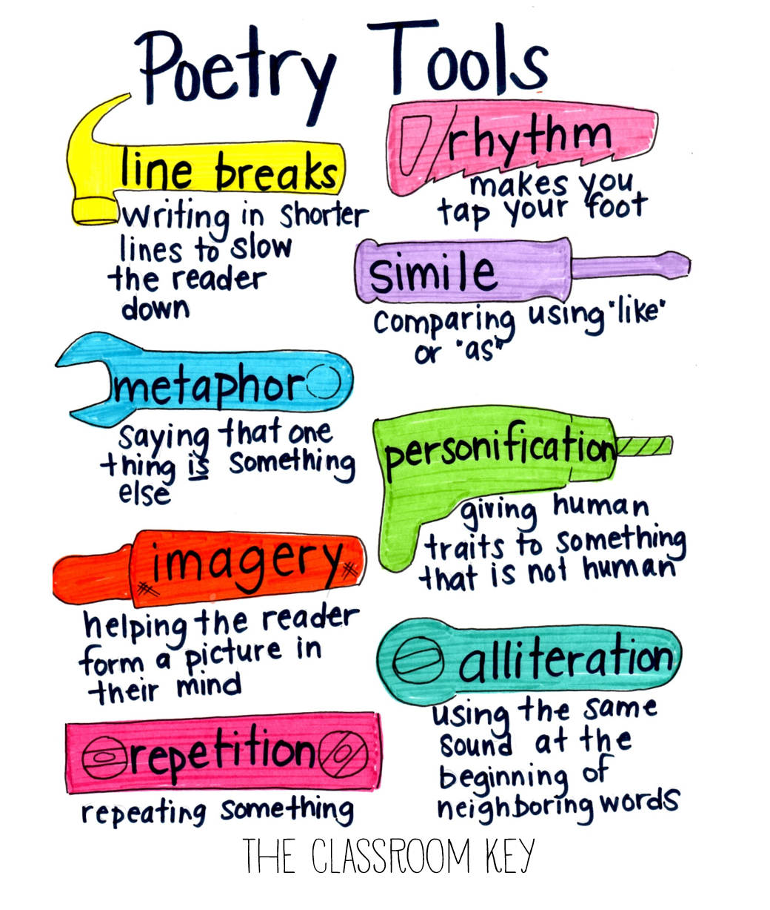

Slide 14
English Text: Poetic Language
Lesson 1: WOW: With children in a circle, mysteriously produce mystery objects (see teacher’s notes). Can children guess the link? Pass them round, encouraging children to look carefully at them and discuss what they see. Read ‘The Words of Poems’ (see resources). Can children spot the link now? How can these objects all be poetry? Read ‘The Words of Poems’ together. Discuss poetic terms and identify any in the poem: stanzas rhythm rhyme alliteration Repetition Simile Metaphor Personification Imagery Grammar: Revise word classes and identify in the poem: nouns, adverbs, adjectives, verbs, pronouns Oracy: Articulate and justify opinions : Discuss what they like/ dislike about the poem Mighty Write: Write their own figurative language sentences describing the objects Vocabulary: stanzas rhythm rhyme alliteration Repetition Simile Metaphor Personification Imagery | Lesson 2: Intro: Read ‘A Matter of Holes’ by Grace Nichols on Resource PPT (slide 2). Agree that the poet makes the reader think differently about everyday things by observing carefully and describing what she sees. What other things could children observe closely? (See PPT Resource slide 8 for prompts: connections, tangles, patterns, shadows etc. Children make some observations before choosing one focus from the agreed list. Give children a set time (10 minutes) in which to make lots of observational notes (alternatively, children could take photos with tablets/cameras). Grammar: Expanded noun phrases to convey complicated information concisely (see Resources PPT, slides 3-7). Emphasise terminology. Oracy: Children discuss in pairs and generate ideas. How could children make interesting observations? Enlarge view (magnifying glasses), observe from different angles (underneath, above etc.), focus on different parts (viewfinders) etc. Mighty Write: Discuss/model how to use the notes to create expanded noun phrases, green leaves→ delicate green leaves→ delicate, paper-thin leaves with wounds. Children develop expanded noun phrases using notes. Vocabulary: descent wealth hollow burrow comfort cosmic store | Lesson 3: Intro: Display and read ‘Sir Autumn’ Discuss personification: giving human attributes to inanimate things. That sandwich is looking sad. My bed is calling to me.The wind howled. Have children heard of other personification to describe nature? Mother Nature, Jack Frost, the sun has got his hat on etc. What is Sir Autumn like? Children discuss ideas in pairs, and then share with class. Together build a picture of autumn as a person, through discussion. Grammar: Use of a semi colon/ dash to join clauses Oracy: Children read poems to a partner. Partners report back on most impactful words/phrases. Partially display and recite the class focus poem – Sir Autumn. What happens when we learn and recite a poem? Continue memorising ready to perform- Oracy assessment opportunity. Mighty Write: Children work individually or with a partner (who has the same focus) to write a poem in the style of ‘Sir Autumn’. They can use their expanded noun phrases from last session and use some of the techniques discussed in the input. Vocabulary: cape ochre rustling sweet tinted promises relished abundance relished
Lesson 4: Intro: Remind children of Day One’s poem, ‘Sir Autumn’, and how it used personification to build an impactful image. Agree that details help to make an image vivid. Relative clauses are one way to add detail. Discuss ideas for a prose titled “Lady Winter” Grammar: Relative clauses (see Resources PPT slides 4-11). Record a list of relative pronouns on f/c for children to refer to later. Use slide 12 to encourage children to try writing their own relative clauses to add detail to the image of Lady Winter on whiteboards. What different images can they create? How will they punctuate the clauses? Oracy: Discuss ideas Mighty Write: Developing their ideas from last time, children write a prose description of Lady Winter, using relative clauses to add detail. Share and celebrate good examples of relative clauses as children write. When children finish, ask them to check the punctuation of the relative clauses with a friend. Where does the relative clause appear in relation to the main clause (at the end or embedded) and does it need to be punctuated with a comma? Vocabulary: Relative pronouns | Lesson 5: Intro: Read ‘Quicksilver’ by Roger McGough (see resources). Discuss rhyme/ rhythm and the effect it creates.Explain Children will write a poem where they take an ordinary item and explore interesting ways to describe it to build vivid images and keep their reader guessing. Model this process with a mundane object. Collect descriptive phrases. Expand some noun phrases with relative clause Grammar: Expand some noun phrases with relative clauses. Oracy: Work collaboratively, collecting and pooling their ideas. Rehearse and perform their poem. Mighty Write: Children work individually or in small groups to write a descriptive, imaginative poem about mundane objects. Vocabulary: quicksilver trice steaming prow | Lesson 6: Intro: Read and enjoy ‘I am a writer’ by Joseph Coelho. Briefly recap features of effective poems and use the poem to create a list of tips for poetry writing. Ideas could include: Use expanded noun phrases and relative clauses to build vivid images Start a new stanza for each new image Use alliteration to draw attention to some words Use simile, metaphor and personification Choose words for impact Grammar: Revise incorporating relative clauses with expanded noun phrases. Oracy: Rehearse and perform their poem – Oracy assessment opportunity Extended Write: Children write independently poems about their mystery objects. They can use the modelled structure from ‘I am a Writer’, opening with the line ‘I am the_____’ with the second line beginning with a relative pronoun. Vocabulary: clash collide awareness refract arteries conversation melodies

Slide 15
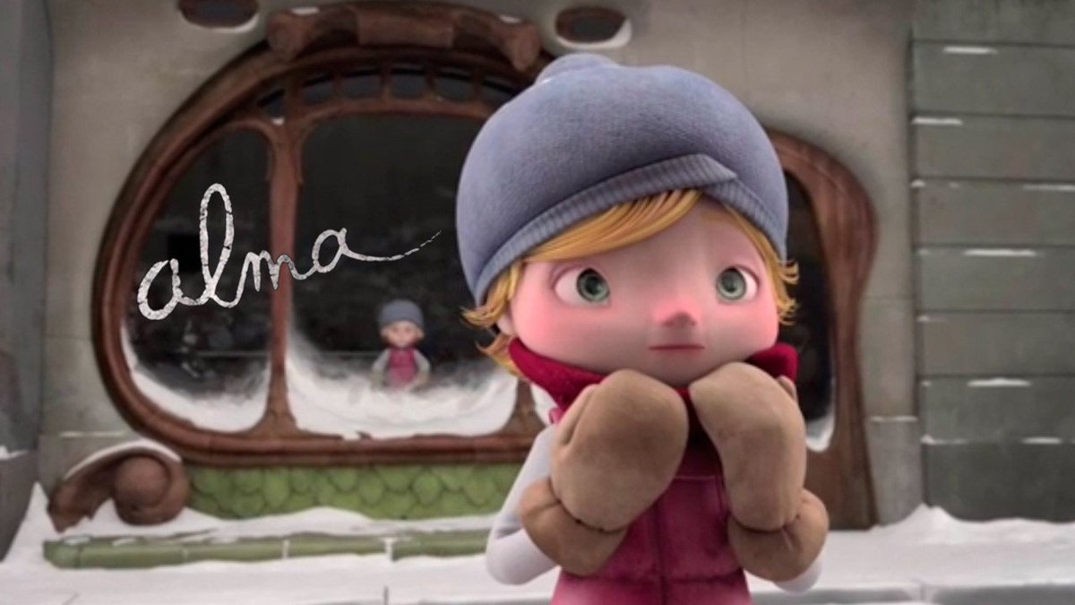

Slide 16
English Text: Alma (The Literacy Shed)
Lesson 1: WOW: Play the clip pausing at intervals – making predictions. (Resource 1a) Identify genre and the key features. (Resource1b) Grammar: Fronted Adverbials Oracy: Make predictions Discuss themes of the story (Resource 1c) Mighty Write: Children should use the list in Resource 1c and create a short paragraph to explain each of the headings and how it applies to the clip. Where is there evidence? Vocabulary: adrenalin porcelain doppleganger consciousness boulevard | Lesson 2: Intro: Give alternative words to adjective cold (resource 2a) Look at Resource 2b – discuss vocabulary and use of elipses Grammar: NNG Activity 2.23: Expanding nouns Oracy: Give ideas for describing the shop front Mighty Write:Children write a setting description focussing on the use of improved synonyms for effect. Vocabulary: synonyms for cold: wintry biting glacial numbing piercing frosty inhospitable | Lesson 3: Intro: Using senses tables chn move around and describe the shop setting Grammar: Resource 3b Figurative language – read description and identify types of figurative language/ Revision of fronted adverbials followed by a comma – identify in text Oracy: Ideas for imagery Mighty Write: Write sentences using examples of imagery, figurative language & descriptive vocabulary using the five senses to describe the shop. Vocabulary: menacing uneasy curious beckoning facade pedestal bemused replica enticing
Lesson 4: Intro: Track moments of suspense and tension in a story. Listen to the music and draw a line showing emotions as you watch the film. Chn complete it themselves on whiteboards. Discuss effect of music. Grammar: Adverbs 0f possibility - perhaps , surely Oracy: Describe Alma’s emotions – show not tell – Complete Resource sheet 4a Mighty Write: Children add notes onto the emotions graph to show not tell Alma’s feelings at different points in the story. Vocabulary: Range of emotive adjectives | Lesson 5: Intro: Resource 5a- Discuss onomatopoeia and examples for each clip. Play the clip from 1:02-1:09 and discuss Alma’s micro expressions. Resource sheet 5b Grammar: Revision of all grammar needed to be included in independent piece using WAGOLL Oracy: Ideas for onomatopoeia Extended Write: WAGOLL – Resource sheet 5c Children are to write the narrative using a variety of sentence lengths, describing Alma’s discovery of the doll and subsequent entry into the shop Vocabulary: momentarily craned panes weighed heavily wandered | Lesson 6: Intro: Play the first part of Alma to 0:47- discuss the weather/ snow. Play give one, get one. Complete resource sheet 6c as a class. Grammar: Adverbs, verbs, adjectives Oracy: Discuss figurative language and add these to their resource sheet 6c Mighty Write: Children write a paragraph setting the scene to the opening part of the clip with heavy emphasis on the weather Vocabulary: Examples of ambitious Adverbs, verbs, adjectives
Lesson 7 Intro: Read and analyse Resource sheet 7a- swipe effective parts; up level weak parts. Begin to use the DADWAVERS sentences to tell the scene from the doll’s perspective- as in the first paragraph in resource sheet 7c. Model write discovery of the doll from the dual perspective of Alam and the doll. Grammar: Sentence Openers – Dadwavers. Using Resource sheet 7c children find examples of each type. Oracy: Mighty Write: Continue writing from the class start using a range of sentence openers to describe Alma’s discovery of the doll to her entrance to the shop. Vocabulary: Ambitious choices from the model writing. | Lesson 8 Intro: Play the clip from 2:15 pausing at 3:45,drawing the children’s attention to the fact that there is no dialogue. Ask them to imagine that the Alma doll could speak during this part of the clip. What might it say to the girl? Would it use commands/questions/exclamations? Work as a class to fill in the first two speech bubbles on resource 8a, then get children to complete the sheet independently before sharing ideas. Grammar: Find good quality work from the previous day and use to make a list of success criteria for the working wall. Oracy: Debate – Do the chn think that the doll deliberately tempted Alma into the shop. Was she made to do it? Who by? Mighty Write:Give each child a copy of the writing planning sheet on resource 8b. Discuss each box, modelling examples and asking children to suggest ideas they might write in each. Chn complete planning sheet. Vocabulary: Ambitious choices from the children’s own writing. | Lesson 9 Intro: Read exemplar from resource sheet 8c. Discuss descriptive phrases and vocabulary. Chn pick out examples of success criteria and annotate on their sheet. Oracy: Discuss what they like from the exemplar and why. Extended Write: Chn to use their planning sheet to begin writing their narrative. Write and edit over a couple of sessions giving chn feedback to improve as they go along. Give time to finally edit their narrative against the success criteria before final marking. Vocabulary: distracted furrowed uneasy grimaced menacing uncertainty beckoning intriguing plinth warily urging minature craned ajar clambering mesmorized

Slide 17
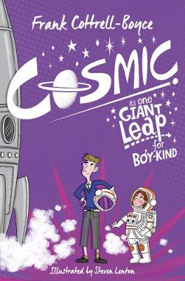

Slide 18
English Text: Cosmic
Lesson 1: Chapters 1-2 WOW: Using google earth zoom out from school to image of earth. Read to the bottom of page 17 (stop just before Dad speaks). Grammar: Cut out examples of speech from pages 12-16.Organise into categories( e.g. speech which is introduced / isolated / within narrative) Highlight features e.g. capital letters, punctuation within speech marks, comma . Swipe incidents of speech which they find effective. Oracy: Discuss characters of Liam /Dad. Resource 1a. Act out dialogue from their writing. Mighty Write: After discovering Liam, model then chn write the dialogue between Liam and Dad as Liam climbs down from the ride to speak to him. Resource 1b. Vocabulary: impression infinite possibility manoeuvre function hopelessly doomed impressed supposedly apparently blatantly accompanied dwindled | Lesson 2: Chapter 3 Intro: Ask the children ‘What would you love to do if people believed you were an adult?’ Share ideas as a class .Children should now consider what instant issues (at the time of deception rather than after the event) could arise for them in these scenarios. Complete reading chapter 3. Continue Resource 1a. Grammar: Revise punctuation with speech- Resource 1c. Dialogue to advance the action. Oracy: Act out their scene. Mighty Write: Model then chn create their own scene which concludes with Liam’s dad arriving and participating in the dialogue (three characters speaking simultaneously) before taking Liam home. Resource 2b. Vocabulary: seized remote noble furious | Lesson 3: Chapters 4-7 Intro: Read to end of page 75 before this lesson. Using the clues on resource sheet 3a chn work out that this chapter of Cosmic draws many parallels with the winning of golden tickets in Roald Dahl’s ‘Charlie and the Chocolate Factory’ Grammar: Resource 3b. Looking at the two different ways in which bullet points are punctuated. Discuss which type would be most appropriate for a novel comparison(Resource 3b) Oracy: Discuss comparisons Mighty Write: Use resource 3b to model write their comparisons. Add an additional list under the subheading ‘Themes:’ (by considering what themes the two novel sections have in common e.g. ‘wealth’). Vocabulary: barely slashed procedure manner terror slightly consequences lush peculiar disruptive credit developing feedback perfection request incident noticeable scoop recent summoned complicated prowled blatantly replacement
Lesson 4: Chapters 8-10 (literacy shed lessons 4-6) Intro: Watch winning scene in CATCF . Read chapters. Discuss the competition winning scenes in CATCF and Cosmic Grammar: Look at dialogue on pages 85-88. Discuss reasons for lack of inverted commas. Revise verbs NNG: Activity 4.16: Digging for verbs Oracy: Discuss ideas for a competition for their extended write. Make a class plan. Extended Write: Write a story chapter which will be about a new competition and just like CATCF and Cosmic, will be told through the eyes of the final winner. It will begin with the announcement of the first winner and end on a cliff-hanger after the third winner is announced Vocabulary: accurate essential quest uncommunicative dispensed bait amusing choked extensive coax barred monitoring mention hijacked complimentary cruise revolutionized | Lesson 5: Chapters 11-13 Intro: Look at image of Gobi Desert. Pick out words and phrases that describe the landscape in the book, such as: ‘The building’s shadow stretched out into the desert, long and straight like a road made of ink.’ ‘It looked like a big, red cliff lit by banks and banks of spotlights.’ Discuss, referring back to previous reading, what we already know about Infinity Park. Look at the map of the Epcot Center in Florida, what can you see and do there? How is this presented to visitors? https://disneyworld.disney.go.com/media/wdw_nextgen/CoreCatalog/WaltDisneyWorld/en_us/PDF/epcot-mapnovember-2012.pdf Make own maps, detailing the attractions of Infinity Park. Set the children up to think about how the theme park that Dr Drax wants to create would be marketed to visitors. Watch the video in the link below to look at an example of how a technology based theme park is marketed: https://disneyworld.disney.go.com/parks/epcot/ Grammar: Adverbs which indicate possibility/modal verbs NNG: Activity 4.19: What animal should you be? Oracy: Ideas for persuasive phrases Mighty Write: Model then chn write a persuasive letter to advertise Infinity Park using adverbs which indicate possibility – surely, possibly and modal verbs – could, might Vocabulary: neat souvenir roughly initiate convincingly wizard entire baffled introverted bawling indescribable hypnotized apparantly convincing reassuring optimistic insured | Lesson 6: Chapters 14-20 Intro: Read aloud to Chapter 20: ‘Last Chance to vote’, “As long as the other two votes didn’t go to Eddie.” Think about and discuss the strengths and weaknesses of each of the ‘fathers’. Which ‘father’ would you vote to accompany you into space and why. Revise use of bullet points to list them. Read to the end of the chapter – Do the children think the vote was fair and the right man won? Grammar: Revise adverbs which indicate possibility/modal verbs. Apostrophes used for contraction in some verb forms: NNG: Activity 4.20: Modal contractions Oracy: Debate about which father should win. Extended Write: Model then chn write a persuasive argument in favour of their chosen ‘father’. using adverbs which indicate possibility – surely, possibly and modal contracted verbs – could, might Vocabulary: chronic pootled assumed satisfying hazard regard snarled capable trundled exposed initiative involuntary mirage appreciated sternly unique crest discourage snorted anticipation plonked endure prolonged sidled
Lesson 7: Chapter 21-23 Intro: Read aloud Chapter 23 . Think about whether, faced with the dilemma Liam is in he should go to space or confess. Share responses in ‘conscience alley’ with children offering their advice to Liam as he walks towards the rocket. Grammar: Teaching the different purposes of the dash and elipses in this chapter. Make a class instruction sheet for working wall with examples from the text. Oracy: Conscience Alley Mighty Write: Model then chn write a text or email to send to Liam’s Draxphone to offer your advice on his situation and what he should do. Vocabulary: flinch decline denied scrambling innate impacted withdrawing reassuring replica glimpsed remains | Lesson 8: Chapters 24- 29 Intro: Read aloud to half way through Chapter 29 . Reflect back on the passage beginning: Then it stopped. Look at how this is set out, more like a poem than prose. Get the children, in groups, to think of key events from just before take-off to this disaster and then emotions that can be connected to these events. This is effective if done on paper strips or post its. Match up the emotions with the events and then organise them to create a list poem chronicling the emotions of the journey from start to disaster. Grammar: Using accurate vocabulary to describe NNG: Activity 2.27: Describe it! Oracy: Perform as a group to the class, thinking how to convey the emotions in your poem. Mighty Write: Group poem Vocabulary: pyschologically mission blank propelled traceless translation monotonous insanely flaws spouting protective metallic doomed hatch | Lesson 9: Chapter 30 Intro: Think back to what the children might have been thinking, feeling or doing while Liam was off on his spacewalk, searching for Hasan. In groups of 3, role-play Florida, Samson Two and Max, exploring the events that occurred whilst Liam was away. Grammar: Revise the different purposes of the dash and elipses Use class instruction sheet from working wall to find different examples from this chapter. Introduce relative clauses- show examples from pages 298,302,313. NNG:Activity 2.25: Commas in relative clauses Oracy: Role Play Mighty Write: Model write then chn add relative clauses to given sentences from the text. Ensure relative clauses add meaning to the rest of the sentence. Vocabulary: valleys plains eventualities diversion unscheduled trajectory abandoned hurled adrift irrationally disproportionally coiled elegantly rummaged

Slide 19
English Text: Cosmic
Lesson 10: Chapters 31-33 Intro: Read to chapter 35 – complete grammar activity. Chn predict ending of the book. Grammar: Revise relative clauses- identify clause in examples from pages 319,320,321,322,330. Make class instruction sheet for working wall. Oracy: Make predictions. Mighty Write: Model then chn write predictions. Vocabulary: instant beneficial convenient specifications calculation compact procedures | Lesson 11: Chapters 34-36 Intro: Read the rest of the book. . Look at the reporting of Shenjian’s mission on the TV and radio. Chn imagine they are a reporter covering the story for the national press. Explore how this might be reported by a tabloid, compared with a broadsheet newspaper. Take notes for the article using the 5 w’s of journalism: Who is it about? What happened? When did it take place? Where did it take place? Why did it happen? Compare what we actually know with what people may speculate and think about how this would be used or presented in the context of your chosen newspaper. Grammar: Features of a newspaper article – annotate an article for the working wall. Oracy: Use hot-seating to conduct press conferences with Dr Drax and Shenjian and possibly Alan Bean to allow the children opportunities to collect quotes for their article Mighty Write: Shared class newspaper article plan Vocabulary: drifts unmediated ample coincidence illogical uncoupled envelope lunged temporary precise inherent assuming | Lesson 12: Intro: Read an example newspaper article( teachers own) Annotate key features. Grammar: Look at writing assessment objectives and identify them in the teacher newspaper article. Teach the inclusion of quotations. Oracy: Read their article in the role of a reporter Extended Write: Chn write their own newspaper article using class plan. Vocabulary: Revise all

Slide 20


Slide 21
English Text: Poems On A Theme :Aspirations and Dreams
Lesson 1: WOW: Watch What do you want to be? by Wilf Merttens https://player.hamiltontrust.org.uk/story_telling_year.php?year=uks2 Discuss aspirations chn have. Read the brief Author Profile of Wilf Merttens(see resources). Share-read the short Author Profile of Langston Hughes(see resources) and then hear Hughes introduce and read his own poem, Hold Fast to Dreams at https://www.youtube.com/watch?v=hz2IOjuxMy0. Display and discuss the poem. Grammar: Identify choice of verbs and metaphors in the poem. Discuss the effectiveness of these choices. Explore the difference between metaphors and similes Oracy: Articulate and justify opinions/ Participate actively in collaborative conversations Mighty Write: Develop some further metaphors that would fit Hughes’ poem, e.g. a poisoned lake, an abandoned building. Vocabulary: Verbs: wither decay bleed break shatter rupture implode collapse break apart shrivel fracture crack fade empty dry up blanch ossify calcify darken close shut down evaporate disperse scatter are extinguished | Lesson 2: Intro: Read Langston Hughes’ Hold Fast to Dreams(see resources)once more and revisit some of the verbs and metaphors developed yesterday in preparation for poems on the same theme. Stress how Hughes extends each of his metaphors with a further line: not just ‘a broken winged bird’, but a bird ‘who cannot fly’. Not just ‘a barren field’, but one ‘frozen with snow’. Grammar: Model turning your own verb and metaphor notes from yesterday’s lesson into finished lines, extending the metaphor in each case. ‘ Oracy: Chn read their own poems aloud, first to a partner and then to the whole class. Ask other children to notice and comment on the metaphors chosen, how they have been extended and which rhyming words were most effective. Mighty Write: Show how you achieve rhyme (see planning). Chn copy the opening line from Hughes’s poem before completing their Life Without Dreams verse from the notes that they made yesterday. They should aim to write at least four pairs of lines, rhyming at least one. Vocabulary: Metaphors: Something…deserted poisoned abandoned shuttered broken cracked homeless leafless sunless empty splintered unloved cheerless unfinished lost smashed snuffed out frozen buried | Lesson 3: Intro: Watch https://www.youtube.com/watch?v=5L-kKxePGqA. Read poem , Mother to Son(see resources) Share-read the closing section of What do you want to be? by Wilf . Ask children to identify the thematic links between the two pieces. What is the same about the theme of these two poems? Draw out the idea of perseverance and determination in the face of adversity.Poems often share a theme, even if they talk about it in different ways. Grammar: Identify contracted words in the poem eg: ain’t . Use as a starting point for revision on contractions Oracy: Participate actively in collaborative conversations Mighty Write: Children work in small reading level groups. They read poems on the theme of perseverance and determination and answer questions about them. Less confident readers read and answer questions about Keep on Keeping On. Most childrenread and answer questions about Don’t Quit. IF APPROPRIATEMore confident readers read and answer questions about Still I Rise. Vocabulary: Contracted words
Lesson 4: Intro: Fill in an A-Z Jobs List as a class (see resources). Display What do you want to be by Wilf Merttens(see resources). Now re-watch What do you want to be? from 0.28 up to 1.11. https://player.hamiltontrust.org.uk/story_telling_year.php?year=uks2 Draw attention to the structure of the poem with its repeated, ‘Maybe you…’ line-opening. Grammar: Using Degrees of Possibility PowerPointslides1-6(see resources), identify ‘maybe’ as an adverb of possibility. Look at the others listed, discussing where they can be placed within sentences. Oracy: Participate actively in collaborative conversations Mighty Write: Model then chn write sentences on where to place adverbs (start/ before main verb) OR make use of two adverbs within one sentence (I would definitely like to work as a farmer, but probably only after I have been to America.) Vocabulary: never maybe possibly perhaps probably certainly surely definitely obviously clearly doubtless | Lesson 5: Intro: Now re-watch What do you want to be? from 0.28 up to 1.11.https://player.hamiltontrust.org.uk/story_telling_year.php?year=uks2 Show children the main Performance Planner(see resources)with its checklist of things to include. Discuss each section, checking children’s understanding of the expectations. Model recording your ideas for a new version of the poem, referring back to the list of features to be included. Model write your poem using your performance planner Grammar: Revise Degrees of Possibility adverbs Oracy: Rehearse and perform poem – assessment opportunity Extended Write: Chn create ideas for their own composition. They record these as brief notes and/or incomplete lines. They talk with a partner about their ideas. Chn work as modelled in the whole class teaching session, turning their Performance Planner notes into polished lines. Vocabulary: Revise Degrees of Possibility adverbs | Lesson 6: Intro: Explain that today we will look at a slightly less serious poem about the freedoms you can maybe look forward to when you’re grown up, When I’m Older by Lemn Sissay.Share-read Author Profile of Lemn Sissay, followed by the poem itself (see resources). Why does this poem make us chuckle? I Grammar: Use Degrees of Possibility PowerPointslides7-10(see resources) to identify these words as examples of modal verbs of obligation. Oracy: Rehearse and perform poem – assessment opportunity Extended Write: Using the modal verbs of obligation discussed in the main class teaching, children write a poem in their books, While You’re Still Young, from the point of view of a parent or carer informing a child of all the things they have to do until they are grown up. They rhyme lines where possible. Vocabulary: modal verbs of obligation

Slide 22
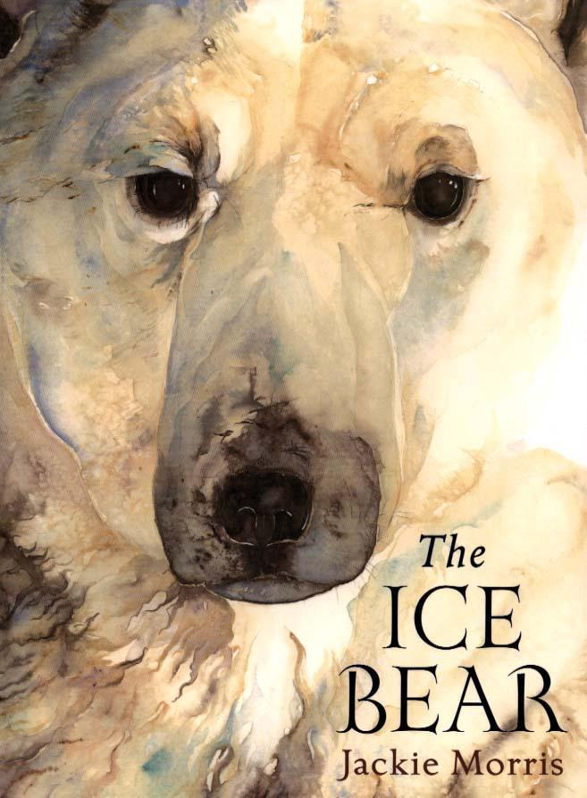

Slide 23
English Text: The Ice Bear Jackie Morris
Lesson 1: WOW: Do not show the children the front cover, the title of the book or any of the images yet. Read the children the first paragraph of the book, up to ‘...a whisper would hold a magic that would shape the world’ Discuss this section of text. Grammar: Relative clauses – identify in paragraph . Rewrite sentences using a different relative clause. Oracy: Respond to the text and make predictions. Mighty Write: Write their predictions about what the book is about. Reveal the front cover and pictures after their writing. Vocabulary: raven soul spirit crystal shape | Lesson 2: Intro: Watch the following nature documentaryhttp://www.bbc.co.uk/programmes/p00m510. Make factual notes. Ask the children to listen to the language used and reflect on the structure, formalities and technical/ subject specific language and compare with language from the book. Grammar: Identify what makes a formal documentary in terms of language, tone, sentence structure etc... Oracy: Read their written clip to the class/group Mighty Write: Create their own formal narration for a short clip on polar bears. Vocabulary: Choose scientific language from the clip. | Lesson 3: Intro: Watch http://www.bbc.co.uk/nature/habitats/Tundra Discuss relationship between mother and cub. Reread page 1. Read aloud to the children the poem ‘Snow’ by Walter de la Mare. Grammar: Figurative language- verbs, adjectives, adverbs, determiners Oracy: Respond to the poem. Mighty Write: Work together as a class to write and create an oral performance of a poem titled The Arctic. Perform poem Vocabulary: gleam bough forlorn stooped feathered shrills
Lesson 4: Intro: Read pages 1 – 6. Discuss how ravens are portrayed in literature. Grammar: Identify sentence types and conjunctions to join clauses/ use of comma Oracy: Discuss the character of the raven. Mighty Write: Complete a ‘Role on the Wall’ for the character of the Raven. Vocabulary: wept carved scent knife- edge bundle scooped snapped | Lesson 5: Intro: Read pages 1 – 10. Several children to hot-seat in role as the man or woman. Compare and contrast the feelings of the mother polar bear and the human mother and father. Grammar: Identify sentence types and conjunctions to join clauses/ use of comma Oracy: Questions/answers for hot seating Mighty Write: Write in role as either the mother or father; reflecting their experiences at finding the child and then the joy this brings them, also consider the possible dilemma the parents face - should they keep the child? And their consideration of where he may have come from. Vocabulary: honoured bundle midwinter ermine lullabies seldom | Lesson 6: Intro: Explore inuit culture (video clip)and find evidence in the text. Read to page 16. Predict what will happen next – who are they? Grammar: use of pronouns Oracy: hot seating as the boy who is lost Mighty Write: rewrite page 15 in the first person. Vocabulary: shard amber fragment ashore trail cupping stooped enchanted
Lesson 7 Intro: Read to page 29. Freeze frame page 29 with every character Grammar: Identify relative clauses in the text Oracy: Conscience Alley/ Predict what the boy will do Extended Write: Write a letter to the boy in the style of an agony aunt reply advising him what to do. Vocabulary: mittened scent echo traced shift chaos sorrow ridges flooded maddened grief blurring vision bloodlust torn | Lesson 8 Intro: Read story from beginning to end. Story map the story. Grammar: Direct speech/ punctuating direct speech Oracy: Review book giving personal opinions Extended Write: Rewrite the story from the perspective of The Raven. Vocabulary: Revise all so far

Slide 24


Slide 25
English Text: Who Let The Gods Out
Lesson 1: Read chapters 1-6 as class guided reading sessions using the Viper questions as a follow up. Intro: Read to page 62, just before prisoner 42 is released from his chains. Ask the children what their impressions of prisoner 42. Populate information about prisoner 42 on Resource sheet 1a/1b Read to the children the urgent press release (resource 1c) Grammar: Key features of the press release (Resource 1c) Oracy: Making predictions about what Virgo and Elliot may find under Stonehenge drawing on evidence from the text to justify their idea Mighty Write: Write a press release about the escaped prisoner including information about the changes in his appearance over time. Use resource 1d Vocabulary: deemed concerned creative serial nurturing odour lurking revulsion instinctively lumbered assembled tottering fancied sumptuous elaborately engraved | Lesson 2: Literacy shed Lesson 2 Intro: Read chapter 7 Resource 2a - discuss the similarities and differences. Resource 2b - Which picture is the scene where the paragraph is set? Why is it difficult to tell? Read second paragraph - which picture was being described. Which words and phrases gave the most clues about the atmosphere? Resource 2c and ask them which pictures they would be best to describe. Grammar: Look at pictures and collect words and phrases e.g. adjectives - ancient, corroded; verbs – snaking, coiling; expanded noun phrases – corroded jet-black metal railings with savage metal spike; preposition phrases – spiralling ominously into the depths simile/metaphor – a coiled metal viper. Ask children to work in small mixed-ability teams to collect ideas for each picture on resource 2e Oracy: Justify their answers when discussing resource sheets 2a/2b/2c Mighty Write: Share write then chn write a descriptive paragraph describing the cave where prisoner 42 is being kept, using resource 2e as a prompt Vocabulary: immortal realm proficiently indignant simultaneously exhilarating reasoned desolate distinguish embrace fragile obligation accustomed inconclusive | Lesson 3: Literacy shed Lesson 3 Intro: Look at image on resource 3a. Chn close their eyes listen to sound effects of a cave .Slowly describe moving through the cave towards prisoner 42. Stations using images from resource 3b. Chn use post it notes to record words and phrases at each of the senses stations. Read resource 3c. Discuss how the writer has used the five senses to create an image. Grammar: NNG: Use synonyms, antonyms and generalisations to create cohesion Activity 2.26: Linking ideas Discuss the vocabulary choices that have been when describing the cave e.g. penetrating, plunged, eerie and compare them to those being used to describe Virgo’s light (ethereal, soft, illuminated). How does this switch in tone make the reader feel about Virgo Oracy: Describing their senses as they move through the cave Mighty Write: Share write then chn write a descriptive paragraph about the children entering the cave, using the acronym SHAMPOO to help include elements of figurative language to aid imagery. Vocabulary: unscathed piercing absurd haughtily deluded restored babbled ventured regardless tedious nonchalantly aroma entitled begrudgingly hollered summoning yanking
Lesson 4: Literacy shed Lesson 4 Intro: Give some groups resource 4b and some groups 4c. Ask the children to select one reader to read the narrative aloud to the group. Think about the rhythm of the narrative read in the starter. How could the piece they have just read/listened to be improved? How many clauses does each sentence have? What could they do to make more complicated multi-clause sentences? (Use subordinating and coordinating conjunctions to link related sentences, use subordinating conjunctions at the start and end of sentences, use parenthesis to embed clauses. How else could they stretch sentences and slow pace? (Expand noun phrases, add adverbials etc.) How could they shorten sentences to raise tension? Split multi-clause sentences by removing conjunctions, shorten noun phrases and omit adverbials Grammar: NNG: Vary sentence construction/ Use non – finite clauses in subordinate structures Activity 1b.14: How does the eagle eat? Different ways sentences are structured – clauses/ conjunctions Oracy: Read in an alternative language from the internet. Discuss how they felt throughout - how sentence structure can change the mood and tone of writing Mighty Write: Using chapter 7 as a base for ideas, model write then chn write a paragraph where some simple sentences are used to build tension and suspense. Include multi and single phrase clauses. Use subordinating conjunctions varying their position within the sentence Vocabulary: Revise all | Lesson 5: Literacy shed Lesson 5 Intro: Look at resource 5a – chn describe what the person in each picture is feeling. – find synonyms . Chn complete resource 5b with more precise abstract nouns. Resource 5c - share the sentences and model to children how to create a clearer idea of emotion. Create a timeline of events as Virgo and Elliot enter the cave. Add thoughts and feelings to the timeline Grammar: NNG: Use synonyms, antonyms and generalisations to create cohesion Activity 2.28: Opposites Oracy: Chn in groups of four act out the timeline. The fourth member in the group is to act as a photographer. At significant parts of the story, the photographer shouts “snap” to freeze the scene. At each freeze, the children consider the story from Prisoner 42’s perspective – what can he see and hear at this point? When does he realise that the children are there? What is he aware of? What is he thinking? What does he feel? In small groups, the children act at the chapter, taking “snapshots” throughout the scene. Mighty Write: Chn create a timeline of events for Prisoner 42 on resource 5e. Add to the timeline the thoughts (the thought bubbles) and feelings (the hearts) that the prisoner may be having. Annotate the timeline with words and phrases that could be used. Vocabulary: Antonyms and synonyms generated from the lesson | Lesson 6: Literacy shed Lesson 6 Intro: Resource 6a - find errors and edit the task. Resource 6b – edit then discuss what further information is needed - share write adding thoughts and feelings of the characters. Resource 6c – discuss balance of action and dialogue. Identify how the dialogue advances both the character and action. Resource 6d – chn annotate the text with partner Grammar: Punctuating direct speech accurately. Oracy: Discuss emotions of the characters Extended Write: Chn write a dialogue between the 3 characters, showing what they could have said when they first meet each other using grammar and vocabulary choices carefully to help reflect each character. Use resource 6e to support writing reporting clauses. Vocabulary: Chapter 7- wisdom clobbered retorted hauling continuation conceded looming summoning scanned spectral pitiful emaciated crevices gesturing mournfully halting eternal reverberated angular swathed seared drawled deftly gratitude dismissal teetered seethed

Slide 26
English Text: Who Let The Gods Out
Lesson 7: Literacy shed Lesson 7 Intro: Resource 7a. Discuss strengths/weaknesses. Resource 7c.- chn underline/highlight the different kinds of sentence starters. Use resource 7d to collect initial ideas for DADWAVERS sentences to describe Prisoner 42 hearing the Heel Stone slam shut. Share good examples with the class. Grammar: Revise sentence openers- DADWAVERS using resource 7b. Oracy: Discussing effectiveness of text Mighty Write: Explain to the children to their independent writing task challenge, which they will undertake in lesson eight: they are going to rewrite chapter seven with Prisoner 42 as the focus character. Children are to continue the writing used in the lesson input, using a range of sentence openers to describe the Prisoner 42 seeing and meeting the children. Vocabulary: Revise all from chapter 7 | Lesson 8: Literacy shed Lesson 8 Intro: Chn work in pairs - resource 8a and the other 8b. Describe their image to their partner - (adjectives, expanded noun phrases, preposition phrases, adverbials of manner/place) Resource 8c - model write what each box could contain. Grammar: Revise adverbials NNG: Understand adverbs and adverbials maintain cohesion across a text Activity 3.22: Links within texts(2) Oracy: Describing image to partner. . Discuss which types of words and phrases were particularly effective at portraying the scene Mighty Write: Fill in resource 8c with information to assist them in the writing of their narrative. If children finish their planning, allow them time to begin their writing. Vocabulary: Revise all | Lesson 9: Literacy shed Lesson Intro: Remind the children of everything they have learnt in this unit: details about the character, using vocabulary to suggest mood and atmosphere, using imagery and figurative language, using sentence structure to build tension, how to show feeling and emotions and how to use dialogue effectively. Grammar: Discuss the non-negotiables of UKS2 writing – Assessment Book Oracy: Talk through their planning with a peer, identifying what the characters might be feeling, thinking and saying at each point of the narrative. Extended Write: Children work as independently as possible to compose their narrative. Remind the children to use their work from previous lessons to help them. Vocabulary: Revise all
Lesson 10: Literacy shed Lesson 10 Intro: Give out the resource 10a, the SURPRISES editing sheet. Ask the children to work with a partner and to have a go at editing resource 4b (that was used in lesson 4) by using the SURPRISES sheet. Model the first few steps so that the children can see you using the process. Ask for feedback: what did they change? What did they improve? Grammar: Features on success criteria Oracy: Discuss strengths/ things to be improved Mighty Write: Tell the children they are going to spend time scrutinising their own work: proof reading, checking for mistakes, editing and making improvements to their first draft. They are to make changes in a different colour pen. The task is independent, but they can ask peers or adults for support with certain factors. Vocabulary: Revise all/ add ambitious examples used by the chn

