Slide 1

English Read to Write Journey
Y6

Slide 2


Slide 3
English Text: Anne Frank As the topic progresses children write facts on their planning sheet/class timeline
Lesson 1: WOW: Watch story using www.annefrank.org Watch PPT 1 Part 1 Grammar: Revision of comma usage/sentence structure NNGActivity 1b.14: How does the eagle eat? Oracy: Discuss their emotions / reactions as they listened to the story Mighty Write: Paragraph about what they would put in their suitcase. Use of ; to join independent clauses/ commas in a list. Vocabulary: Timeline inspirational courageous harrowing | Lesson 2: Intro: Look at Secret Annexe using www.annefrank.org Watch PPT 1 Part 2/Extract 1 Grammar: Revision of fronted adverbials NNG Activity 1b.15: Clause detective Oracy: Discuss the different emotions Anne would have felt being in a confined space/living in fear Mighty Write: Paragraph describing the annexe using given range of fronted adverbials Vocabulary: typically introduced suspect attic | Lesson 3: Intro: Watch PPT 2 Part 1/Extract2 Superspag 1 Grammar: Revision of apostrophes Oracy: Freeze frame different scenarios in the annexe Mighty Write: Paragraph summarising Anne’s feelings Vocabulary: dismal depressing heartrending specimens nationality
Lesson 4: Intro: Look at Secret Annexe using www.annefrank.org Watch PPT 2 Part 2/Extract 3 Grammar: Comparative/superlative adjectives Oracy: Freeze frame different scenarios in the annexe Mighty Write: Paragraph describing how the Gestapo treated the Jewish people using superlative adjectives Vocabulary: dreadful cruise proceed clutches dearest cruellest | Lesson 5: Intro: Watch extract from DVD Watch PPT – Difference between autobiography/ biography Grammar: Personal Pronouns Oracy: Discuss differences between biography and autobiography Mighty Write: Short autobiography about their family Vocabulary: Revise all | Lesson 6: Intro: Read Part 1: Who was Anne Frank? Grammar: Superspag 2 Active/Passive tense NNG Activity 4.23: Who’s to blame? Oracy: Discuss character of Anne Frank backing up their opinions with extracts from her diary or her actions Mighty Write: Paragraph about her family unit Vocabulary: published confidence awkward discrimination restricted thrived
Lesson 7: Intro: Read Part 2: Anne’s Early Life Grammar: Multi clause sentences Oracy: Discuss character of Anne Frank backing up their opinions with extracts from her diary or her actions Mighty Write: Writing own multi clause sentences about Hitler’s increasing power/ adverbials across text to maintain cohesion NNG Activity 3.22: Links within texts(2) Vocabulary: economy chaos influential resented establish occupied | Lesson 8: Intro: Read Part 3: The War Grammar: Multi Clause sentences Oracy: Discuss characters of Anne’s family backing up their opinions with extracts from her diary or by their actions Mighty Write: Writing own multi clause sentences about how life changed for Jewish people/ adverbials across text to maintain cohesion Vocabulary: struggled strenuous fled situated occupied | Lesson 9: Intro: Read Part 4/5: Anne’s Diary Grammar: Multi clause sentences Oracy: Discuss how her dairy could be like a physical friend. Discuss why her dad had conflicting emotions on whether to publish her diary. Mighty Write: Writing own multi clause sentences about her diary Vocabulary: circulated identified employees site peril observation Extended Write: Use their planning sheet to write a biography of Anne Frank Research and write a short biography about a famous person (other subject)

Slide 4
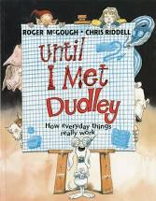

Slide 5
English Text: Until I Met Dudley
Lesson 1: WOW: Read and discuss Before Dudley(see resources). Explain the concept of the book Until I met Dudley : a child comes up with fanciful explanations of how everyday objects work and then Dudley (a dog) explains how they actually work. Look at Dudley Extract 1(see resources). This is from the start of Dudley’s explanation.. Read the first paragraph. Which parts here are instructions? Explain that often we will find writing that mixes instruction and explanation. Read the second paragraph. What examples of informal language do you notice? (e.g. ZZZZZP) What example of technical vocabulary is there and how is it marked? (catch – in bold) What is the effect of mixing these two types of language? Grammar: . Work together to find Explanation Features(see resources) in this short extract, annotating the text to show them Oracy: Partner work: Give reasons for their choices Mighty Write: Children work with their partner to read Dudley Extract 2. They use Explanation Features, annotating the text to show language and organisational features. Vocabulary: Vocabulary associated with explanations | Lesson 2: Intro: Read Before Dudley(see resources. Look closely at the first sentence and try to count the number of events in this one sentence. Map these into the Steps Diagram. Grammar: Look at how the sentence coordinates these five different steps, noticing the use of adverbials (e.g. ‘When you put’); the coordinating conjunction (‘into the toaster and push the handle down’); the commas separating a clause (‘,an alarm goes off underground,’); the present participle (‘alerting’) and the relative clause (‘who spring into action’). Work together to write a similar sentence about opening a door (e.g. When you put the key in the lock and turn it, an alarm goes off in the wall, warning the door fairies who spring into action). Ask children to work with their partner to write a similar sentence (for example: about opening your pencil case). Oracy: Partner work: rehearse and compose sentences orally Mighty Write: Model then chn map on a step diagram and the write a single paragraph explanations of some of the everyday objects from Writing Ideas. Vocabulary: Features: title introduction clear layout bullet points sub heading diagrams illustrations technical vocabulary casual language passive verbs formal connectives formal register closing sentence | Lesson 3: Intro: Watch and discussthe video of FluTag (https://www.youtube.com/watch?v=zehwQueoK3I) Read FluTag Explanation(see resources) Children work in pairs to highlight the punctuation in the writing. Grammar: Use Punctuation PowerPoint, slides 1-4(see resources) to teach the use of semi-colons, colons and dashes to mark independent clauses. Make sure children understand the difference between semi-colons and colons – colons link a clause that expands the first part of the sentence – try replacing the colon with ‘because’. Semi-colons link clauses that are of equal weight. Oracy: Discussion- give reasons for their opinions Mighty Write: Children complete the tasks on Using Semi-Colons, Colons and Dashes 1 or 2. Children write their own two-clause sentences about the Giant Flying Techno Badger design using semi-colons and colons. Vocabulary: competitors criteria according creativity limited ultimately pier value launched rarely original format
Lesson 4: Intro: Read and discuss Terms of Participation 1(see resources). What do you think this piece of text is about? (It explains the rules for Flutag) Discuss how colons and semi-colons are used . Look together at Crazy Competitions (see resources). Children imagine what types of rules these competitions might have. Grammar: Use Punctuation PowerPoint, slides 5 and 6(see resources) to teach the use of colons and semi-colons in lists. Come back to the text and see how this writing has a colon, following an independent clause, introducing a list of items that are separated by semi-colons. Use Punctuation PowerPoint, slides 7-9(see resources) to teach about Bullet Points, explaining that this is a particular way of presenting a list Oracy: Partner work: rehearse and compose sentences orally Mighty Write: Display Beard and Moustache Championship rules(see resources) and model how this can be turned into a list in the same pattern as Terms of Participation. Children choose competitions and write the rules as single sentences using a colon to introduce the list and semi-colons to separate items. Vocabulary: craft maximum pyrotechnics permitted exception dozen deducted duration remove necessary | Lesson 5: Intro: Display Headlines(see resources) and ask children to read it to themselves and then with a partner. Ask if they can find different ways that these headlines can be read, modelling this for them if necessary (e.g. the toe wrestling champion, or a toe-wrestling champion; six year-old children or six-year-old children…) Grammar: Use Punctuation PowerPoint, slide 10 (see resources) to teach how hyphens can be used to avoid ambiguity. Oracy: Read aloud to a partner Mighty Write: Children work individually to add hyphens to the sentences on Hyphens. They compare their answers with their partner, discussing any differences.Search non-fiction books, for examples of hyphens and for examples of punctuation from Day 1 and Day 2 as well. Write and illustrate their own examples of possible ambiguities when hyphens are missing. Vocabulary: examples of hyphenated words | Lesson 6: Intro: Display and read Richard Platt(see resources).Explain that we are going to learn about the process that Richard Platt uses when he writes an information book. Grammar: Use Cohesive Devices PowerPoint, slides 1-8 (see resources)to show the stages that Richard Platt goes through. What do you think he means by ‘divide into chunks’? Why is it important that each double-page spread in the book is about the same subject? Oracy: Give reasons for their judgements Mighty Write: Children work together to read the captions. They cut them out and decide which category to put them. They compare their decisions with another group or pair of children, identifying captions that could be placed in more than one category. Vocabulary: published illustrated shortlist corporate interpretation preserves provides skinning network guardians sacred

Slide 6
English Text: Explanations
Lesson 7: Intro : Read The Water(see resources). Although this is set out like a paragraph and although all the information is to do with the same subject, it does not flow properly yet. Read Green Island Home (see resources). Explain that these are paragraphs that Richard Platt wrote and that they flow much better. They are much more cohesive. Give out one copy of Green Island Home. Discuss cohesive devices in text. Take feedback, using this as an opportunity to check their current understanding. Grammar: Use Cohesive Devices PowerPoint, slides 9-18(see resources) to teach about five cohesive devices. Children use their copies of Green Island Home throughout this presentation. Display Five Cohesive Devices(see resources) as a summary. Oracy: Give reasons for their choices Extended Write: Model how to turn The Water into a cohesive paragraph. Think about changing the order that information is giving, re-structuring sentences, adding sentences and using any of the five cohesive devices. Children use the grouped captions from Day 6 to write cohesive paragraphs. They re-order the information, add new sentences, change sentences and choose from the five cohesive devices. Vocabulary: skinning harbour creek community rich scoop network preserves | Lesson 8: Intro: Play ‘Pass it on’ with a set of illustrated information books. Give each pair of children a book and ask them to choose a page and then to identify the layout devices used on it. They explain these to another pair of children, listen to theirs and then swap their book with them. Keep playing until children have seen at least five sets of books. Grammar: Display slide 6 of Cohesive/Layout Devices PowerPoint (see resources).Compare this early draft with the final version.The layout of a book helps the reader to make sense of the information that it contains.It can suggest the order that the text is read, make links and can make the writing more attractive. Display Layout Devices(see resources) and check children’s understanding of each of the elements. Oracy: Explain the layout devices used in a text Mighty Write: Children work with their partner to decide how to layout the paragraphs from Day 6. They create a table and a bullet-point list to add to their design. They make a rough layout of their design, by creating elements and then cutting and sticking them on to a master page. Vocabulary: title sub heading captions columns diagrams illustrations summarise particular paragraph cohesive devices determiners pronouns conjunctions adverbials ellipses repetition | Lesson 9: Intro: Discuss Headlines(see resources) Discuss these news stories.(see planning) Play Kimberley Walsh and Johnny Ball clips from BBC series Strictly Come Dancing. https://www.youtube.com/watch?v=AlGHLcJenx0 https://www.youtube.com/watch?v=vElnk0ZnX0I Ask children to make brief notes about the performance after watching each. Which did you think was most successful and why? Display and discuss Judges explain their voting – Kimberley Walsh/Johnny Ball (see resources). Pick out Explanation Features(see resources).Discuss the contrast in register and structure to previously examined texts. Discuss the reasons for this. Point out use of dashes. How are they being used here? Grammar: Revise cohesive devices / dashes Oracy: Perform their writing using appropriate intonation, volume and movement. Mighty Write: Allocate children to judge either of the clips distributing Judging Sheets. Children watch clip, write and role-play explanations for their scoring. Vocabulary: precise exuberance anxious efficient pose technique distracting fluidity content posture choreography Crisp passion entertaining transitions posture rhythm
Lesson 10: Intro: Read and annotate What makes Green Vale School Football Team So Successful?(see resources)This is a more formal text than we wrote on Day 9. How is this achieved? Ask children to discuss with partners and then work together to make a class list on the flipchart. What sort of text is the recommendation section? (Instructions). Grammar: Revise imperative verbs with instructions Oracy: Give developed reasons for their opinions Mighty Write: Children choose an explanation topic based on their own interests, explaining why a performance is leading to success/failure. Children plan explanations, developing ideas using research. Children begin first drafts, referring to explanation features displayed. Vocabulary: produce comprising whereas siblings communication informed initial unfavourable unpredictability agility poise conceded | Lesson 11: Intro: Research a current class topic. Chn use research skills to gather information. Plan writing using the design sheet as previous lessons. Grammar: Revise cohesive devices Oracy: Share information with a partner. Extended Write: Plan, write and edit an explanation from their research. Vocabulary: Choose vocabulary linked to their topic. Address any issues from your class marking. Repeat explanation task in future topic – best piece can then be used as evidence for writing moderation

Slide 7


Slide 8
English Text: The Lighthouse (Story with a flashback)
Lesson 1: WOW: Watch film clip (literacy shed) Grammar: Reported/ direct speech NNG Activity 1b.18: Dressing up! Oracy: Hot seating: Views of the coastguard Mighty Write: Short coastguard report on The Night the Bulb Smashed Vocabulary: Hauled Winched Launched aground | Lesson 2: Intro: Read WAGOLL 1 paragraph 1 Grammar: Expanded noun phrases NNG Activity 2.22: Revising noun phrases Oracy: Discuss ideas for figurative language/ Perform their written scene setting in dramatic form Mighty Write: Scene setting of a stormy night at sea Vocabulary: Jagged Stalking Prey Morphed striken | Lesson 3: Intro: Read WAGOLL 1 Grammar: Revision of sentence types/ Use of question in different forms NNG Activity 1c.10: Question this Oracy: Freeze frame parts of the story Mighty Write: Plan retell Vocabulary: Engrossed imprinted Spiralled Ferocious Rickety Frustratingly harmony
Lesson 4: Intro: Read WAGOLL 2/Swipe phrases Grammar: Features of narrative/connectives/punctuation NNG Activity 1b.17: Brackets, dashes, commas Oracy: Summarise the story o a talk partner Extended Write: Write and edit narrative retell Vocabulary: Revise all previous words | Lesson 5: Intro: Film Clip of The Lost Lighthouse Keepers of Eilean Mor Grammar: Bullet points Oracy: Debate about what happened to the men Mighty Write: (S/L) Evidence against the theory that the men were washed away by the sea Vocabulary: Trepidation supernatural eerie aura lured uninhabited superstitions perilously engulfed amiss exposed | Lesson 6: Intro: Watch haunted Lighthouse 4D trailer/Read Haunted House WAGOLL Grammar: Superspag slide Oracy: Mime walking into a haunted house as talk partner reads extract Mighty Write: Description of a haunted lighthouse Vocabulary: Penetrated Aromas Uneasiness Dilapidated Reeked consumed
Lesson 7: Intro: Debate on what may have happened to the men (S/L) Grammar: Debate formal language/Quotations from different formalities NNG Activity 4.26: If I was... /Activity 4.30: Man on the moon Oracy: Debate Mighty Write: Plan narrative story of The Lost Lighthouse Keepers of Eilean Mor Vocabulary: Opinion Opponent Position Raise Respond Claimed Dispute Recap | Lesson 8: Intro: Poem Creating mystery analysis Grammar: Word that can fit both Oracy: Reading their own stories to Year 5 Mighty Write: Write and edit their narrative story- The Lost Lighthouse Keepers Vocabulary: Dwell ail gallant wonder foreboding Ransacked forsaken ill-chance befall

Slide 9
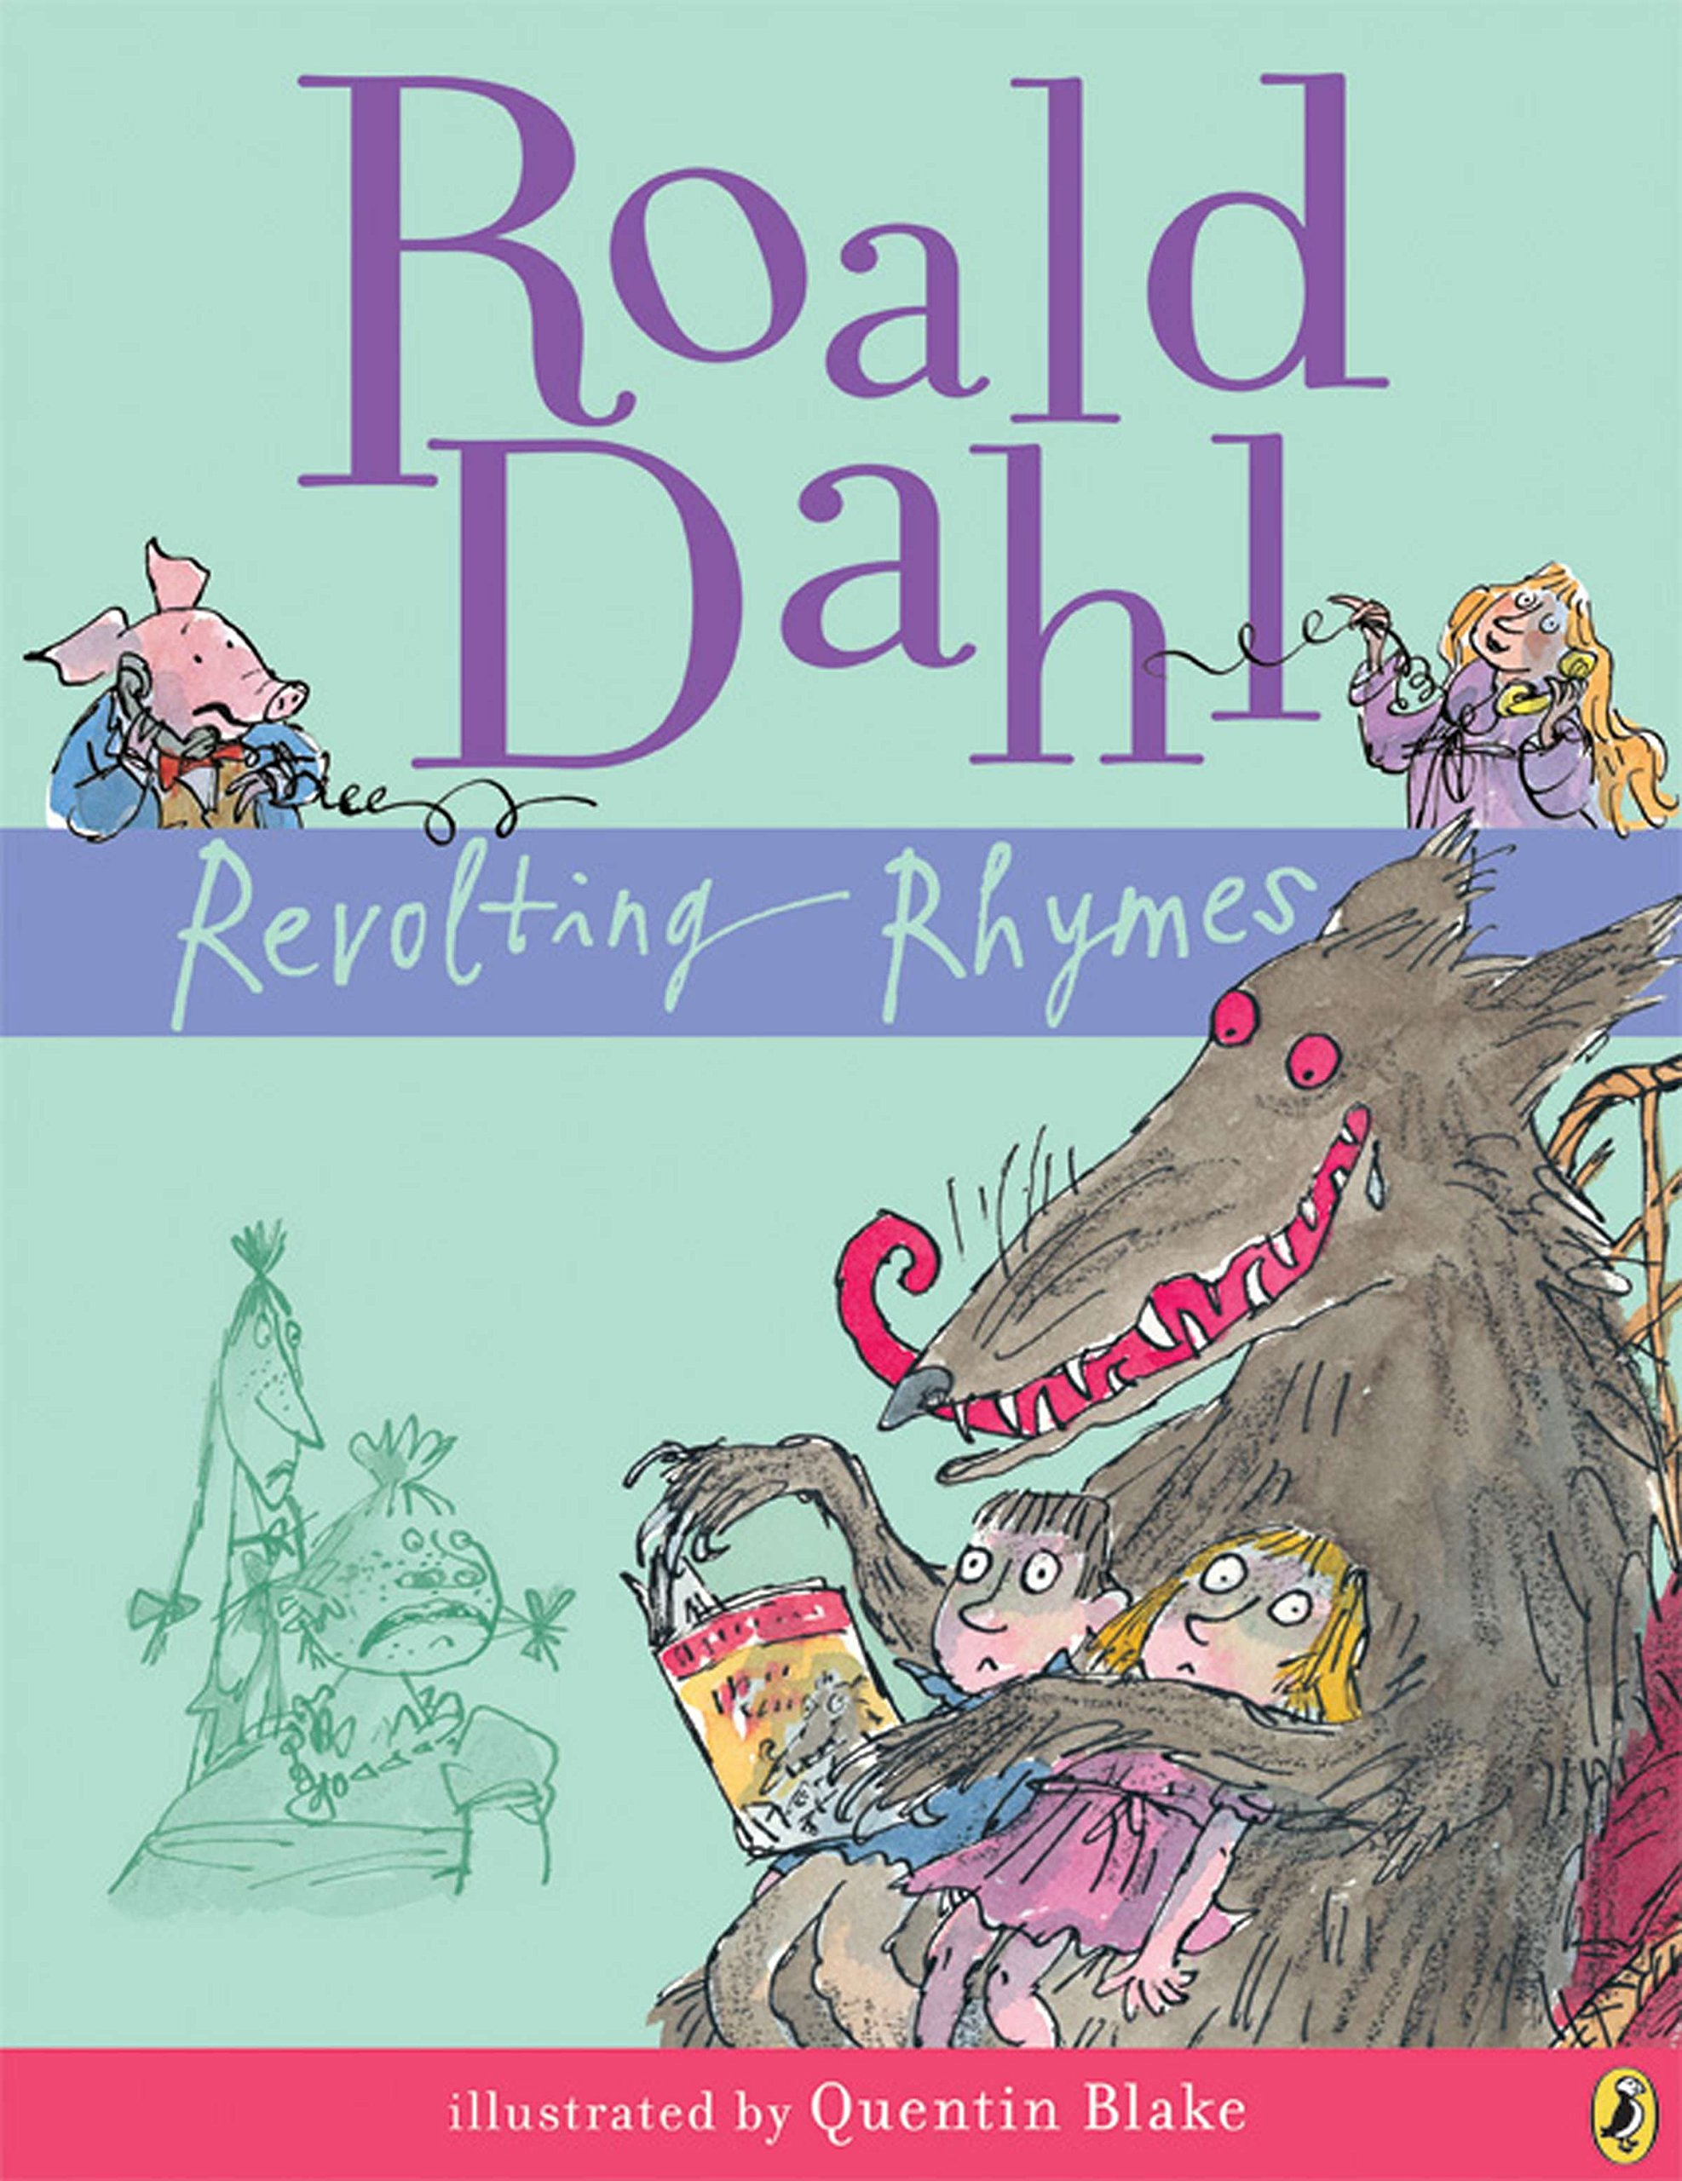

Slide 10
English Text: Performance Poetry
Lesson 1: WOW: Define the terms. ‘performance poem and ‘choral poem’? Can they work out the meaning from other linked words? (chorus, choir) Watch some performance poems (see websites). Ask children if they thought that these were good poems for performance. What sort of features makes a poem good to perform? Start a list for display which you can develop and add to during the unit (see resources for ideas). Read the opening lines of Jack and the Beanstalk ,explaining that it is from the Revolting Rhymes collection by Roald Dahl. Model the performance nature of the poem as you read (expression, intonation, taking on characters, etc.). Grammar: Building Expanded Noun Phrases : PPT slides 1 - 7 Oracy: Discuss and identify features of a poem. Read verse of a poem as a mini performance to their partner. Mighty Write: Write their own expanded noun phrases ( worksheet) Vocabulary: Stanzas Rhythm Rhyme Alliteration Onomatopoeia Repetition Simile Metaphor Narrative | Lesson 2: Intro: Display Poem opening (see resources) and give children reading time. Discuss which story is being told and at which point they were sure. Are some clues more obvious than others? Children read Fuss Fuss Fuss or The Goldilocks Rap and answer Questions A. Grammar: Making Complicated Information Concise : PPT slides 7-11 Oracy: Perform the poem Fuss Fuss Fuss or The Goldilocks Rap Mighty Write: Distribute the Instruction sheet and Sentences (see resources). Children work in pairs to generate information Vocabulary: Revise comparative/ superlative adjectives and the spelling rule : fussy, fussier, fussiest deep, deeper, deepest Slumber forensic justice vindicated sedated | Lesson 3: Intro: Read Goldilocks on CCTV. As a class answer Questions B. Discuss which Goldilocks poem they prefer and why. Grammar: Changing perceptions through expanded noun phrases: PPT slides 12- 14 Oracy: Discuss which Goldilocks poem they would like to perform. Read and watch Michael Rosen’s Tips for Performing Poetry(see resources). Explain that each box has space for children to make notes of tips they think will be useful for them. Play the video at https://www.youtube.com/watch?v=RvV23xoZRkI Assessment opportunity: Chn practise and perform their chosen Goldilocks poem as a choral performance to the class. Mighty Write: Distribute Changing Perceptions (see resources) model how to do this with the first sentence (e.g. The cruel children with axes and hammers, who had already smashed up three homes in the wood, ran to the cottage.). Children choose starter sentences and add expanded noun phrases to change the perception of the characters. Vocabulary: razors merry cackled cheery wicked scheming destruction
Lesson 4: Intro: Read the beginning of The Language of Cat (see resources), emphasising the onomatopoeic words as you say them, and ask children to fold their arms when they hear onomatopoeia. Discuss some of the examples the class spotted and why they think the poet has used them. Emphasise the impact: draws attention to certain words, captures the sound powerfully; enables performers to say words like sound effects; makes it fun to perform and listen to. Chn read the rest of the poem and highlight examples of onomatopoeic . Grammar: Display and share slides 1-6 Grammar Presentation: Subjunctive Form. Distribute activity sheets, Subjunctive Form for Wishes and Hypotheticals (see resources). Children work through sections A-C, which increase in challenge. Oracy: Read The Language of Cat aloud to their partner as a performance. Mighty Write: Write a verse for a poem beginning If I were a cat I ....... Using the subjunctive form and onomatopoeic. Vocabulary: saunter crystal clink exist eager Revise hyphenated words - slow- motion wide-mouthed tight-lipped | Lesson 5: Intro: Read the beginning of Russian Doll (see resources), emphasising the alliteration words as you say them, and ask children to fold their arms when they hear alliteration. Chn read the rest of the poem and highlight examples of alliteration. Grammar: Display and discuss slides 7-10 of the Grammar Presentation. Distribute activity sheets, Subjunctive Form for Requests and Commands (see resources). Children work through sections A-C, which increase in challenge. For C, you may need to put some examples on the board to get the children started. Oracy: Read Russian Doll aloud to their partner as a performance. Mighty Write: Write another verse for a new Russian doll . Vocabulary: Revise hyphenated words - rosy-posy butter-won’t-melt-in-my-mouth-type can’t- be-bothered-sort-of wouldn’t-say-boo-to-a-goosey class-clown-funny-one-of didn’t-do-it-blameless grass-is-always-greener | Lesson 6: Intro: Display and read Gran, Can You Rap?by Jack Ousbey (see resources). Discuss the features that make this a good performance poem. Reread together so that they get the feel of the rhythm. Is there a strong beat? Can we clap along? Discuss why a strong, regular rhythm is important for raps – they are designed to be performed with a fast pace. What would happen to the rhythm if we changed ‘gran’ for ‘grandmother’? Elucidate that the syllables of the words have to fit into the rhythm – if we add a longer word with more syllables, we have to reconfigure the other words in the line to keep the overall number the same. Look at the rhyme scheme (AABBCC). Why do the children think the rhyme pattern is so regular? It propels the poem along, making it easy to say quickly; it makes it more musical like a spoken song (or a rap); it seems more fun/playful. Grammar: Recap subjunctive form Oracy: Assessment opportunity: Practise and perform their poem to class Extended Write: Discuss: What if the poem were about someone else, somewhere else? Introduce today’s activity: change some of the words in Gran, Can You Rap? while maintaining the rhyme and rhyme scheme. Show and discuss the example (see resources) Model starting your own new version. Chn work in pairs to continue the poem or use their own idea. Vocabulary: Revise all

Slide 11
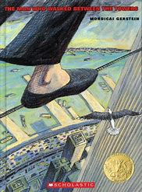

Slide 12
English Text: The Man Who Walked Between The Towers
Lesson 1: WOW: Tightrope walk in hall/ Watch film clip 1 Grammar: Adjectives to describe feelings of exhilaration- ladder task Oracy: Debate whether they think the story is real or imaginary Mighty Write: Paragraph beginning- Standing on the edge of ... Vocabulary: exhilaration pounding joy | Lesson 2: Intro: Watch film clip 2 /Read story/sequence cards /Key questions Grammar: Superspag 1/Question Tags Oracy: Hot seating Mighty Write: Write questions for a hot seating session with Phillip Vocabulary: Imprinted Construction Plummeted | Lesson 3: Intro: Watch The Walk Trailer film clip 3 Grammar: Modal Verbs/Superspag 3/ NNG Activity 3.23 Oracy: Read their persuasive paragraph to a talk partner- would they be persuaded to go to the cinema – why? Mighty Write: Write a persuasive paragraph to advertise the film Vocabulary: Aided recruits betrayal mentor Immense void
Lesson 4: Intro: Watch film clip 4 Grammar: Read Diary Extract/Find Features Oracy: Discuss impact of /own ideas for figuarative language Mighty Write: Short paragraph of figurative language describing the birds, wind, clouds Vocabulary: whirled swayed absolutely ultimate ingeneous apprehensive sanity consumed | Lesson 5: Intro: Watch film clip 4 Extended Write: Plan, write and edit a diary Extract Vocabulary: Revise all | Lesson 6: Intro: Watch Newspaper report- Film Clip 5/Read Report/Find Features Grammar: Different verb tenses/dash to add a clause NNG Activity 4.24: Keep your tenses straight Oracy: Freeze frame The Walk- take parts of friends/ clouds/ public/ birds Mighty Write: Write script for a newsreader Vocabulary: Routine associates enthralled rigged prancing
Lesson 7: Intro: Negative statement stimulus Grammar: Informal/ Formal language Oracy: Conscience Alley :Taking on the role of Phillipe- Should I ask my friends to help me Mighty Write: Introduction to an argument Vocabulary: Debate language | Lesson 8: Intro: Conscience Alley – Should I go ahead with the walk? Grammar: Fronted Adverbials Oracy: Conscience Alley Mighty Write: Writing debate style sentences using fronted adverbials Vocabulary: Fronted adverbials to introduce an opinion | Lesson 9: WOW/Oracy: Courtroom drama – Prosecution and defence of The Walk Extended Write: Plan and write a balanced argument for The Walk Plan and write a balanced argument about a relevant topic (St Helens scheme) Vocabulary: Revise all

Slide 13
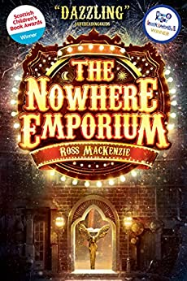

Slide 14
English Text: The Nowhere Emporium: Ross Mackenzie
Lesson 1: Front Cover WOW: Look at and discuss front cover. Find meanings of vocabulary. Watch movie clip. Share write expanded noun phrases Grammar: Revise Expanded Noun Phrases which include relative clauses NNG: Activity 2.24: Expanding nouns (2) Revise what a simile is from Y5. Oracy: Share ideas for descriptive language/ similes Mighty Write: Model write a poetry of phrases using expanded noun phrases which includes a relative clause and a simile. Vocabulary: abuzz hearsay ironmongers jostled intricate Include ambitious language children share | Lesson 2: Prologue Intro: Read the prologue to the chn. On the 2nd read, chn analyse how it appeals to their senses. Brainstorm and complete senses table for working wall. Grammar: Subordinate clauses. Beginning a sentence with an ing verb or simile. NNG:Activity 1b.15: Clause detective Oracy: Share/ describe emotions after listening to prologue Mighty Write: Model/ share write a descriptive paragraph which includes sentences beginning with a main clause/ subordinate clause including an ing and simile starter. Vocabulary: traded theories glimpse shimmered intricate glimmer ripple emerged enchanted entranced spectacle troubled recall | Lesson 3: Chapters 1 Intro: Read chapter 1 . Look at pages 11-14. Find examples of action , dialogue and description which come together in a scene. Begin class sheet (resource sheet 1a/b) analysing Daniel’s character for working wall. Grammar: Revise punctuating direct speech. Look at different examples from the text and annotate for working walls. Oracy: Discuss insights into Daniel’s character Mighty Write: Model/share write 3 sentence structure – action, dialogue, description. Chn write their own independently. Vocabulary: weaving boutique gargoyles wailing jinked infused splendour porcelain talons fixed plucked
Lesson 4: Chapters 2-4 Intro: Read chapters 2-4. Continue Daniel’s character sheet. Share and discuss. How do the children think Daniel would react to this note?.From pages 26,27 identify how the suspense is conveyed. Highlight and annotate –display on working wall. Make a time line of events so far. Grammar: NNG:Activity 4.21: Sentence slots Verb Tenses -Changing passive to active and vice versa. Give chn examples from the text for them to change. Eg: Pg 20- The closed sign was still displayed in the door(P) – The door displayed a closed sign(A) Oracy: Conscience Alley – should Daniel return to the shop? Mighty Write : Use page 26,27 to write their own paragraph using suspense features/ Short diary recount of events so far Vocabulary: illusion gestures bathed retraced furrowed retreated craned trudge ploughed reasonable mere strikingly recollection | Lesson 5: Chapter 5-9 Intro: Display resource 2a. What could the Wonder be called? Ask each child to quickly note down 5 – 10 possible names (ideas). Look at resources 2b and 2c. Discuss what Wonders these could represent (underwater world; life-size game of chess; land of dinosaurs; books which spill real stories/characters/worlds; flying machine; apothecary). Discuss the possible adventures which could be had in each of these Wonders but also what hidden danger could be present in each to challenge Daniel. (e.g. oxygen tank could run out when locked in underwater world and must find key or you must win the chess game to be able to exit or a volcano erupts in the land of dinosaurs). Children can select one of these Wonders or another of their own choice for their writing. Grammar: NNG:Activity 4.22: The passive voice Verb Tenses -Changing passive to active and vice versa. Give chn examples from the text for them to change. Discuss effectiveness of verb tense choice – why is it written mainly in the active form. Oracy: Discuss Ideas for their wonder Mighty Write : Model write/share planning format how Daniel is in danger in their Wonder and how he is able to overcome it and escape. (Resource sheets 2d/2e) Vocabulary: babbling narrowed flourishes entangled intertwining boundaries elaborate manipulate occurrence genius lunatic adjusted illuminated intensified summit wonderstruck spaciuos pleasantries proposition dabbling tendrils commence navigating tantalising accomplish fanned deserted | Lesson 6: Intro: Read resource 3a together. Discuss how Daniel has fallen into the painting which has become animated around him. children to imagine that there is something deeply disturbing about the painting and that Daniel will soon discover it and wish to escape. Decide the danger . Grammar: Children identify which words within this short story opener are actually missed opportunities to convey the danger? (lots of adjectives; some adverbs but also some of the verb choices). Now look at resource 3b together. Challenge children to find alternative vocabulary for all the pink words. Extend children could also look to replace the gold words and phrases. Read again with children’s vocabulary choices and discuss the impact. Oracy: Discuss ideas for danger/ alternative vocabulary Mighty Write: Chn write the first part of their story focussing carefully on word choices which allude to something sinister; warning the reader of the dangers ahead and conveying the magic and spectacle of their ‘Wonder’ Vocabulary: Revise all

Slide 15
English Text: The Way Home For Wolf
Lesson 7 Intro: Look at pages 11-12 and page 165. Chn identify how exciting and tense moments are achieved- use of short sentences, rhetorical questions and ellipses (used for thoughts trailing off or interruption or words intentionally left unspoken). Ideas often not developed; sentences echo the pace of the character’s thoughts; lack of conjunctions etc. Grammar: Past progressive tense – find examples in the text. Change simple past tense in to past progressive and discuss effect. Oracy: Freeze frame pages 11-12 and 165 Mighty Write: Model/share write the second part of the class suspense story. Children write the second part to their story using their planning sheet. Vocabulary: latch emaciated withered enveloped heaved | Lesson 8 Intro: To convey detail in the climax of the story introduce the technique that Ross Mackenzie used - pause time. Look at copies of page 27 and highlight the sentences relating to time slowing and then returning to normal. Identify how Daniel is able to look about and describe the sounds of the car and the face of the driver etc. when time has slowed. Model redraft the first sentence of the third section of the class story – conveying to the reader that time has appeared to slow. Grammar: Past progressive tense – find examples in the text. Change simple past tense in to past progressive and vice versa. Discuss effect. Oracy: Mighty Write: Model/share write the third part of the class suspense story. Children write the third part to their story using their planning sheet. Vocabulary: Revise all | Lesson 9 Intro: Share sections of children’s high quality writing with the class. Identify what makes it high quality. Demonstrate how to up evel some of their work. Grammar: Verb tenses – Give chn a sentence containing simple past tense verb. Use a spider web diagram to change the tense into as many different forms as they can. Oracy: Read aloud to partner – tone, intonation, expression Mighty Write: Chn have a chance to edit and uplevel their work before final assessment. Vocabulary: Revise all

Slide 16
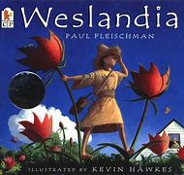

Slide 17
English Text: Weslandia
Lesson 1: WOW: Which garden would you choose? Grammar: Present Progressive tense Oracy: Discuss which garden they prefer and why. Class vote Mighty Write: Description of their perfect garden Vocabulary: Outcast Civilization Fleeing Staple | Lesson 2: Intro: Film Clip Grammar: Past Progressive tense Oracy: Debate- Is this based on a true story? Mighty Write: Synopsis for book Vocabulary: found ploughed blazed Bedlam ancient tradition | Lesson 3: Intro: Interview with Wesley/Hot seating Grammar: All progressive tense Oracy: Hot seating Mighty Write: Interview Question and Answer Vocabulary: Magenta Rind Entrancing Tubers Aromatic Devise Loom myriad
Lesson 4: Intro: Mayor Visit Grammar: Formal language Oracy: Talking all day in a formal tone Extended Write (paired): Persuasive Letter from mayor asking for the garden to be opened as an educational trip (formal) Vocabulary: Scornful Grudgingly Tangy Adopted Innovation Scope blunders | Lesson 5: Intro: Weslandia 20th Anniversary Clip Grammar: Standard English Oracy: Take on role of Wesley as an adult and his mum or dad. Role play a conversation reflecting on his childhood. Extended Write (paired) : Letter from Wesley as an adult- to choice of recipient (informal) Vocabulary: Morale Passable Finale shortage | Lesson 6: Intro: How many fantasy stories have been made into films? Grammar: Direct/Indirect (reported speech Oracy: Group discussion about their own garden Mighty Write (paired): Plan their own utopia garden Vocabulary: Revise all previous words
Lesson 7: Intro: Share plans Grammar: Punctuating direct speech Oracy: Present their utopia garden to the class in a format they choose Extended Write: Write a narrative about their own utopia in the style of Weslandia Vocabulary: Revise all previous words

Slide 18
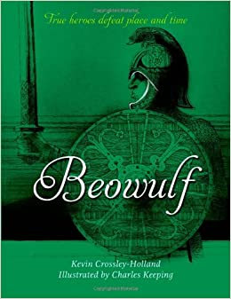

Slide 19
English Text: Beowulf
Lesson 1: WOW: Images of Beowulf Grammar: semicolon to separate phrases in a list/relative/embedded clause Oracy: Discuss character of Beowulf Mighty Write: Rewrite paragraph introducing Beowulf Vocabulary: Slayer Epic Unleashes Brooding Lair Intent Waft ensconced | Lesson 2: Intro: Images of the hall Grammar: Colon or semi colon NNG Activity 1b.16 Oracy: Act out receiving invitation- discuss conflicting emotions- excitement to attend /flattered by invite/ scared of the rumours of a monster Mighty Write: Invitation to a great feast at the hall Vocabulary: Cordially Lavishly Majestic Stirred Succulent Noble bestowing | Lesson 3: Intro: Conscience alley- should Beowuf go? Grammar: convert nouns to adjectives/ verbs NNG 4.28 Oracy: Conscience Alley Mighty Write: Job advertisement for a brave warrior Vocabulary: Appoint Vanquish Formidable combat
Lesson 4: Intro: Interviews for the job/hot seating Grammar: Descriptive phrases NNG 2.24 Oracy: Perform interviews Mighty Write: Create a wanted poster for Grendel Vocabulary: bellowed Sinister Shrithed Stooping snorted Quiver Bristled slobbered | Lesson 5: Intro: Battle scene reading Grammar: Passive verb NNG 4.21/4.22 Oracy: Extended Write: Plan and write a newspaper report on the battle between Beowulf and Grendel Vocabulary: loathsome lurched devoured stench wheeled | Lesson 6: Intro: Read a high quality report from previous day- discuss strengths. Up level sentences from previous day. Give time for editing. Grammar: Verb tenses NNG 4.24/4.27 Oracy: Read their edited report to their talk partner in a reporter style Mighty Write: To create a back story Vocabulary: Banished Loyal vengeance
Lesson 7: Intro : youtube video Grammar: Passive verb NNG 4.23 Oracy: Working in groups act out their report including witness statements Mighty Write: Create their own live news report on the death of Beowulf Vocabulary: Grim-faced stronghold fretting mournful brandished abate fumbled

Slide 20
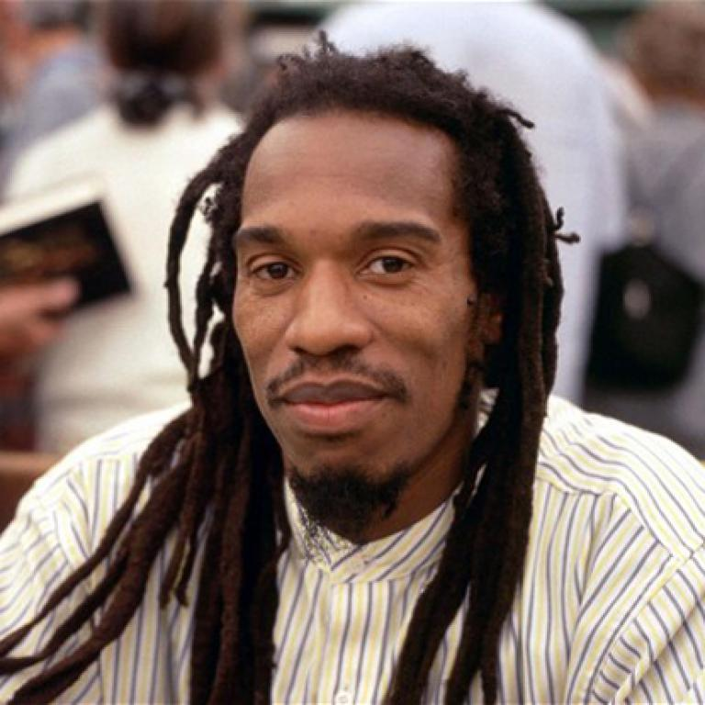
Author Profile – Benjamin Zephaniah
Black Lives Matter

Slide 21
English Text: Black Lives Matter
Lesson 1: WOW: Watch Benjamin Zephaniah read his poem on the One Show. https://www.youtube.com/watch?v=1suwnlmBlao Read the poem Missing Line and to talk about what the repeated missing line could be. Hear children’s ideas and model reading some of the poem with their lines inserted. Notice how the rhythm of the poem and the length of the lines (as well as the poem’s content and meaning) shape what the missing line could be. Which of our ideas fits the poem best? Display or distribute People Need People(see resources). Were any of our ideas close to this? Ask children to read the poem to themselves and then with a partner. What speed works best for the poem? What patterns can you find and emphasise as you read? Are there places to pause? Read the poem through as a class. Grammar: Revise all word classes and find identify in the poems Oracy: With their partner to practise reading the poem aloud. They can read some of the lines in turn and some together. Refer children to Tips for Reading a Poem Aloud as they practise reading aloud. Mighty Write: Answer poetry questions with a partner or in groups. Vocabulary: rely ease appealing | Lesson 2: Intro: Display and read And then they came for me(see resources). Briefly check children’s understanding of communists, socialists, trade unionists, and Jews and explain more if necessary (e.g. people with particular political beliefs and people from a particular community). What point is the poem making? Display Poetry Questions(see resources) and ask children to discuss them with a partner. Hear and discuss children’s ideas. How does this poem compare to the poem from Day 1? (e.g. It too uses a repeated line, but its tone is more sombre.) Challenge children to work with a partner to learn this poem off-by-heart. Hear how they have done by reading the poem aloud, but leaving out key words for children to fill in. How could this poem link to the Black Lives Matter protests? Hear children’s ideas and help them to see that some protestors are motivated by their belief in the importance of speaking out. Explain that today we will be reading more about the protests. Grammar: Revise all word classes and find identify in the poems Oracy: Read poems aloud. Justify opinions Mighty Write: Children work with a partner to read First News 1 and 2. They read and discuss First News Questions and then write their answers in sentences Vocabulary: communist socialist trade unionist | Lesson 3: Intro: Display and read together My Experience by Claire Heuchan(see resources). Ask children to discuss the contents of this article first. How would you summarise the message of this article? What does it make you feel when you read it? What did you notice when we read it this time? Go through the passage and to collect and count up the different types of punctuation that have been used. Grammar: Punctuation PowerPoint(see resources) to revise key types of punctuation. Oracy: Mighty Write: Children work with their partner to read My Experience by Asim Chaudbury.They discuss the contents with their partner: How would you sum up this article? How does reading it make you feel? They complete the Punctuation Collector, finding examples of punctuation and identifying their function in this writing. Write a summary of the article using colons and semi colons in different ways. Vocabulary: local context commuters choreographing gravity-defying commentary elaborate consumed imminent euphoria comply meek crippling
Lesson 4: Intro: Watch Lemn Sissay perform his poem Let There Be Peace. (The poem starts at 1:47, but you may wish to watch the whole video.)https://www.youtube.com/watch?v=kXp8yzY99uw Read Let There be Peace by Lemn Sissay (see resources). Highlight each piece of punctuation and then, referring to the guide, discuss what each is doing. Notice a particular choice that Lemn Sissay has made:Why do you think that the final ‘Let there be peace’ ends with a full stop when the first two had commas?(Maybe to make the words have more weight and emphasis). Grammar: Identify and discuss how a poet has used punctuation. Oracy: Maintain attention and participate actively in collaborative conversations, staying on topic and initiating and responding to Mighty Write: Chn highlight the punctuation and make notes on what each is doing in Rock the Boat. Write their own stanza for Let There Be Peace . Explain why they have included chosen punctuation. Vocabulary: albatross correspondents evaporate reservoirs harsh shoal | Lesson 5: Intro: Listen to song Whitney Huston “The Greatest Love”as chn enter classroom. Listen to and discuss Martin Luther King speech “ I have a dream” Display Good Hope(see resources).Ask children to read the poem in their heads and then read it together out loud. Ask children to talk with their partners about the poem.What do you like about it? is there anything that you dislike? What links can you make to other poems or reading? What patterns can you spot? Hear and discuss children’s ideas. Display MORERAPS(see resources). Which of these poetic devices does this poem use? Check children’s understanding and ask them to annotate copies of the poem to show these and other features. Grammar: Identify poetic techniques: Metaphor Onomatopoeia Rhyme Emotion Repetition Alliteration Personification Simile Oracy: They choose one of the poems and practise reading it aloud. They can refer to the Tips for Reading a Poem Aloud. Extended Write: Write own poem following the same structure as “Good Hope” Vocabulary: | Lesson 6: Intro: Watch and discuss https://www.youtube.com/watch?v=8pjzv7eDE4o (from 6:59) Read and discuss Building Bridges(see resources) Encourage children to speculate about the meaning of the poem, using phrases like: ‘I think Deanna means…’ ‘Maybe she was trying to say…’ Ask children to look at the first letter of each of the lines of the poem. What is spelt out? What is this type of poem called? (An acrostic). Notice together how the lines in this poem break in unusual places in order to make the acrostic pattern. Grammar: Revise all word classes and find identify in the poems Oracy: They read their poem to a partner, then practise reading it aloud. Perform to class – Oracy assessment opportunity Extended Write: Children follow the Writing Brief to write an acrostic poem about racism. Vocabulary: colliding potential diversity inclusivity unifying generosity collaboration galaxies courageous

