Slide 1


SpAG Meeting KS2
March 23rd 2016

Slide 2
Why spelling and grammar?
-Greater rigour in the English curriculum.
- Clear emphasis on the ‘nuts and bolts’ of the English language, particularly grammar and spelling.
- The level of grammar children will be required to master is more challenging than in the previous curriculum.
- Programme of Study includes a long appendix of words children should be able to spell by the end of each year, as well as the spelling rules and guidelines they should be taught.

Slide 3
How is SpAG taught in Melling?
Daily spelling practice through handwriting
SpAG lesson x3 each week-emphasis on fun, interactive activities
SpAG focus during guided reading sessions
Hammer Grammer every fortnight to assess gaps in knowledge

Slide 4
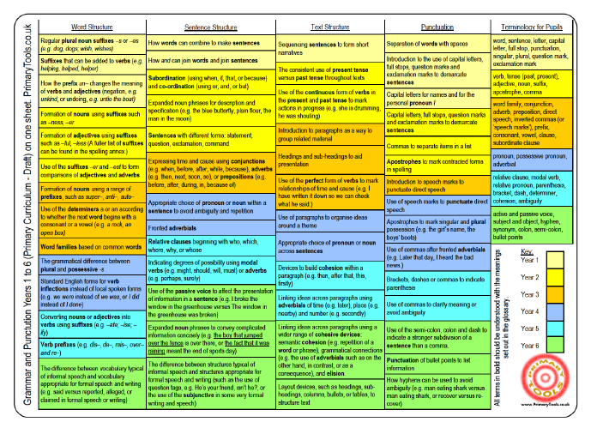

Slide 5
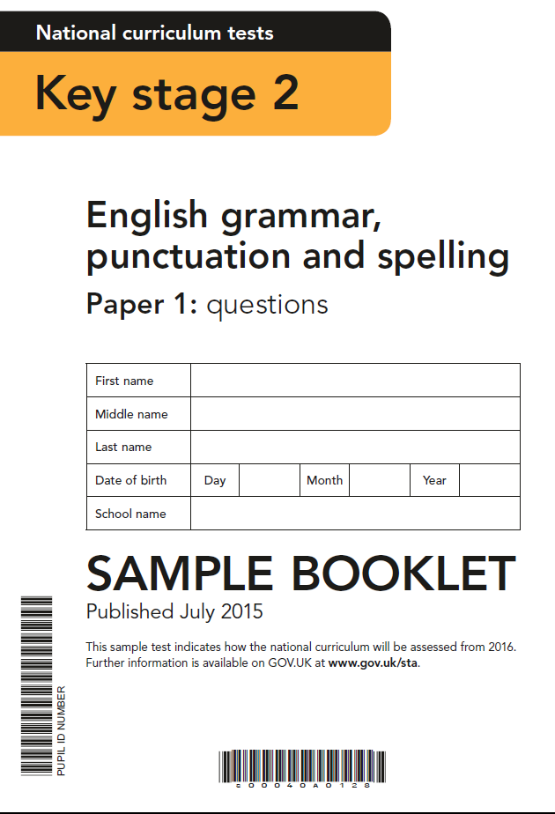

Slide 6
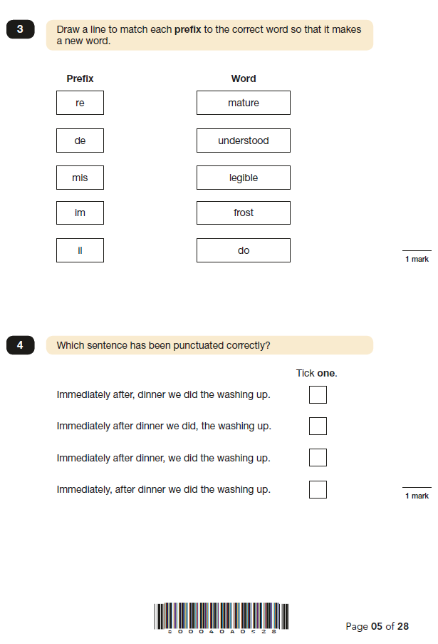

Slide 7
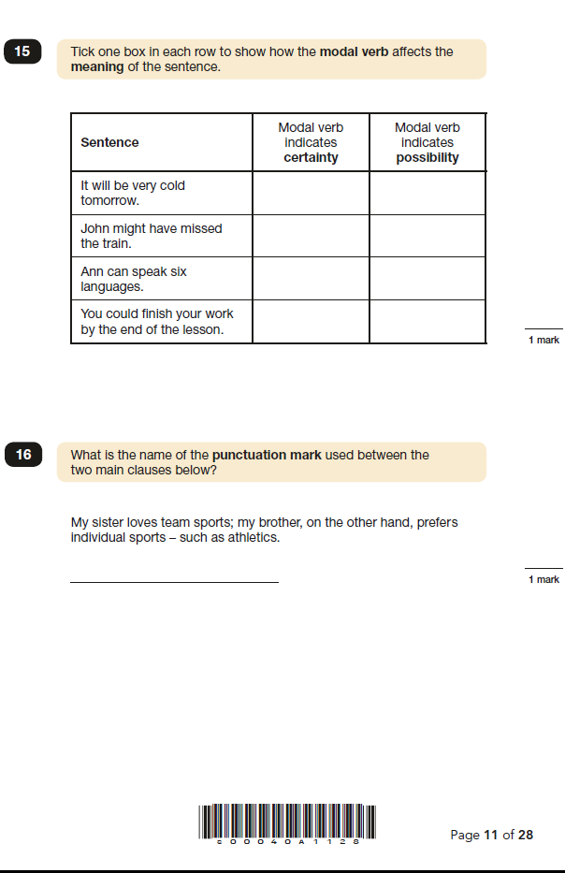

Slide 8
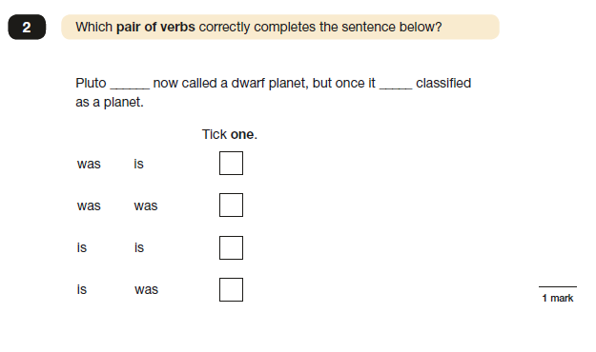

Slide 9
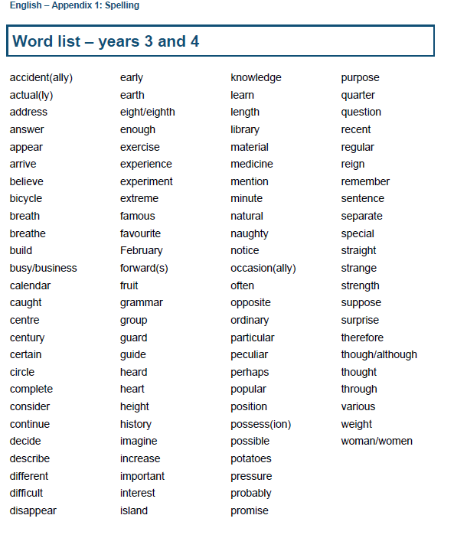

Slide 10
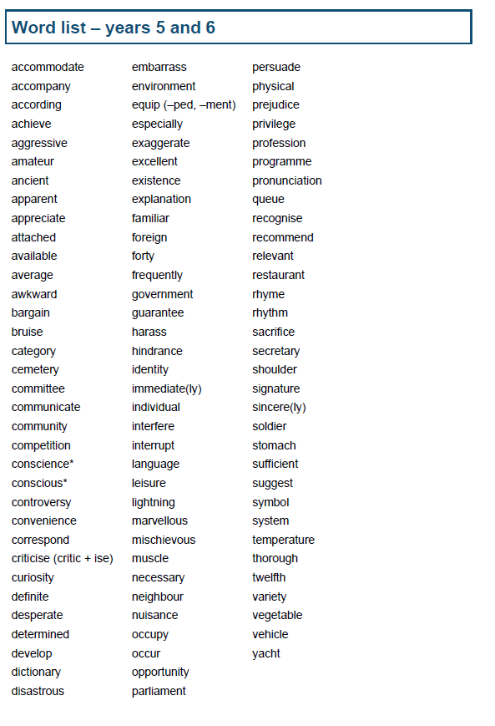

Slide 11
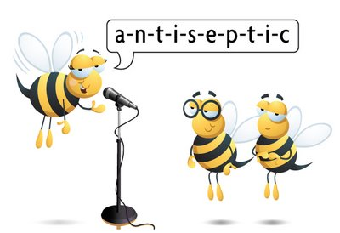
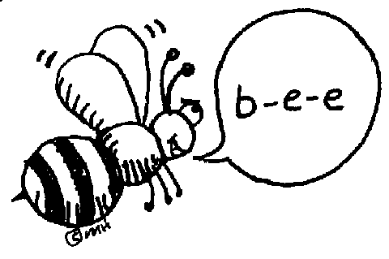
Spelling strategies?
How can we help children learn spellings-and keep them in their long-term memory?

Slide 12
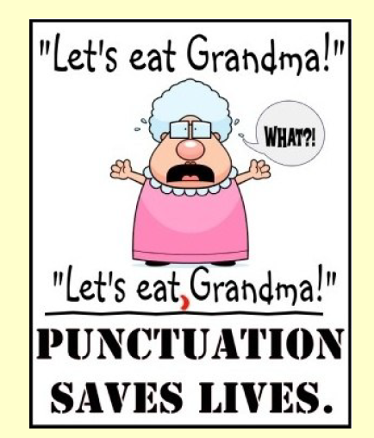

Slide 13
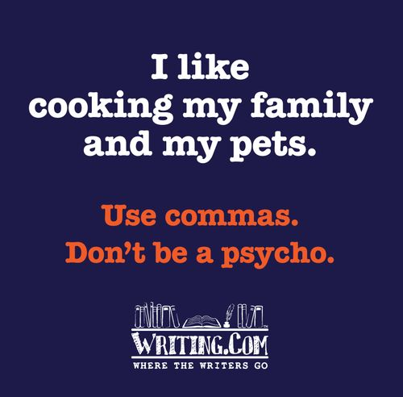

Slide 14


Slide 15
Useful SpAG websites:
http://resources.woodlands-junior.kent.sch.uk/interactive/literacy2.htm
http://www.bbc.co.uk/skillswise/game/en29punc-game-beat-the-clock-apostrophes

