Slide 1
Strong Start to Y2

Slide 2
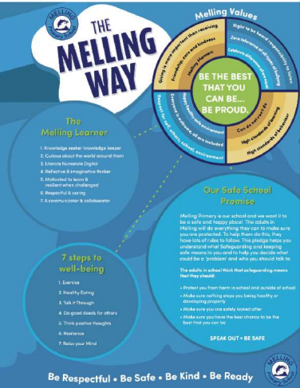
Welcome to Upper Key Stage 1.
Here is all the information you need to know to ensure your child’s start to the new school year is successful.
We are looking forward to welcoming our new class back to a brand-new school year.
The Y2 class email is: y2.melling@schools.sefton.gov.uk
Staff:
Mr Jambors (Monday, Tuesday and Wednesday)
Mr Fawcett (Thursday and Friday)
Mrs Ashton and Mr Pybus (every morning)
Mrs Thomas (every afternoon)
Start 8:55
Break 10:15
Lunch 12:00
Finish 3:05

Slide 3
Start and end of the day
Children should independently be able to walk round through the gate on the playground and into Y2.
After school: staff will call your child’s name and they will come to you as you wait outside of the Y2 door. If you need to speak to staff, please wait on the edge of the field until all children have been seen out safely. Staff will then be able to see you.
Thank you for your patience with this. Hopefully, it will speed up once we all get used to it.

Slide 4
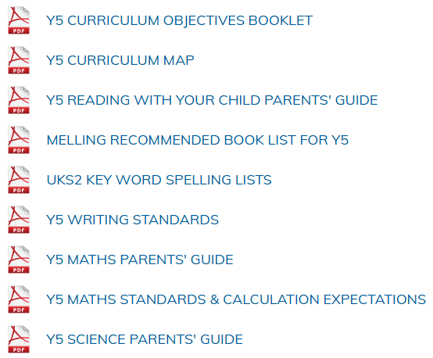
Please see the class page for the following documents detailing information on the curriculum:
Y2
Y2
Y2
Y2
UKS2
Y2
Y2
Y2
Y2

Slide 5
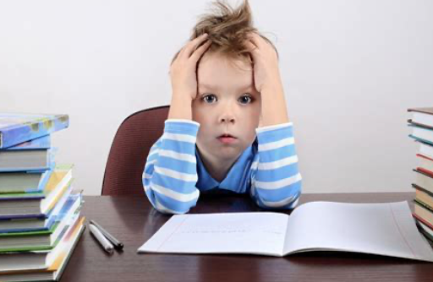
Homework in Y2
Homework book (spellings, maths and English) Handed in every Monday and given out on a Tuesday.
Oxford Owl Reading and phonics. Books will be set for you to read at home and phonics videos will also be set online (school website) to help practise sounds learnt in class.
Numbots / TTRS Online. Logins will be on the front of your child's reading records.

Slide 6
Trips in Y2
Autumn Term:
Imagine that
Spring Term:
World Museum / Walker Art Gallery
Summer Term:
BeWILDerwood

Slide 7
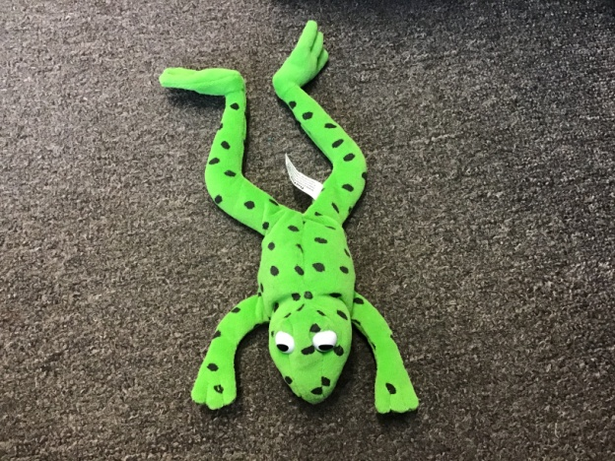
Read, Write, Inc Phonics
We will revisit the current year objectives at the start of every topic.
There will be some fluidity within the curriculum and it will accelerate children if appropriate.
Children may initially move down bands within reading. This is not a reflection on your child, it is to ensure there is a greater focus on comprehension and understanding rather than decoding.

Slide 8
RWI Banding
Children will now be grouped within RWI colour banding scheme.
These groups will be allocated to a specific RWI Reading teacher.
Children will be assessed every half-term and accelerated to a different group within the half-term if needed.
Better differentiation within groups.
More expertise from Teaching staff.

Slide 9
Spelling Spelling test day - Monday
Each week, children will be taught a spelling pattern.
For homework and in class, they will be given a sheet for written practice of 10 words containing this spelling pattern.
It would be useful if you could help your child with learning spellings at home using whichever method they find most helpful to learn. For example, the ‘Look Say Cover Write Check’ method is just one way to learn to spell.
New spellings will be given out on a Tuesday for a test on the following Monday.
Please ensure your child is learning and practising their spellings regularly.
Spelling homework should be returned to school on a Monday.
Spelling results will be sent home to keep you informed of your child’s attainment.

Slide 10

All children will have the opportunity to read a variety of texts during phonics and English lessons.
Individual readers will also be heard and children will have the opportunity to read books of their own choice in class.
If they wish to bring in a book from home to read in class, this is welcomed.
There is an expectation that your child should read at least 3 times a week at home - this will be monitored and rewarded (a prize for every 50 reads and a raffle ticket for a draw at the end of the year).
Please hear your child read, discussing the text and new vocabulary with them; fill in and sign the purple reading record to note their progress and any difficulties they may have.
We recommend a ‘3-read approach’ – 1. decoding 2. fluency 3. understanding
Please ensure reading records are sent into school daily to help us with monitoring.
Children are encouraged to return and change a book on any day.
If children fall behind with reading at home, there will be a discussion with parents/carers to help get them back on track.

Slide 11
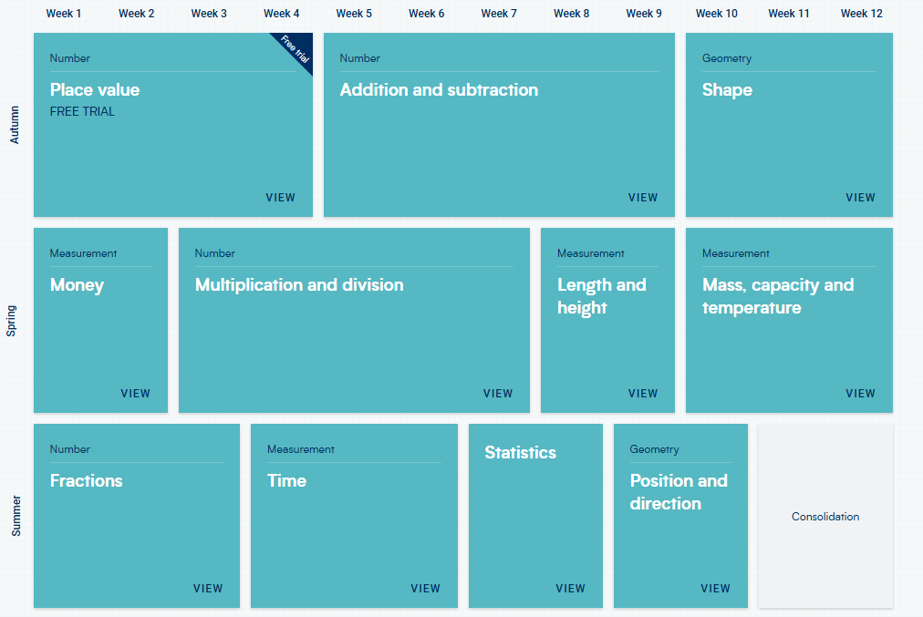

Maths in Y2
We use White Rose in maths and will continue to use the booklets in KS1.
TTRS is introduced: 2,5 and 10
Hit the Button: number bonds to 10
addition up to 10 and 20
subtraction up to 10 and 20
Double and halving up to 15

Slide 12
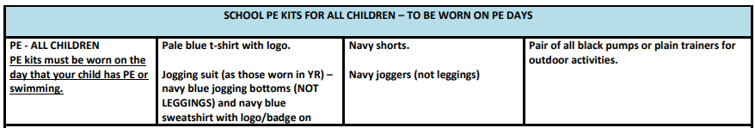
P.E. days - Tuesday and Wednesday
Children should come to school dressed in their P.E. kit on P.E days.
If your child is attending an after school sports club, they are permitted to wear their P.E. kit on that day also.
Alternatively, they can bring a kit to get changed into after school.

Slide 13
Behaviour System
‘BE THE BEST THAT YOU CAN BE…BE PROUD.’
Whole school rewards:
Name in Lights for Melling values: BE READY BE RESPECTFUL BE SAFE BE KIND
Cups – awarded in the weekly Friday assembly at 2:30. You will be invited in if your child wins.
House points – winners announced weekly and a chance to win a prize each half term.
Gold stars – these are collected to earn a badge for your child’s school cap.
Golden text – a very special award from Mrs Ainsworth.
Roar the resilient lion – awarded to the child who shows resilience through the week.
Tiny – Goes home with whoever has impressed most in maths.

Slide 14
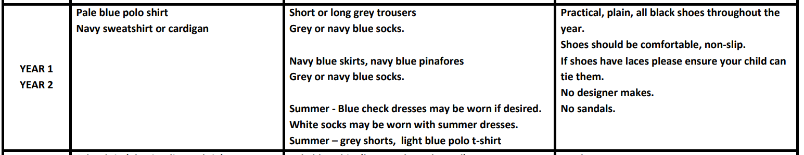
Reminder: Uniform

Slide 15
Reminder: Health and Safety
Children are encouraged to bring a bottle of still water to school to keep them hydrated throughout the day. Children must take their bottles home each day so that they can be washed, refilled and remain clean and fresh.
Snacks for playtime should be healthy choices. Sweets and chewing gum are not permitted.
Children are encouraged to continue to practise good toilet and hand hygiene. Please reinforce the importance of this with your child.
Bags must be the size of a book bag or smaller. No large bags/rucksacks as they are a tripping hazard; cloakrooms and corridors lead to fire exits; there is no space to accommodate large items in these spaces.

Slide 16
Reminder: Health and Safety
Children are not permitted to:
wear jewellery other than small stud earrings
wear nail varnish, false nails, tattoos or make up
wear smartwatches, or watches with games on
bring toys or other personal belongings, including pencil cases – everything the children need will be provided
Hair – shoulder length (boys and girls) must be tied back
Please make sure that your child’s clothing, lunch box and water bottle are clearly labelled with their name.
This facilitates returning lost items.

Slide 17
Reminder: Communication
Absence must be reported to the office on or before the day of absence. Please leave a message on the answering machine. This will be received and noted.
Urgent information, questions or complaints should be communicated to the office.
Share information or news with us at y2.melling@schools.sefton.gov.uk Please remember that this may not be picked up straight away. Replies will only be sent between the hours of 8am and 6pm. You will be contacted by telephone should there be a concern regarding your child.
Check the class webpage, website and app regularly as these are our main sources of communication with you.

Slide 18
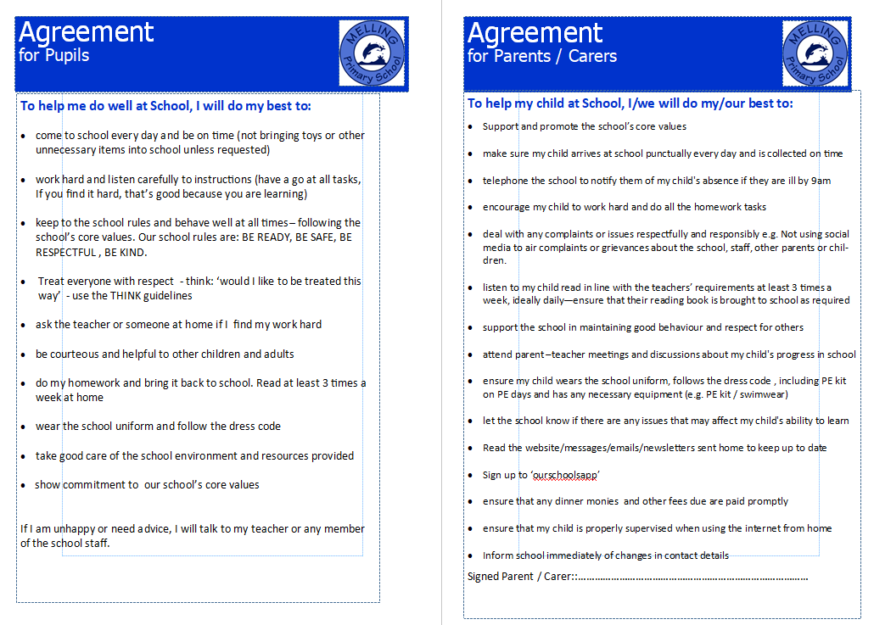
Reminder: Home-School Agreement

Slide 19





Be The Best That You Can Be…Be Proud

Slide 20

THANK YOU FOR SUPPORT
We are really looking forward to working with you all to ensure your children can ‘Be the best that they can be…be proud’

