Slide 1
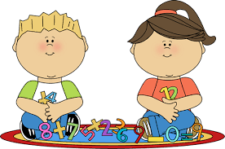
Maths and the new curriculum
MELLING PRIMARY
MATHS INFORMATION EVENING

Slide 2
Principles underlying Curriculum 2014 in maths
Raising attainment and heightening expectations. – benchmarked against age related expectations in other ‘high performing’ nations.
Deeper learning rather than superficial learning
Removal of levels to help this. Children's achievement will be measured as emerging, expected and exceeding end of year expectations.
All children mastering calculation with confidence.
More time on fewer topics.
Focus on Fluency, reasoning and solving problems.

Slide 3
Assessing without levels
Applies to all subjects
Attainment no longer given as a numerical ‘level’ such as Level 2,3 or 4
Attainment measured as…….
EMERGING towards end of year group expectations
At EXPECTED year group expectations
EXCEEDING end of year group expectations

Slide 4

New Maths Curriculum Expectations
What does your child need to know by the end of each year group?

Slide 5
A ‘Mastery’ Curriculum
Based on three strands, which should underpin all mathematics…
FLUENCY: in the fundamentals of mathematics, through varied and frequent practise with increasingly complex concepts over time;
REASONING: conjecturing relationships and generalisations; developing an argument, justification or proof using mathematical language;
PROBLEM SOLVING: applying their mathematics to a range of problems with increasing sophistication.

Slide 6
Fewer Things; Greater Depth
The new curriculum has been designed to ensure that teachers spend more time on fewer topics;
This should mean that ‘deep learning’ rather than ‘superficial learning’ takes place;
Children’s learning will be extended in depth within their own year group’s expectations rather than moving onto another year’s expectations;
Children need to achieve all their year group’s objectives in order to be at ‘expected’ level.

Slide 7
Number and calculation
(KS 1/2 Sample arithmetic paper)
FLUENCY
REASONING
PROBLEM SOLVING

Slide 8
ADDITION
SUBTRACTION
MULTIPLICATION
DIVISION

Slide 9
Number and mental maths
FLUENCY
REASONING
PROBLEM SOLVING

Slide 10
Mental Maths – being fluent and comfortable with numbers
Counting
Quick recall
Place value
Mental strategies

Slide 11
Reasoning and problem solving
What else do I know?
Finding all possibilities
Odd one out
Missing numbers

Slide 12
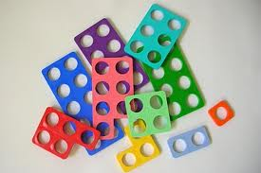
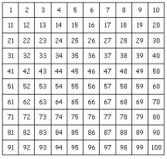
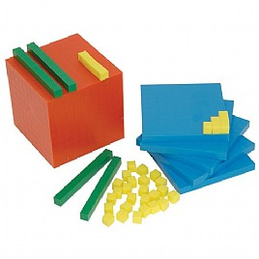

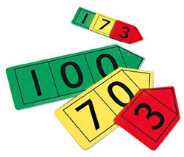
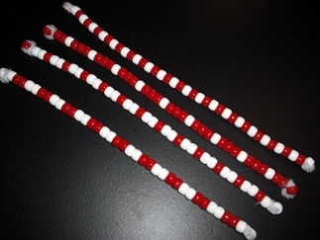
Resources
Number line
Numicon
Counters
100 square
Dienes
Interactive computer resources
Place value cards
Beadstrings

Slide 13
Thank you for coming and your continued support.
ANY QUESTIONS?
PLEASE MAKE SURE YOU TAKE AWAY YOUR PACK TO SUPPORT YOUR CHILDREN.

