Slide 1
YR Parent Information
September 2024
A huge welcome to YR. Please find attached information about YR routines, phonics, reading and maths.
The Melling Way Poster
Behaviour system

Slide 2
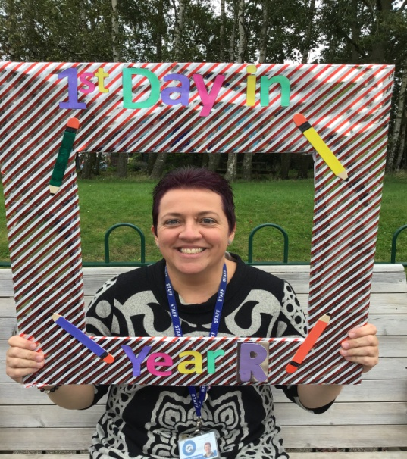
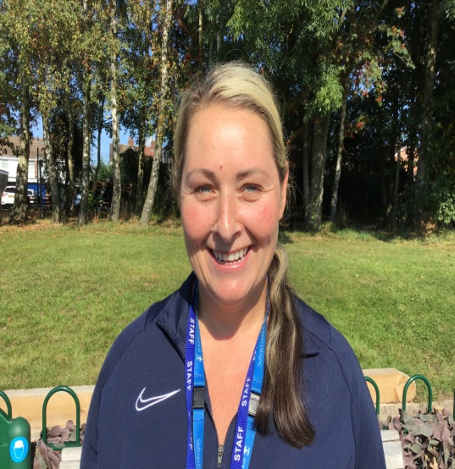
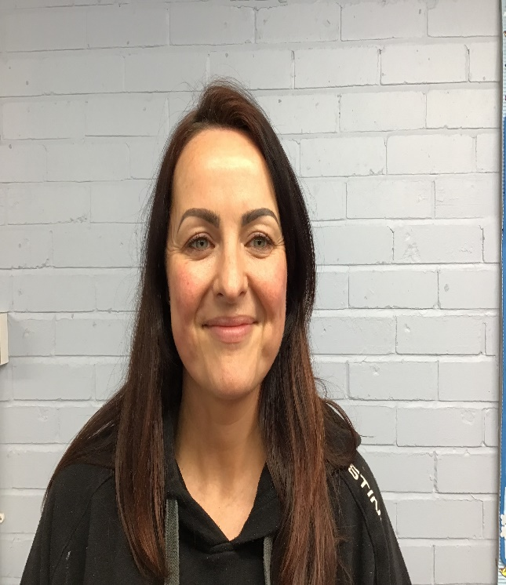
Staff in YR
Mrs Hargreaves
EYFS Lead/ Teacher
Mrs Madden
YR TA
Miss McGurk
YR TA

Slide 3
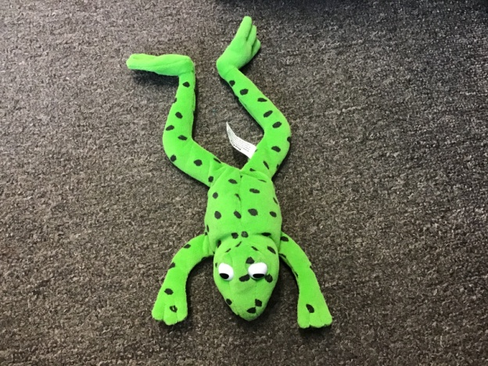
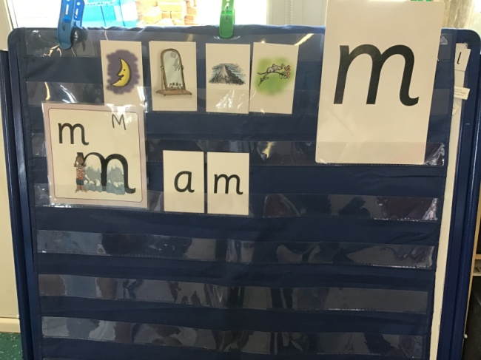
Read, Write, Inc Phonics
This is Fred. He helps us learn our new sounds and shows us how to read and spell words using Fred Talk (sounding out) and Fred Fingers (segmenting words). If you go on You Tube there are lots of examples of RWI sessions and how we say each of the sounds.
Every YR child will be set phonics homework/ practise on see saw. This will consist of portal videos of the speed sound sessions taught in class for you to practise with your child at home.

Slide 4
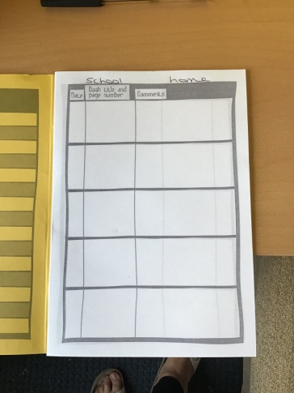
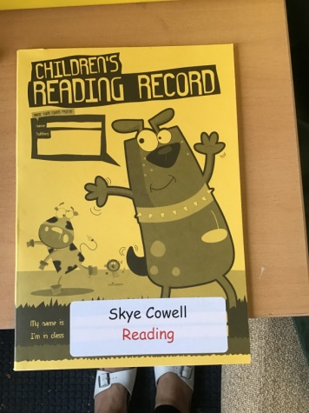
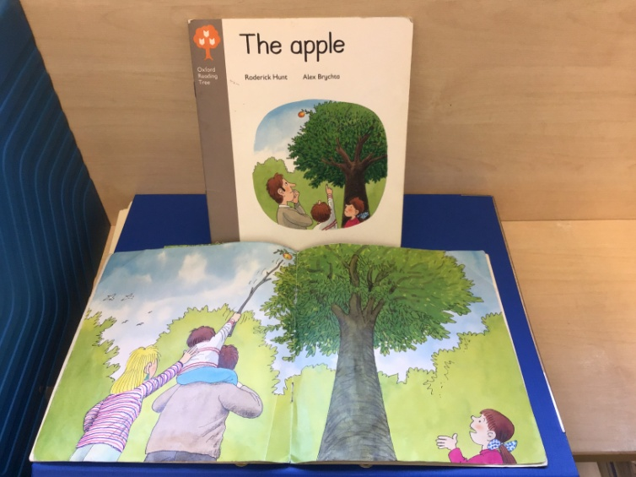
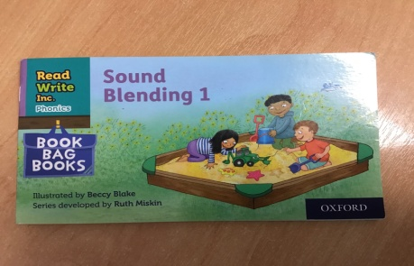
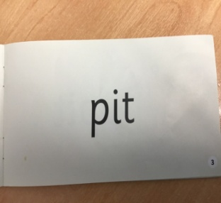
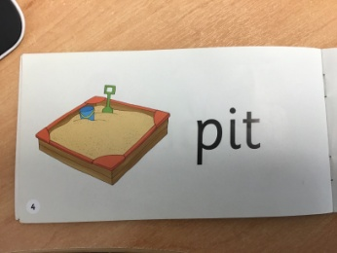
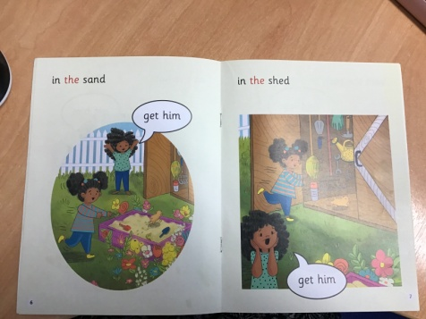
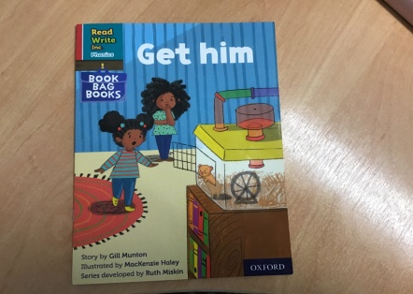
Reading Books
Once your child knows all set 1 sounds and can orally blend sounds to make words they will be put on the school reading scheme. Children will bring home discussion books first to understand the importance of using the pictures to retell the story. They will then bring home sound blending books where they need to blend sounds to read simple words. Finally they will read books with words they are able to sound out and some tricky, high frequency words. (3 read approach)
Please hear your child read every night and sign the book so we know they have read. Please send to school every day. (Reading Reward) (Bedtime stories)

Slide 5
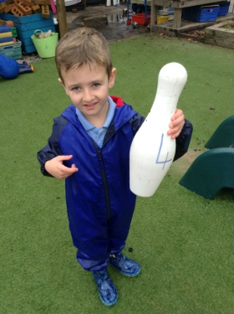
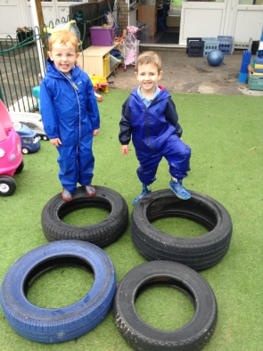
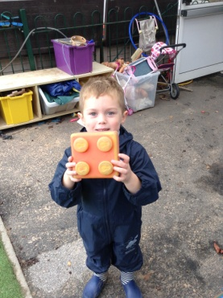
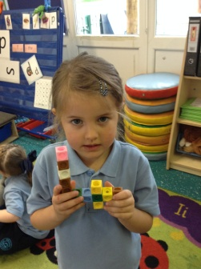
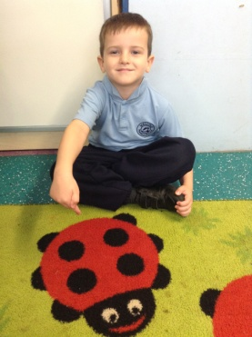
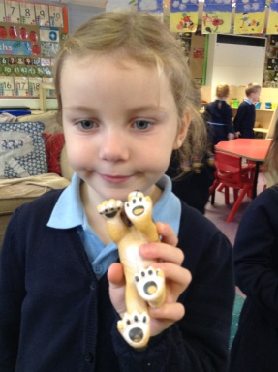
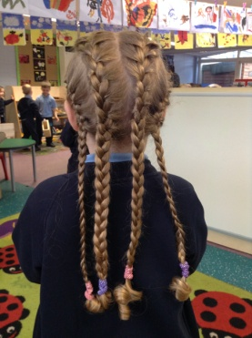
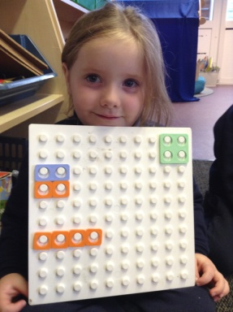
Maths in YR
We found and made lots of things that represented 4.
Number 4 was our number of the week.
YR follow the early maths fluency programme, NCETM maths and White Rose maths. We watch Number Blocks and understand where our number of the week comes within the number system. When learning about number 4 for example we would look at:
Where number 4 belongs on the number line
What is 1 more and 1 less than 4
How to make 4p using different coins
Different ways we can make 4 e.g 3+1 or 2+2 or 4 lots of 1
Who is fourth in the line
What number 4s can look like
Shapes with 4 sides.
4 o’clock and what happens at this time…… and much much more!!

Slide 6
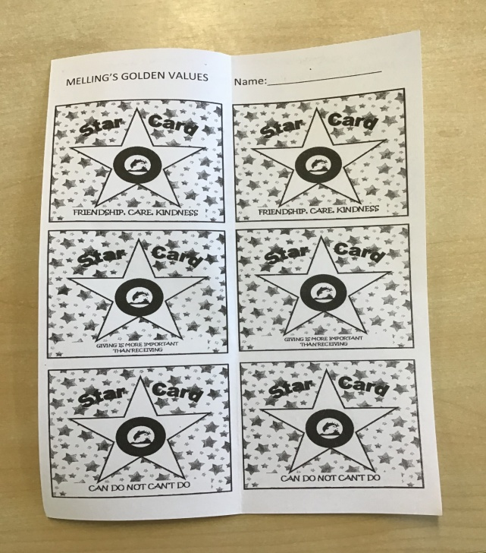
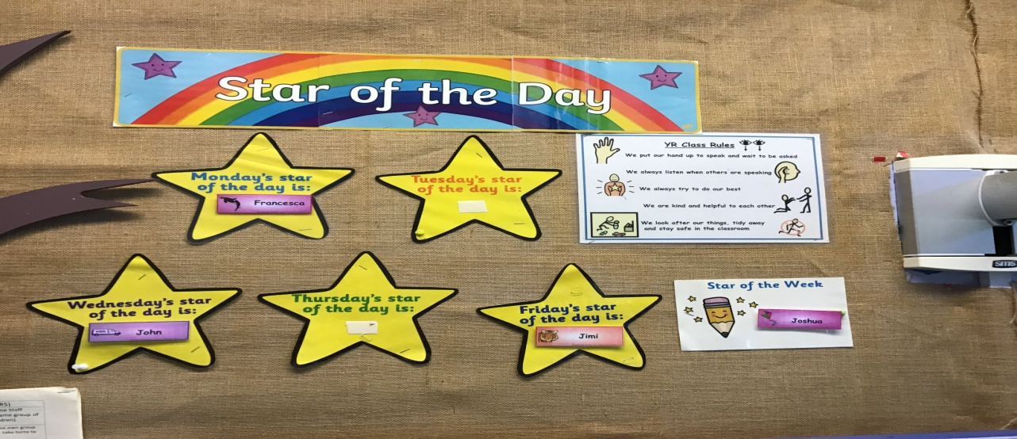
YR Rewards
Children in YR are rewarded daily with positive praise and encouragement and are supported to always be the best that they can be. They will receive stickers for doing their best and will get a coloured token for their coloured team. They may also be rewarded in the following ways:
Star of the day/ Star of the Week. Two children are chosen every day to be Star of the Day and one child will be chosen on a Friday to be Star of the Week. They will come home with a star of the day/week sticker and will get a treat from the treat tin in class. Children who get Star of the Week will bring Scruffy the dog home for the weekend. Please take some photos and sent them to the YR class email to show what Scruffy has done over the weekend with your child.
Star Cards/Gold Stars. Children will get gold stars when they consistently demonstrate our school values of Melling Manners, Friendship care and kindness, high standards of learning, high standards of behaviour, can do not can’t do and giving is more important than receiving. When children have 10 stars on their card they receive a badge in our caps assembly to put on their school cap (these are kept in school). Golden text.
Name in Lights. Children will get their name displayed on their class ‘Name in Lights’ display for demonstrating our behaviour values of ‘Be Ready’, ‘Be Respectful’, ‘Be Safe’, ‘Be Kind’.
Roar. Roar is our class lion who is awarded to a child every Friday for showing resilience. Roar will come home with your child for the weekend. Please send photos to the YR email of your child showing resilience at home.

Slide 7
CUPS
Courtesy Cup/ Cullen Cup/ Apter Cup/Gem of a Reader. Every few weeks one child from YR will be chosen to receive one of our school cups. The Courtesy Cup is for lovely manners and being respectful, the Cullen Cup is for hard work and the Apter Cup is for being a good friend and never giving up. The Gem of a reader is for children who show a love for reading. Your child will be presented with the cup in assembly(the cup stays in class) and will bring a school medal home (to keep). We will inform you when your child is receiving a cup so you can come to the assembly (Friday 2.30pm). Please keep this a secret as we like it to be a surprise for the children. A photo of your child with the cup will be put on the class page of the website on the Friday evening.

Slide 8
Homework in YR
See Saw. All home learning for YR will be set on the see saw app (logins). This may include:
Education City. This will usually consist of phonics and maths activities to reinforce learning in school. There may also be some topic based activities.
Home Learning Challenges. Topic based and practical activities will be put on the see-saw app when needed eg going on a woodland walk, making a family tree etc.
Oxford Owl Reading and phonics. Books will be set for you to read at home and phonics videos will also be sent to help practise sounds learnt in class.

Slide 9
Start and end of the day
Please continue to bring children onto the playground before school and encourage them to walk in by themselves (with all of their own bags)
After school: staff will call your child’s name and you need to come forward and collect them from the YR door. If you need to speak to staff, please wait on the edge of the field or back on the playground until all children have been seen out safely. Staff will then be able to see you.
Thank you for your patience with this. Hopefully, it will speed up once we all get used to it.

Slide 10
YR Reminders
The YR class email is yr.melling@schools.sefton.gov.uk You can leave messages for YR staff but the emails may not be replied to immediately. The YR email will be checked before and after school.
Class web page. Please keep checking the YR class page for letters, updates and photos.
Names in clothes and on anything the child brings to school eg water bottle, shoes.
Wellies and waterproofs. Please ensure you have sent waterproofs and wellies to school with your child as they will need these for messy, outdoor activities and forest school sessions. £1 donation every Monday.
PE bags. Children need a PE bag to keep their waterproof clothes in. They will do PE in their YR uniform (joggers or shorts).
Please make sure your child has black velcro trainers…No shoes or trainers with laces please.
Please put sun cream on your children before school if the weather is hot and send caps to school. (hats, gloves and scarves in winter please)
Absence reporting - on the day/ direct to office/ answer phone (appointments to be given to school office)
No jewellery, nail varnish or tattoos are allowed in school.

Slide 11
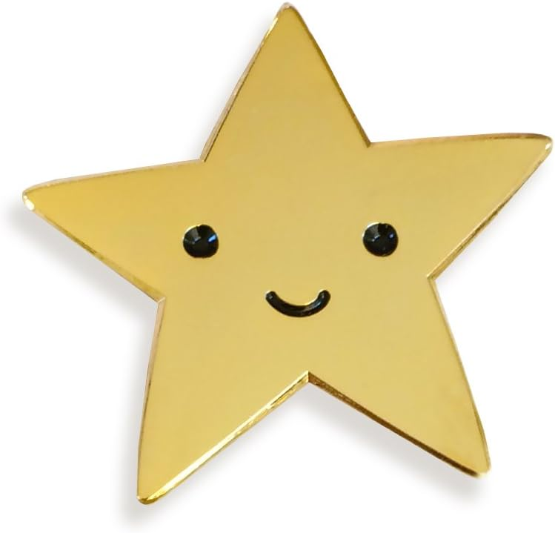
THANK YOU FOR COMING
Any questions?
We are really looking forward to working with you all to ensure your children can ‘Be the best that they can be…be proud’

