Slide 1
CHET 2026-2027
The holiday is planned so the children...
Have fun!
Enjoy spending time with their friends
Become more independent
Try new activities
Challenge themselves
Staffing: Mr Jambors, Miss Riley, Mrs Taylor and a member of SLT (evenings)
All instructors have DBS clearance and are highly qualified and are first aid trained.

Slide 2
DAY 1
Arrive in school at normal time with luggage and a backpack.
Luggage in the storyteller campsite and bring backpack into class.
Cases will be taken to CHET.
We leave school after lunch and walk to Kirkby station. We will then take the train to Crosby (changing at Sandhills) and walk to Chet Residential Centre.
Each child will need a plastic drinks container and a rucksack for the activities.
No technology is to be brought along with the children.
A teddy/soft toy/ puzzle book/ reading book to be packed in their luggage.

Slide 3
Medicines
All medicines are to be labelled clearly with the child’s name and required dosage and handed to Mr Jambors/ Miss Riley/ Mrs Taylor on the morning of the trip.
The exception being inhalers, which the children will keep with them and to be packed in their backpack.
All medication will be given and overseen by 2 members of staff : Mr Jambors & Miss Riley ……
Calpol will also be provided by school (for emergencies)
Cosmetics are not needed - only washing toiletries

Slide 4
Activities
The children will be taking part in a range of outdoor and adventurous activities. These are subject to change depending on the weather conditions and availability. Safety is always paramount.
The class will mostly stay as a class for the activities. There will be an instructor and at least one member of Melling staff with a group if the class is split for an activity.

Slide 5
Time | Wednesday | Time | Thursday | Time | Friday
 |  | 9:15 | ½ CLIMBING ½ ARCHERY SWAP AS ABOVE | 9:15 | PACK/ STRIP BEDS/ BAGS OUT OF ROOMS LOW ROPES COURSE NIGHT LINE SHOP
12.30 | LUNCH IN SCHOOL | 12:30 | LUNCH | 12:30 | LUNCH
2.30/3 | ARRIVE INTRODUCTION UNPACK/MAKE BEDS | 13:30 | SHELTER BUILDING & CAMP FIRE PIZZA MAKING | 13:30 14:00 | PRESENTATION CHILDREN TO BE PICKED UP BY PARENT/CARER
17:30 | DINNER | 17:30 | DINNER
18:30 | CURLING | 18:30 | INDOOR GAMES

Slide 6
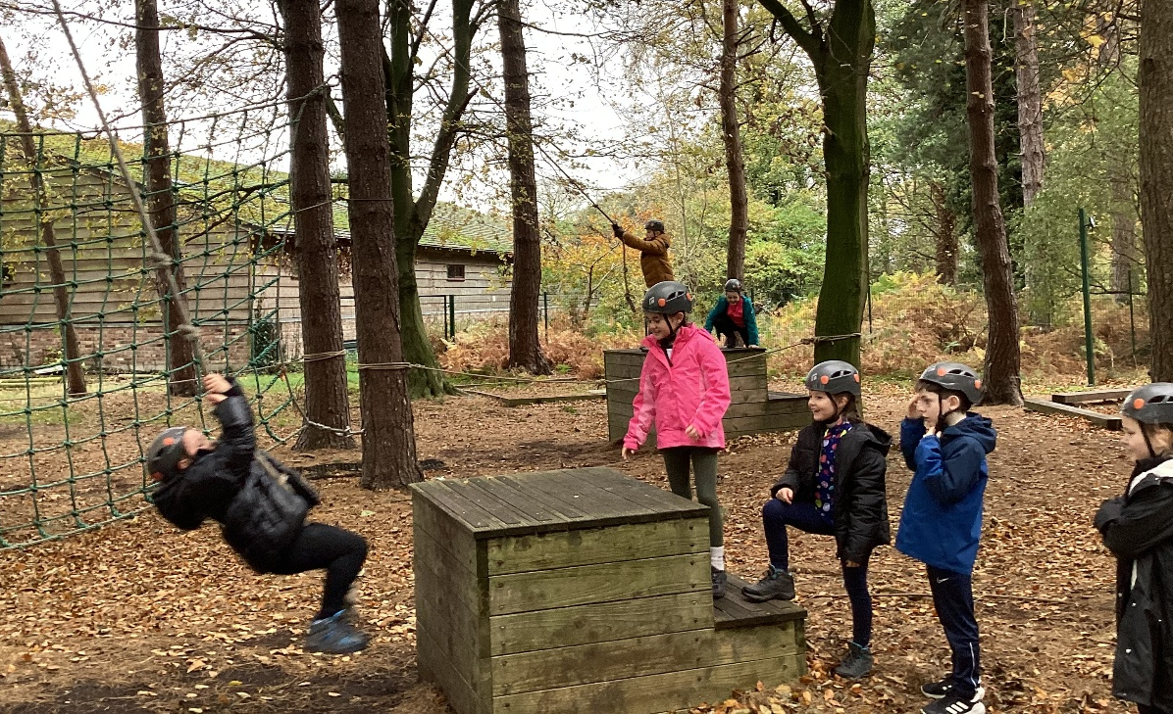
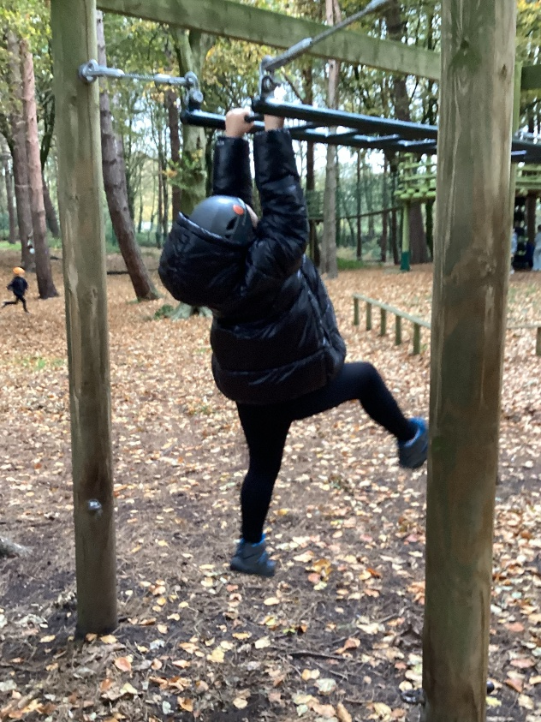
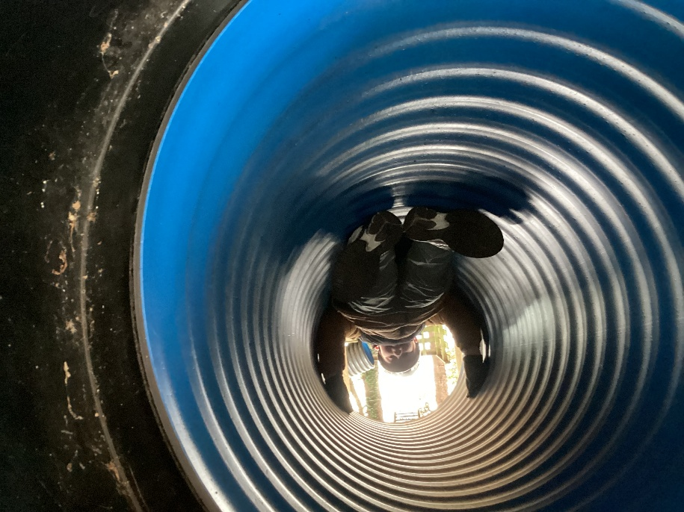
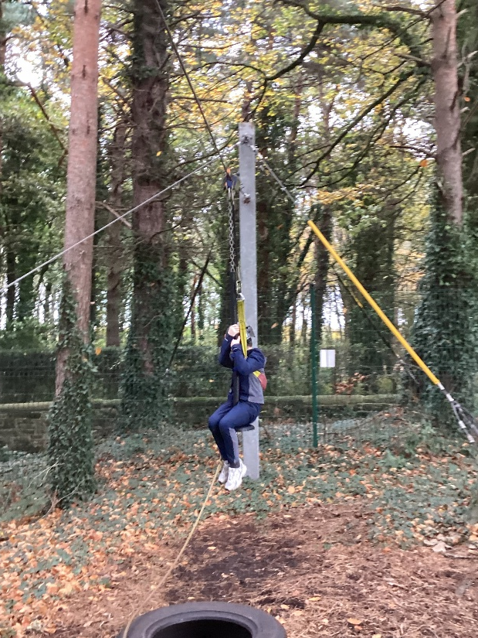

Slide 7
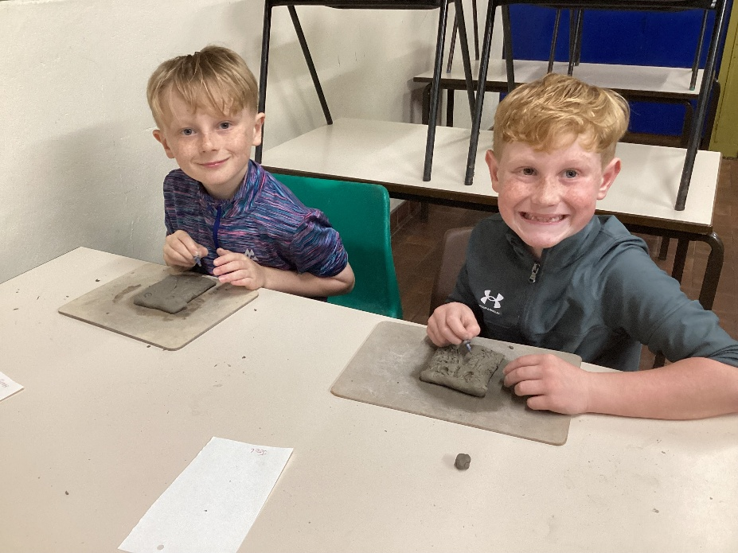
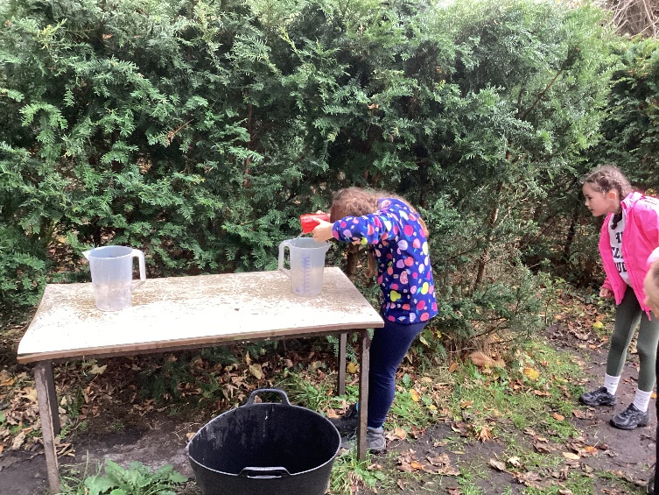
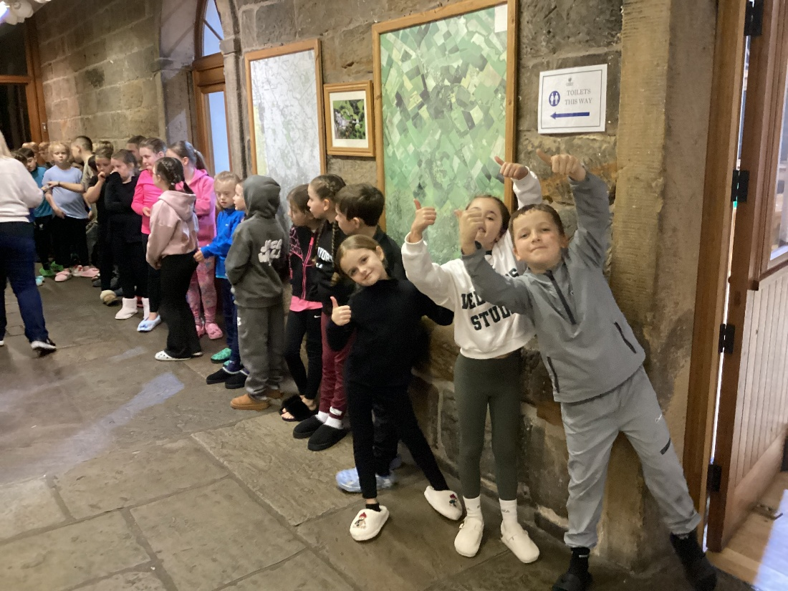
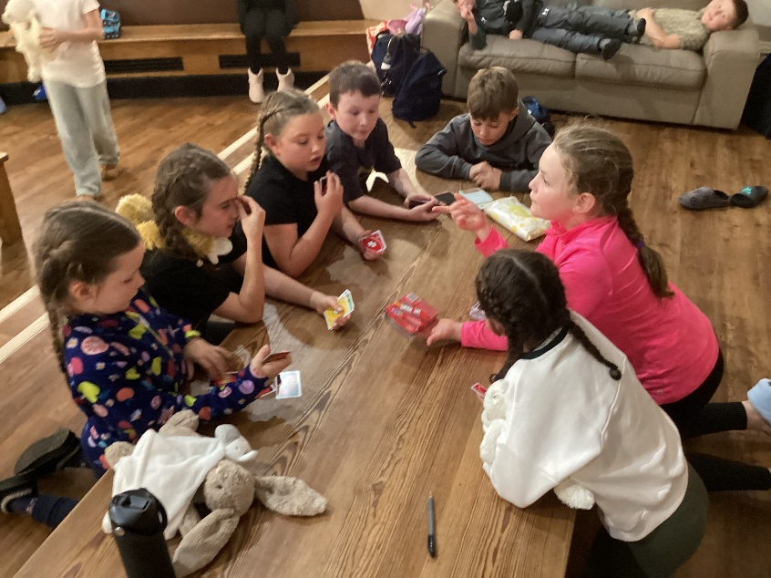

Slide 8
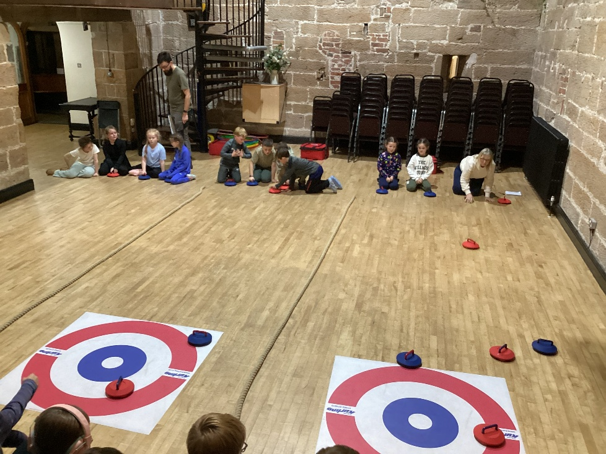
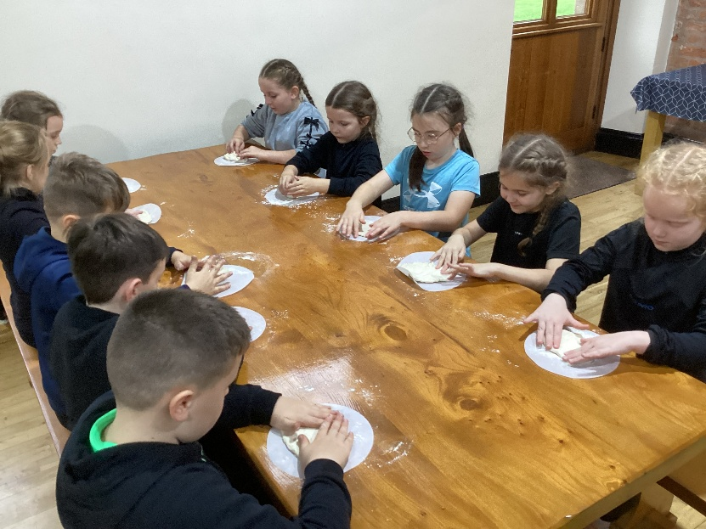
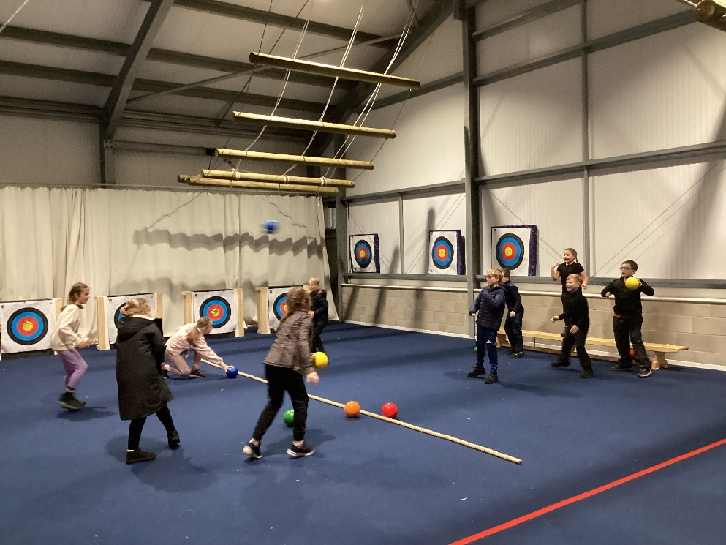
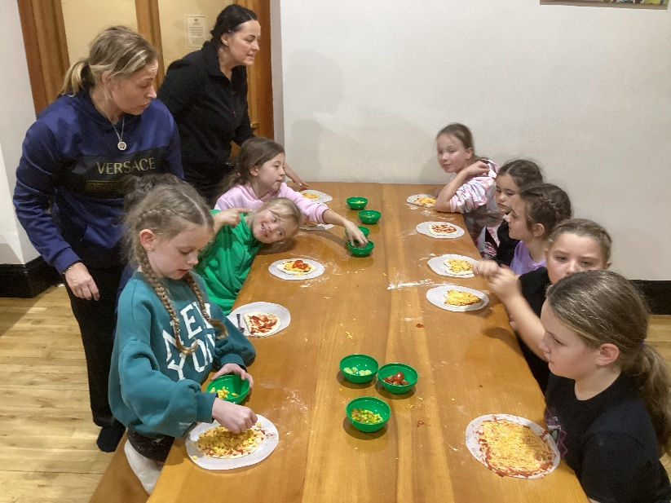

Slide 9
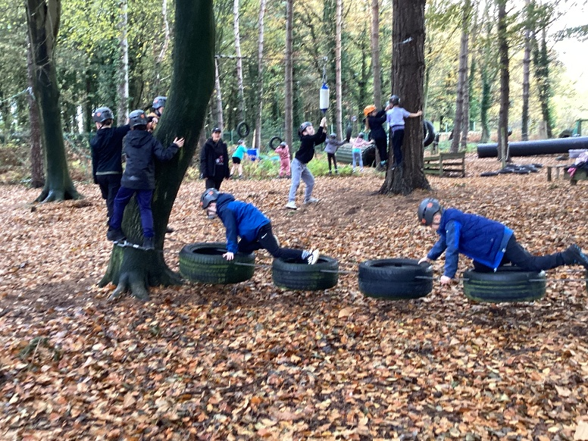
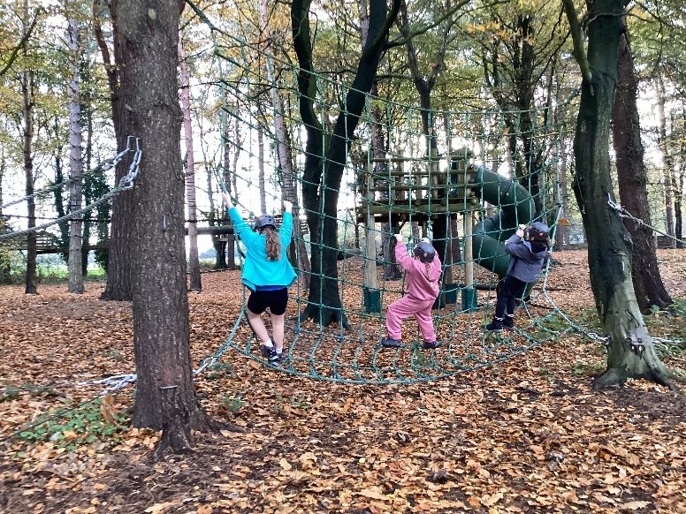
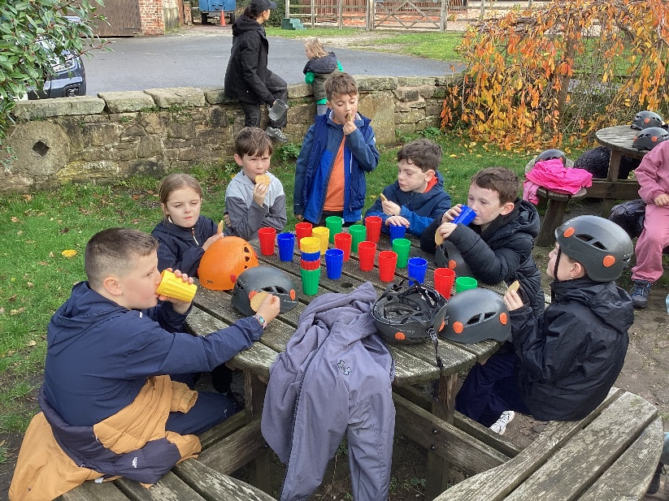
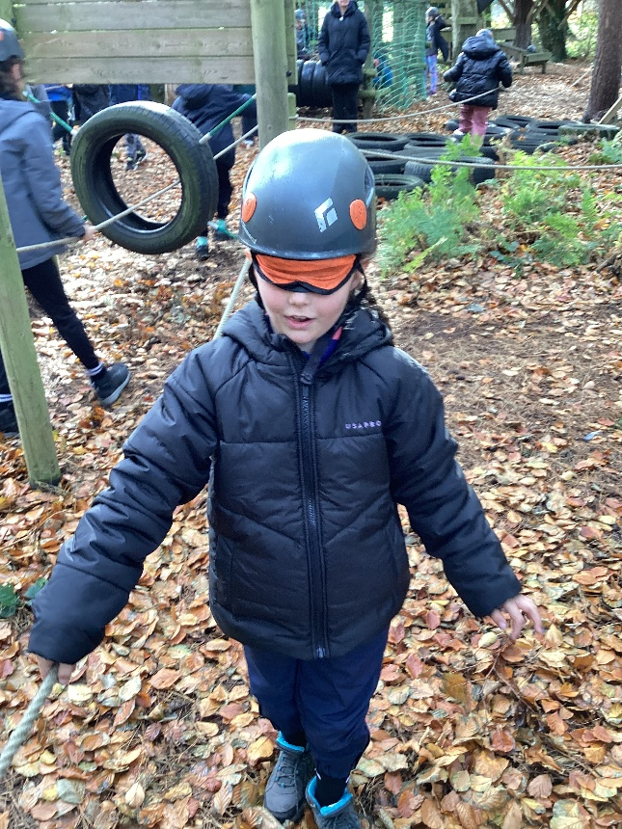
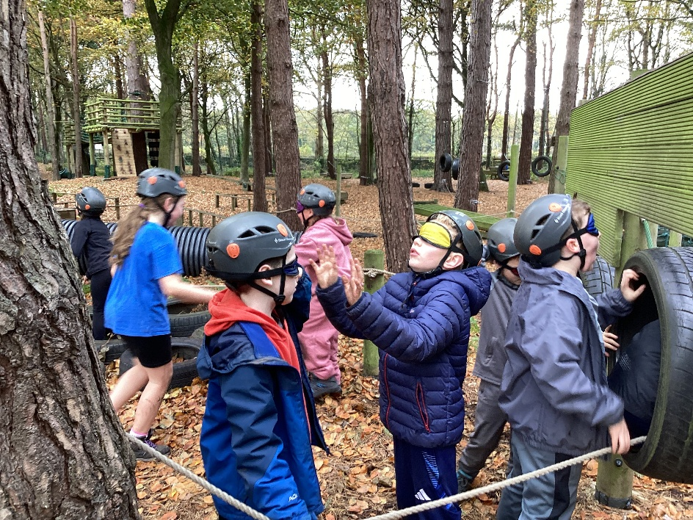

Slide 10
What to pack…
-Warm waterproof jacket
-Nylon tracksuit bottoms are best as they are easy to dry (rather than jersey or fleece)
-Two pairs of trainers are recommended (one will get wet and dirty so an old pair would be preferable)
-A small rucksack to be used for carrying a reusable water bottle, snacks and a book etc..
-Functional, practical clothing rather than fashionable clothing is ideal. It will get dirty and maybe wet!
Comfortable and warm clothes are needed. For warmth, several layers of thin clothing are better than one thick one. A change of underwear and socks per day of stay
-A pair of slippers for indoor use.
-Two towels along with essential toiletries such as soap, toothbrush and toothpaste.

Slide 11
Wednesday – children will stay in the clothes they come to school in – change may be needed if raining on the walk.
Thursday- children may need a change of clothes if they get dirty or wet.
Friday- children will stay in their clothes as their luggage will be packed in the morning (no wet activities happening).
Naming clothes and personal items
It is essential that all items of clothing and shoes are named and that the children are able to recognise their own belongings.
The centre takes no responsibility for loss or damage to personal property so any valuable items are best left at home.
Other useful items
Hats, gloves, hairdryer and a disposable camera may all be brought. Please name all items.
Hair dryers are permitable but no other heated appliances.

Slide 12
Rooms
Children will be able to choose at least 1 friend who they share a room with.
Rooms can cater for mainly groups of 2 and 4.
Children will not be allowed into other rooms unless permission has been given by a member of staff.
Room inspections will take place each day and children will receive points for tidiness! The winning room mates will win a prize.
PLEASE MAKE SURE THEY CAN MAKE A BED BY THEMSELVES

Slide 13
Meal Times
Breakfast: cereal and toast.
Lunch and evening meals*: Hot meals (chosen in advance).
*A salad bar is also provided at these times. The meals are of an excellent standard.
Children are offered biscuits/ toast and hot chocolate/ cordial at suppertime.
Children's snacks
Snacks must be in a plastic bag with their name written on and handed into staff. These will be kept in the lounge and children can eat them in the evening and at some times during the day. Please try and avoid too many sugary snacks as it will then be difficult for them to sleep!!!

Slide 14
Last but by no means least….
MAKING BEDS ! Children will make their own beds so please teach them how to put on a sheet, pillowcase and quilt.
Safety is of paramount importance and we will need each child to demonstrate responsible behaviour and treat all those in charge of the activities with respect.
Children are encouraged to take part in all activities, even if they are nervous. However, if your child is clearly distressed a member of staff will take charge of them as soon as it is possible.
The holiday is action packed so it is essential that everyone gains enough sleep. All children must bring a teddy or soft toy for bedtime (staff included) so that those who do need a sleep aid are able to bring one without embarrassment!
Staff will sit with children in the lounge or outside rooms if they are finding it difficult to sleep.
Bedtime is 10 0’clock and lights out at 10.30.

Slide 15
Any Questions?.....

