Slide 1
Strong Start to Y5

Slide 2
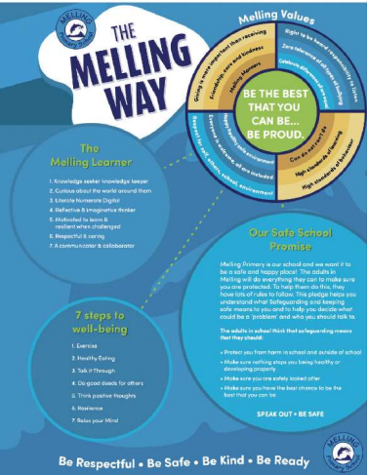
Welcome to Upper Key Stage 2.
Here is all the information you need to know to ensure your child’s start to the new school year is successful.
We are looking forward to welcoming our new class back to a brand-new school year.
Staff:
Mrs Grainger Mon-Fri
Mrs Freeman (TA) Mornings only
Mrs Thomas (1:1 & TA) Mon-Fri
Miss Freeman & Miss Thomas to support
Start 8:45
Break 10:45
Lunch 12:30
Finish 3:15 (adults please wait outside main gate)

Slide 3
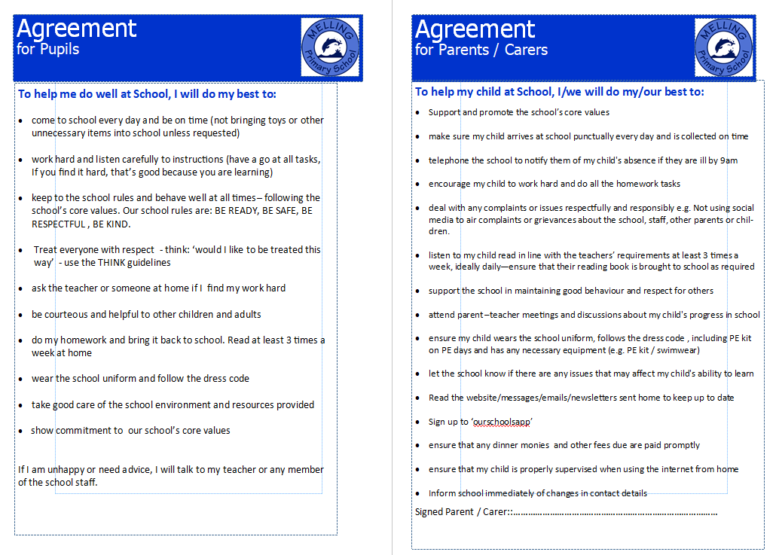
Reminder: Home-School Agreement

Slide 4
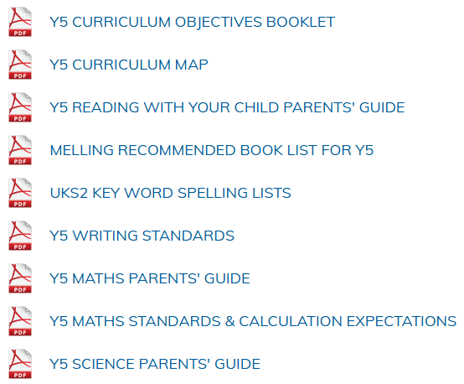
Please see the class page for the following documents detailing information on the curriculum:

Slide 5
Trips & residentials in Y5
Autumn Term:
CHET residential
Spring Term:
To be organised – Science focus
Summer Term:
To be organised – History focus

Slide 6

In Upper Key Stage 2, children are expected to read and understand texts at a much higher level than previously; the skill of comprehension is needed across the curriculum to be able to access a wide range of subjects.
All children will have the opportunity to read a variety of texts during lessons.
Individual readers will also be heard and children will have the opportunity to read books of their own choice in class.
If they wish to bring in a book from home to read in class, this is welcomed.
There is an expectation that your child should read at least 3 times a week at home - this will be monitored and rewarded (a prize for every 50 reads and a raffle ticket for a draw at the end of the year).
Please hear your child read, discussing the text and new vocabulary with them; fill in and sign the purple reading record to note their progress and any difficulties they may have.
We recommend a ‘3-read approach’ – 1. decoding 2. fluency 3. understanding
Please ensure reading records are sent into school daily to help us with monitoring.
Children are encouraged to return and change a book on any day. day.
If children fall behind with reading at home, there will be a discussion with parents/carers to help get them back on track.

Slide 7
Spelling Spelling test day - Monday
Each week, children will be taught a spelling pattern and 5 of the Y5 statutory key words.
For homework and in class, they will be given a sheet for written practice of 10 words containing the spelling pattern and 5 key words.
It would be useful if you could help your child with learning spellings at home using whichever method they find most helpful to learn. For example, the ‘Look Say Cover Write Check’ method is just one way to learn to spell.
New spellings will be given out on a Tuesday for a test on the following Monday.
Please ensure your child is learning and practising their spellings regularly.
Spelling homework sheets should be returned to school on a Monday.
Spelling results will be sent home to keep you informed of your child’s attainment.

Slide 8
Homework
In addition to reading and spelling practice, children are expected to access online tasks to support learning.
Login details are stuck on the front of the reading records. If these are lost, please request a new one.
The following platforms should all be accessed each week:
Mirodo– an English and a Maths task will be set
Times Tables Rock Stars
If homework/home reading is not completed, parents will be notified. Children will be given an opportunity
to complete it in school. If a child does not have a device at home for online homework, they will be given
an opportunity to complete it during school hours.

Slide 9
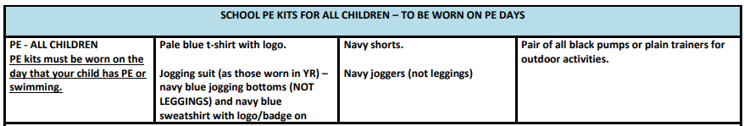
P.E. days - Tuesday and Thursday
Children should come to school dressed in their P.E. kit on P.E days.
If your child is attending an after school sports club, they are permitted to wear their P.E. kit on that day also.
Alternatively, they can bring a kit to get changed into after school.

Slide 10
Behaviour System
‘BE THE BEST THAT YOU CAN BE…BE PROUD.’
Whole school rewards:
Name in Lights for Melling values: BE READY BE RESPECTFUL BE SAFE BE KIND
Cups – awarded in the weekly Friday assembly at 2:30. You will be invited in if your child wins.
House points – winners announced weekly and a chance to win a prize each half term.
Gold stars – these are collected to earn a badge for your child’s school cap.
Golden text – a very special award from Mrs Ainsworth.
Roar the resilient lion – awarded to the child who shows resilience through the week.
Special rewards in Y5:
Secret Student – each week, one child will receive a certificate to bring home. They can choose a prize and a class coupon.
Star jars – an extra playtime for the winning row.

Slide 11
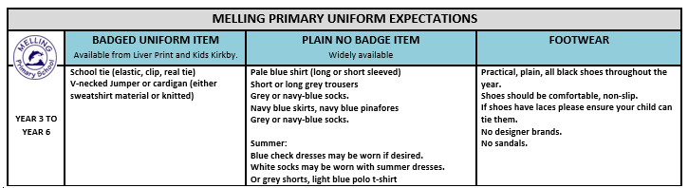
Reminder: Uniform

Slide 12
Reminder: Health and Safety
Children are encouraged to bring a bottle of still water to school to keep them hydrated throughout the day. Children must take their bottles home each day so that they can be washed, refilled and remain clean and fresh.
Snacks for playtime should be healthy choices. Sweets and chewing gum are not permitted.
Children are encouraged to continue to practise good toilet and hand hygiene. Please reinforce the importance of this with your child.
Bags must be the size of a book bag or smaller. No large bags/rucksacks as they are a tripping hazard; cloakrooms and corridors lead to fire exits; there is no space to accommodate large items in these spaces.

Slide 13
Reminder: Health and Safety
Children are not permitted to:
wear jewellery other than small stud earrings
wear nail varnish, false nails, tattoos or make up
wear smartwatches, or watches with games on
bring toys or other personal belongings, including pencil cases – everything the children need will be provided
Hair – shoulder length (boys and girls) must be tied back
Please make sure that your child’s clothing, lunch box and water bottle are clearly labelled with their name.
This facilitates returning lost items.

Slide 14
Walking home from school
In Y5 and Y6 children are permitted to walk home from school. However, we must have a form signed by Parents/Carers to record that permission has been given. An adult must be at home for when they arrive.
The form will be sent out in your child’s end of year report. Please sign and return it before the end of term so that we can ensure that permission has been recorded.
If you still wish to have your child collected at the end of the school day, please ensure your child knows this and that they know to stay in school until their adult comes to collect them.
If you wish your child to bring a phone to school for safety when walking to/from
school, this must be handed in at the start of the day, switched off and collected
at the end of the day. It must not be turned back on until your child is off the
premises.

Slide 15
Phones – Social Media – Internet
We ask parents/carers to think very carefully before allowing your child to have a mobile phone. Social media (eg WhatsApp; Snapchat; Instagram; TikTok) can cause numerous issues between children and can affect friendships in school. Platforms such as these can have unsuitable content on and can lead to children accessing inappropriate posts.
We would advise all parents/carers to familiarise themselves with the guidance on use of Parental Controls. (https://primarysite-prod-sorted.s3.amazonaws.com/melling-primary-school/UploadedDocument/f279259b-9483-480d-8353-10c25cf44e9a/parental-controls-booklet-2025.pdf )

Slide 16
Reminder: Communication
Absence must be reported to the office on or before the day of absence. Please leave a message on the answering machine. This will be received and noted.
Urgent information, questions or complaints should be communicated to the office.
Share information or news with us at y5.melling@schools.sefton.gov.uk Please remember that this may not be picked up straight away. Replies will only be sent between the hours of 8am and 6pm. You will be contacted by telephone should there be a concern regarding your child.
Check the class webpage, website and app regularly as these are our main sources of communication with you.

Slide 17





Be The Best That You Can Be…Be Proud

